Slide 1
Areas of Municipal Reform
16th Amendment: the government’s power to put in place a graduated income tax (you pay based on how much money you make)
17th Amendment: Direct election of Senators
Direct Primaries: People get to vote on which individuals they want to run for office

Slide 2
Areas of Municipal Reform
Secret Ballot: now all voting takes place in private- ends the political machine
“Wisconsin Idea”: idea of Governor Robert M. LaFollette- suggested that the government bring in college professors to help them solve the problems of society

Slide 3
Areas of Business Reform
Corrupt Deals: Things like the Mann Act and the Elkins that help end corruption with railroads
Exploitation of Workers: minimum wage and limited workday- safety innovations required like sprinkler systems and fire escapes

Slide 4
Legislation By President-
Teddy Roosevelt:
Guarding the Public Health:
Meat Inspection Act
Pure Food and Drug Act
Regulating Big Business
Known as “Trust-Busting Teddy”
Conservation
Continued the National Park Movement
Reserved millions of acres for reserves and parks

Slide 5
Legislation By President-
William Taft
Regulating Big Business
Breakdown of many trusts
Scandal
Ballinger-Pinochet Affair
Election of 1912
Causes a split in the Republican Party
Roosevelt comes back as the Progressive or “Bull Moose” candidate
Due to the split in the party, Democrat Wilson easily wins

Slide 6
Legislation By President-
Woodrow Wilson (promises to attack the “Triple Wall of Privilege”- trusts, tariffs, and taxes)
Regulating Big Business
Attacking Taxes
Government Regulation of Money
16th, 17th, 18th, and 19th Amendments

Slide 7
American Imperialism
Imperialism: the complete takeover of a smaller, weaker country by a larger one

Slide 8
America at this point…
America has finally recovered from the Civil War and Reconstruction
America has proven itself to be one of the strongest countries in the world
America has watched all these other major world powers being to take over other countries (build empires)….can’t they get a piece of the pie too???

Slide 9
MAIN reasons of U.S. Imperialism
Imperialism is:
M: anifest destiny-
A: nglo-saxon superiority-
I: ndustrialization-
N: aval superiority-

Slide 10
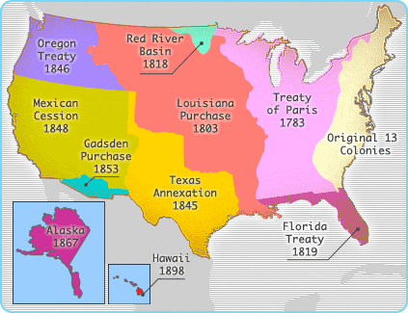
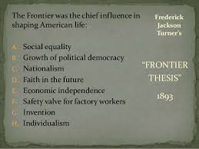
Manifest Destiny

Slide 11
Anglo Saxon Superiority
Read the poem “White Man’s Burden”
Write down 3 things that stand out to you.
Write down 1 question you have about it.

Slide 12
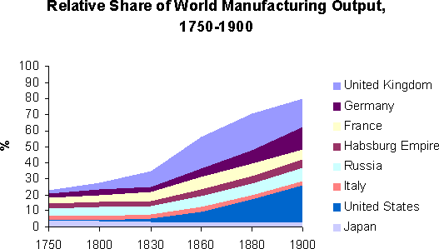
Industrialization

Slide 13
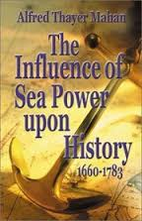
Naval Superiority
Alfred Mahan
“The Influence of Sea Power on History”

Slide 14
Summary of Causes
Cause of Imperialism | Key Person Involved | Reason it led to Imperialism
Manifest Destiny | Frederick Jackson Turner- Turner Thesis | Belief that America needed to expand in order to maintain its identity and key beliefs
Anglo-Saxon Superiority |  | Belief that Americans and Europeans were superior to people in other countries and they needed to bring their sophisticated cultures to the world
Industrialization |  | America wanted access to more raw materials and new countries to sell their goods to
Naval Superiority | Alfred Mahan- The Influence of Sea Power on History | By building up their navy they had the capability to take over other countries

Slide 15
Hawaii:
"Crossroads
of the
Pacific"

Slide 16
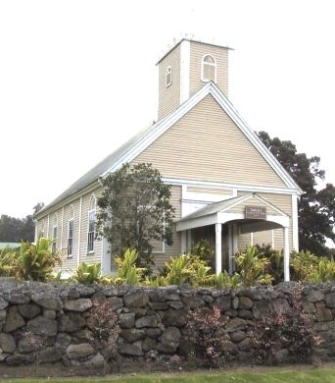
U. S. Missionaries in Hawaii
Imiola Church – first built in the late 1820s

Slide 17
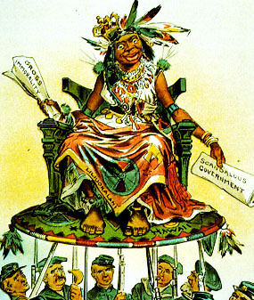
U. S. View of Hawaiians
Hawaii becomes a U. S. Protectorate in 1849 by virtue of economic treaties.

Slide 18
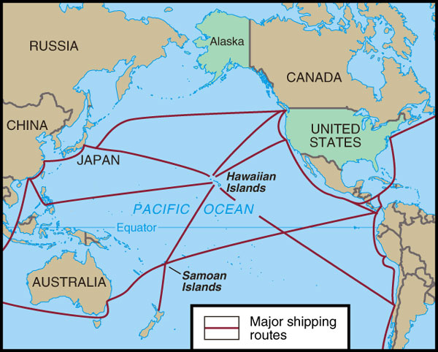
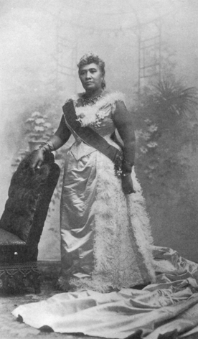
Hawaiian Queen Liliuokalani
Hawaii for the Hawaiians!

Slide 19
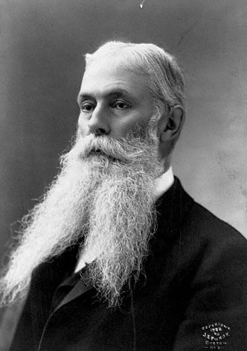
U. S. Business Interests In Hawaii
1875 – Reciprocity Treaty
1890 – McKinley Tariff
1893 – American businessmen backed an uprising against Queen Liliuokalani.
Sanford Ballard Dole proclaims the Republic of Hawaii in 1894.

Slide 20
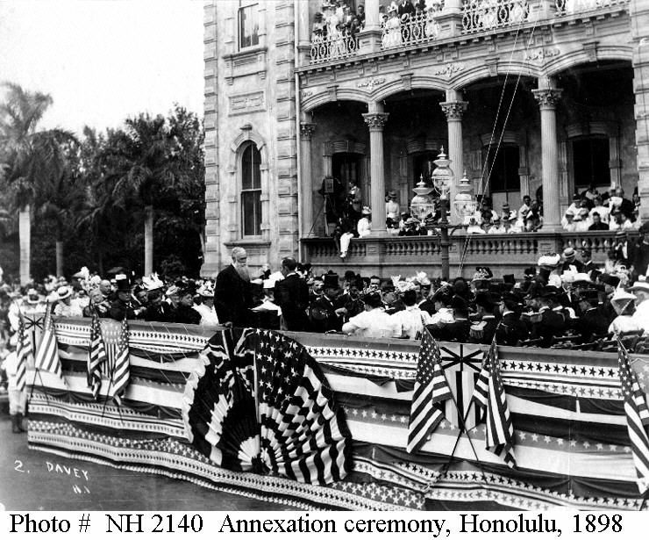
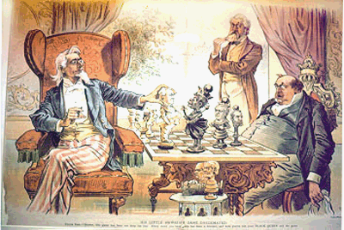
To The Victor Belongs the Spoils
Hawaiian Annexation Ceremony, 1898

Slide 21
Japan

Slide 22
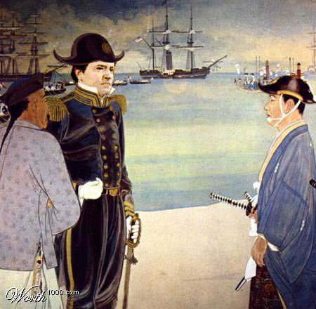
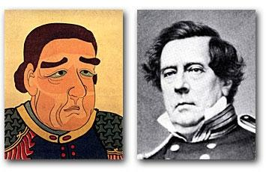
Commodore Matthew Perry Opens Up Japan: 1853
The Japanese View of Commodore Perry

Slide 23
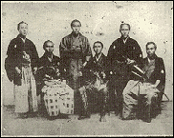
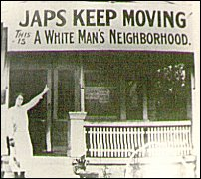
Gentleman’s Agreement: 1908
A Japanese note agreeing to deny passports to laborers entering the U.S.
Japan recognized the U.S. right to exclude Japanese immigrants holding passports issued by other countries.
The U.S. government got the school board of San Francisco to rescind their order to segregate Asians in separate schools.
1908 → Root-Takahira Agreement.

Slide 24
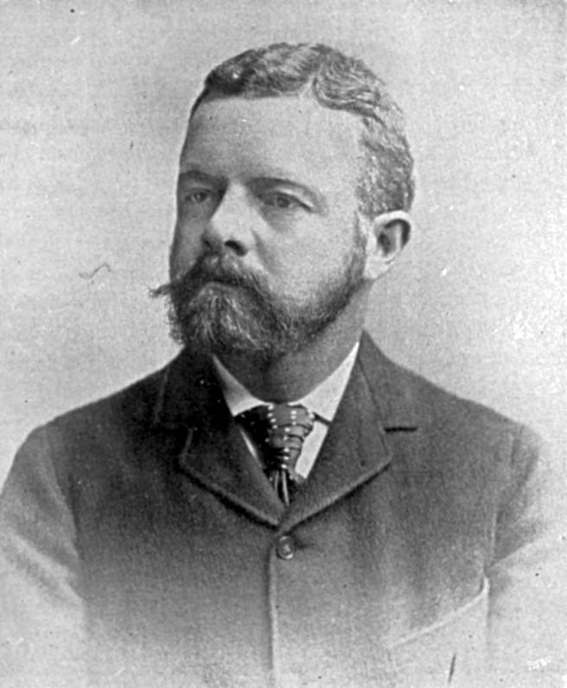
Lodge Corollary to the Monroe Doctrine: 1912
Senator Henry Cabot Lodge, Sr. (R-MA)
Non-European powers, like Japan, would be excluded from owning territory in the Western Hemisphere.

Slide 25
Alaska

Slide 26
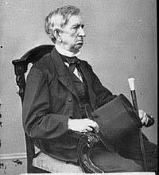
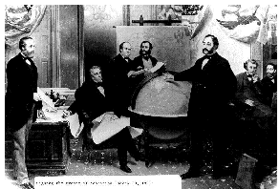
“Seward’s Folly”: 1867
$7.2 million

Slide 27
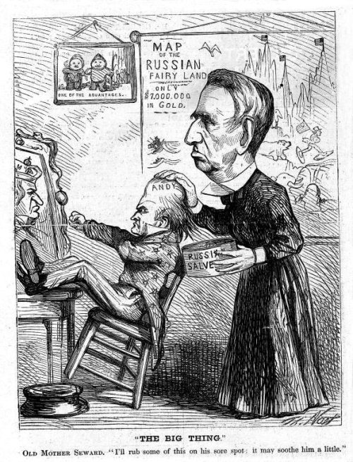
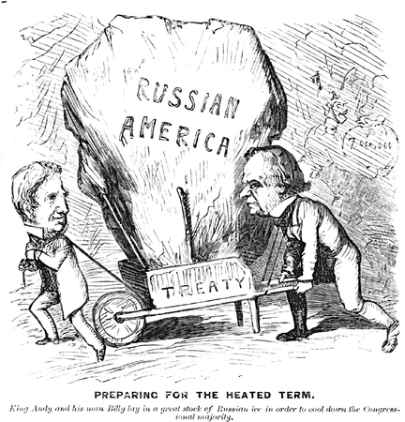
“Seward’s Icebox”: 1867

Slide 28
Cuba

Slide 29
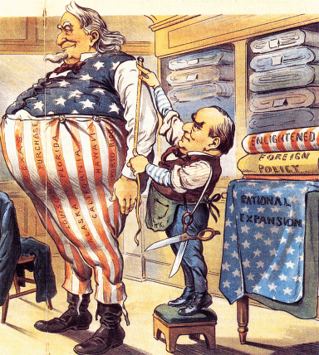
The Imperialist Tailor

Slide 30
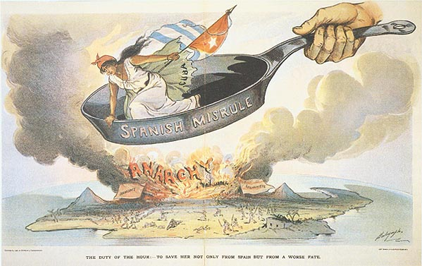
Spanish Misrule in Cuba

Slide 31
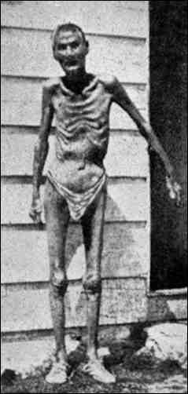
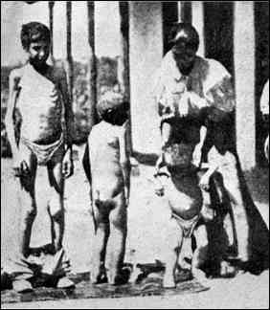
Valeriano Weyler’s “Reconcentration” Policy

Slide 32
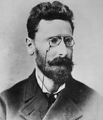
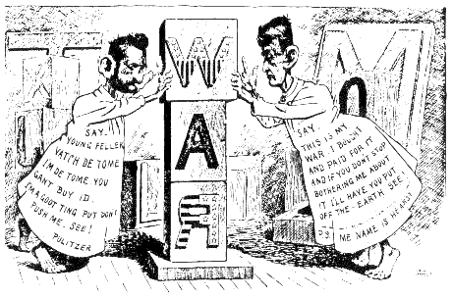
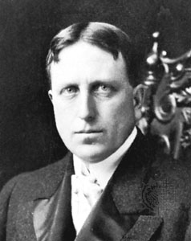
“Yellow Journalism” & Jingoism
Joseph Pulitzer
Hearst to Frederick Remington: You furnish the pictures, and I’ll furnish the war!
William Randolph Hearst

Slide 33
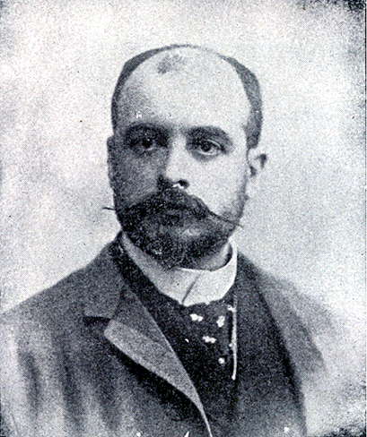
De Lôme Letter
Dupuy de Lôme, Spanish Ambassador to the U.S.
Criticized President McKinley as weak and a bidder for the admiration of the crowd, besides being a would-be politician who tries to leave a door open behind himself while keeping on good terms with the jingoes of his party.

Slide 34
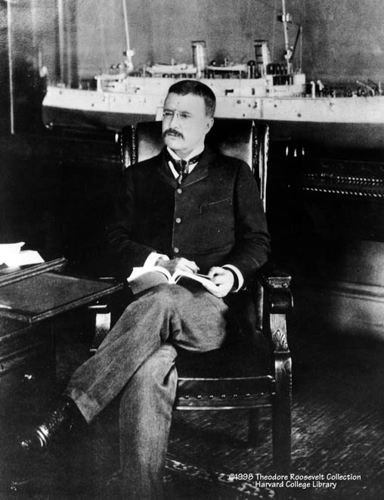
Theodore Roosevelt
Assistant Secretary of the Navy in the McKinley administration.
Imperialist and American nationalist.
Criticized President McKinley as having the backbone of a chocolate éclair!
Resigns his position to fight in Cuba.

Slide 35
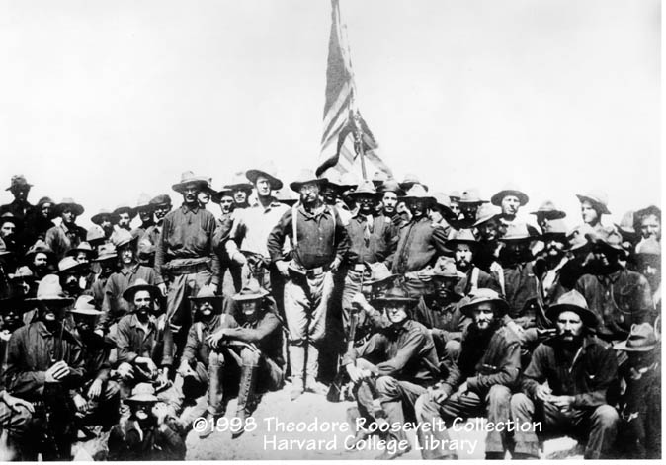
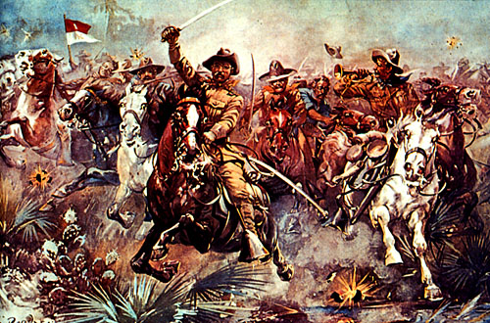
The “Rough Riders”

Slide 36
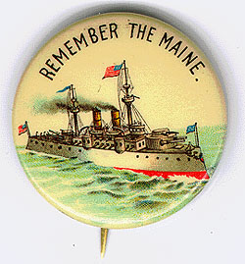
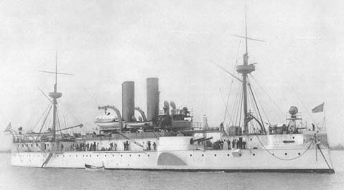
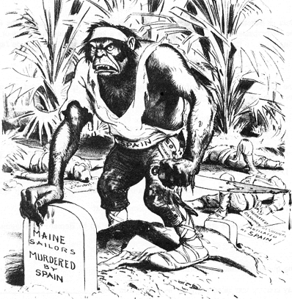
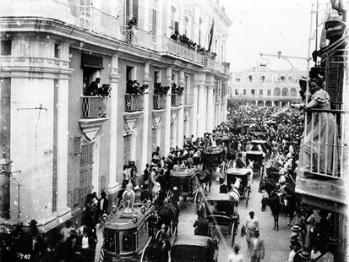
Remember the Maine and to Hell with Spain!
Funeral for Maine victims in Havana

Slide 37
The Spanish-American War (1898): “That Splendid Little War”
How prepared was the US for war?

Slide 38
The
Philippines

Slide 39
The Spanish-American War (1898): “That Splendid Little War”

Slide 40
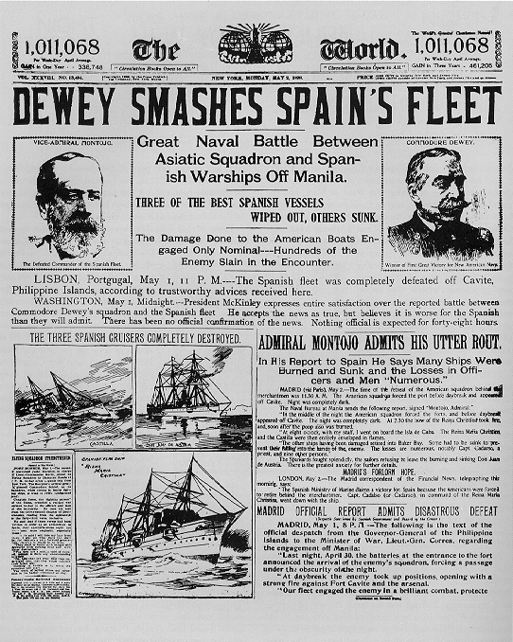
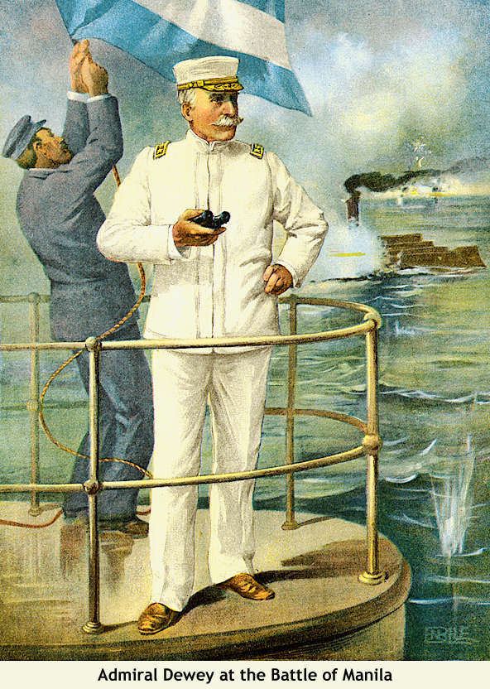
Dewey Captures Manila!

Slide 41
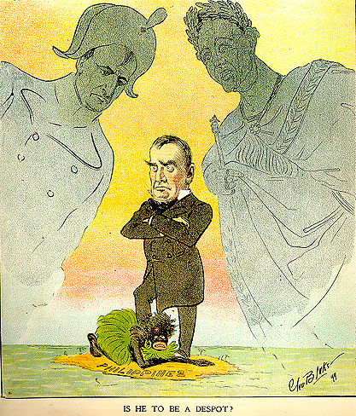
Is He To Be a Despot?

Slide 42
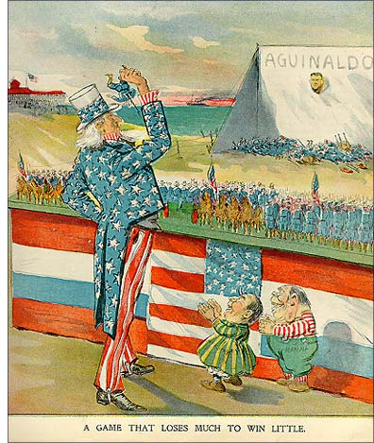
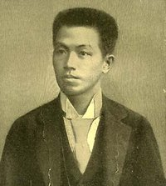
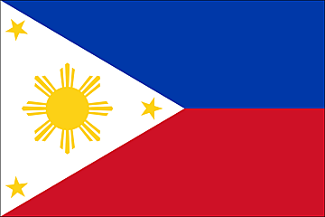
Emilio Aguinaldo
Leader of the Filipino Uprising.
July 4, 1946: Philippine independence

Slide 43
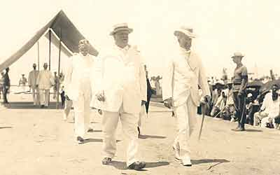
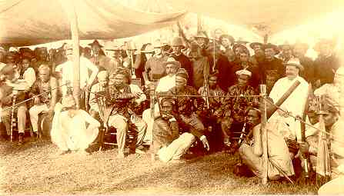
William H. Taft, 1st Gov.-General of the Philippines
Great administrator.

Slide 44
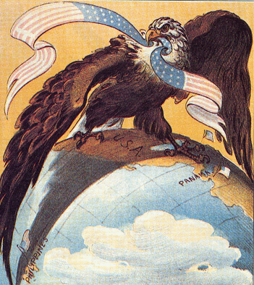
Our “Sphere of Influence”

Slide 45
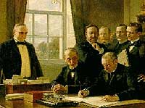
The Treaty of Paris: 1898
Cuba was freed from Spanish rule.
Spain gave up Puerto Rico and the island of Guam.
The U. S. paid Spain $20 mil. for the Philippines.
The U. S. becomes an imperial power!

Slide 46
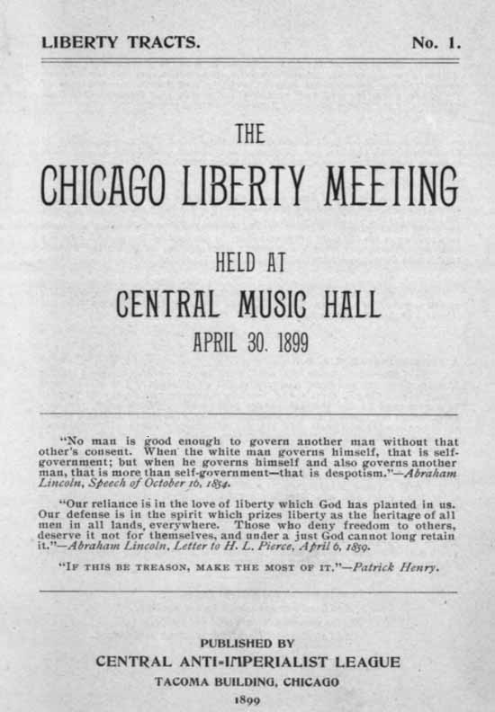
The American Anti-Imperialist League
Founded in 1899.
Mark Twain, Andrew Carnegie, William James, and William Jennings Bryan among the leaders.
Campaigned against the annexation of the Philippines and other acts of imperialism.

Slide 47
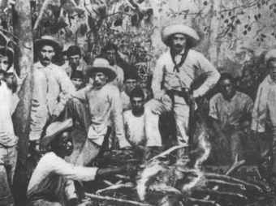
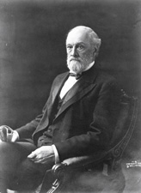
Cuban Independence?
Teller Amendment (1898)
Platt Amendment (1903)
Cuba was not to enter into any agreements with foreign powers that would endanger its independence.
The U.S. could intervene in Cuban affairs if necessary to maintain an efficient, independent govt.
Cuba must lease Guantanamo Bay to the U.S. for naval and coaling station.
Cuba must not build up an excessive public debt.
Senator Orville Platt

Slide 48
DILEMMA--Did
U. S. citizenship
follow the flag??

Slide 49
Puerto
Rico

Slide 50
Puerto Rico: 1898
1900 - Foraker Act.
PR became an “unincorporated territory.”
Citizens of PR, not of the US.
Import duties on PR goods

Slide 51
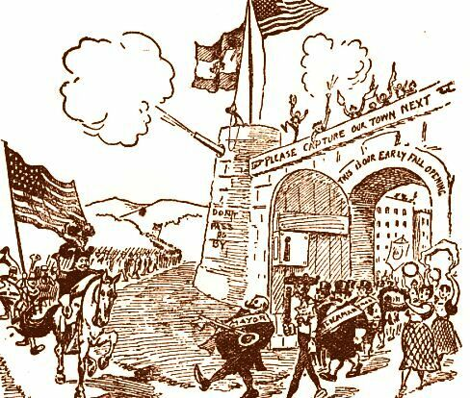
Puerto Rico: 1898
1917 – Jones Act.
Gave full territorial status to PR.
Removed tariff duties on PR goods coming into the US.
PRs elected their own legislators & governor to enforce local laws.
PRs could NOT vote in US presidential elections.
A resident commissioner was sent to Washington to vote for PR in the House.

Slide 52
Panama

Slide 53
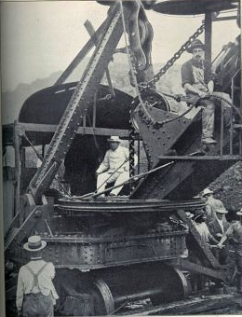
Panama Canal
TR in Panama (Construction begins in 1904)

Slide 54
The Roosevelt Corollary to the Monroe Doctrine: 1905
Chronic wrongdoing… may in America, as elsewhere, ultimately require intervention by some civilized nation, and in the Western Hemisphere the adherence of the United States to the Monroe Doctrine may force the United States, however reluctantly, in flagrant cases of such wrongdoing or impotence, to the exercise of an international police power .

Slide 55
Speak Softly, But Carry a Big Stick!

Slide 56
China

Slide 57
Stereotypes of the Chinese Immigrant
Oriental [Chinese] Exclusion Act, 1887

Slide 58
The Boxer Rebellion: 1900

Slide 59
The Open Door Policy
Secretary John Hay.
Give all nations equal access to trade in China.
Guaranteed that China would NOT be taken over by any one foreign power.

Slide 60
The Open Door Policy

Slide 61
America as a Pacific Power

Slide 62
America's
New
Role

Slide 63
The Cares of a Growing Family

Slide 64
Constable of the World

Slide 65
Treaty of Portsmouth: 1905
Nobel Peace Prize for Teddy

Slide 66
The Great White Fleet: 1907

Slide 67
Taft’s “Dollar Diplomacy”
Improve financial opportunities for American businesses.
Use private capital to further U. S. interests overseas.
Therefore, the U.S. should create stability and order abroad that would best promote America’s commercial interests.

Slide 68
Mexico

Slide 69
The Mexican Revolution: 1910s
Victoriano Huerta seizes control of Mexico and puts Madero in prison where he was murdered.
Venustiano Carranza, Pancho Villa, Emiliano Zapata, and Alvaro Obregon fought against Huerta.
The U.S. also got involved by occupying Veracruz and Huerta fled the country.
Eventually Carranza would gain power in Mexico.

Slide 70
The Mexican Revolution: 1910s
Emiliano Zapata
Pancho Villa
Venustiano Carranza
Porfirio Diaz
Francisco I Madero

Slide 71
Wilson’s “Moral Diplomacy”
The U. S. should be the conscience of the world.
Spread democracy.
Promote peace.
Condemn colonialism.

Slide 72
Searching for Banditos
General John J. Pershing with Pancho Villa in 1914.

Slide 73
Country | Summary
Hawaii | Queen Lili was in power- she said that native Hawaiians needed to take back control from the U.S. businesses in Hawaii- that led to her being dethroned and eventually the U.S. taking over Hawaii.
Japan | The U.S. sent Matthew Perry to try and build trade relations with Japan- they later sign Gentleman’s Agreement with Japan that ends segregation of Asians in the U.S. but also bans Japanese labor immigration
Cuba | America helped Cuba get their independence with the Spanish American War- then, with the Platt Amendment, Cuba was given their independence from the U.S. BUT the U.S. could intervene whenever they wanted
Philippines | American got the Philippines after the Spanish American War, with help from Emilio Aguinaldo whom we promise independence to after the war- but then we end up keeping the Philippines instead
Puerto Rico | America gains this property after the Spanish American War- with the Jones Act, citizens of Puerto Rico become citizens of the U.S.
China | U.S. promotes the “Open Door Policy” to allow the Chinese to have more freedom and less control by the European powers in China. This allows the U.S. to be able to trade with China.
Russia | America buys Alaska from Russia for $7 million- known as ‘Seward’s Folly’ because William Seward who wanted to buy it- and it was so cold and wasn’t known to have many resources
Panama | America wanted to build a canal in Panama to make trade easier, got the Panamanians to rebel against Columbia who controlled them- America was able to build their canal.
Mexico | America briefly supported rebel Pancho Villa when a new leader, Carranza came to power in Mexico.. But eventually the U.S. was able to work things out with Mexico and continue trade.

Slide 74
President | Actions
Roosevelt | “Big Stick Policy”- argued that a country could get what they wanted from smaller nations just because they have a very strong military and are intimidating Roosevelt Corollary- added to the Monroe Doctrine…stated that the U.S. was in control of the entire Western Hemisphere Panama Canal and negotiates an end to the Russo-Japanese War
Taft | Dollar Diplomacy: controlling smaller countries with money
Wilson | Moral Diplomacy- the U.S. has the right to intervene in any country that is struggling with human rights violations (treating their citizens with cruelty)- Mexico

