Slide 1
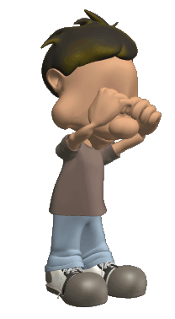
Psychology
What is it?
The study of our inner feelings and behaviors.
Do our feelings always match our behaviors?
If you call me an idiot, I may feel sad inside.
But I will still act tough.
(but I will be crying on the inside, so be gentle).

Slide 2
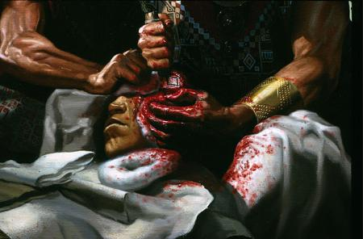
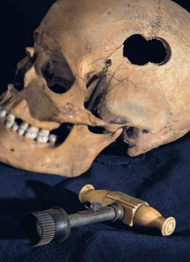
History of Psychology
Although the science of psychology started in the late 1800’s, the concept has been around a lot longer.
There was evidence of trephination (cutting holes into a skull to let evil spirits out) back in the stone age.
It was like a bad SAW movie!!!!

Slide 3
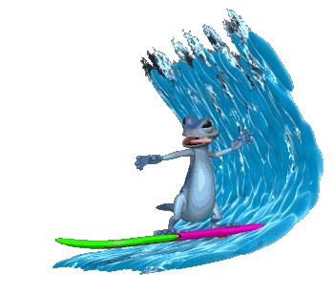
Waves of Psychology
The science of psychology has gone through about 5 different waves since it started.
Waves are different ways of thinking over time.

Slide 4
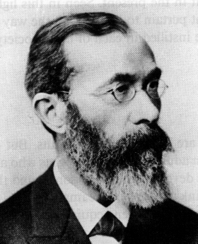
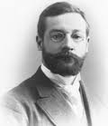
Wave One: Introspection Kickin it old school
Started with William Wundt’s first psychological laboratory and his concept of introspection (structuralism). This is when people report their thought and feelings.
Then William James wrote The Principles of Psychology and discussed functionalism.
In reality these ideas do not have much impact on how psychologists think today.
These guys were considered hot, back in the day!!!!

Slide 5
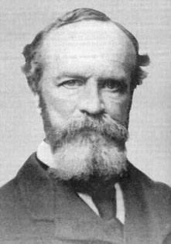
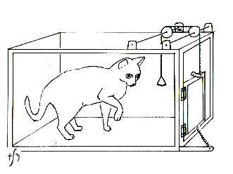
Functionalism
How is conscious related to behavior?
How does the mind affect behavior?
Edward Thorndike and William James (father of psych)
Thorndike’s puzzle box as related to functionalism
Law of Effect
Wm. James
What function does
the animal’s
behavior have?

Slide 6
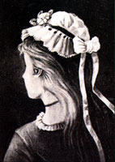
Wave Two: Gestalt Psychology
Led by Max Wertheimer, these guys focused not on how we feel, but on how we experience the world.
Learning comes from insight, not by repetition
The whole of an experience can be more than the sum of its parts.
Think for a moment of all the reasons that you love your mom.
If you add all those reasons up, do they equal your love for your mom?
Hopefully not!!!
This may seem like one picture, but it can be perceived as 3 different faces. Can you find them?

Slide 7
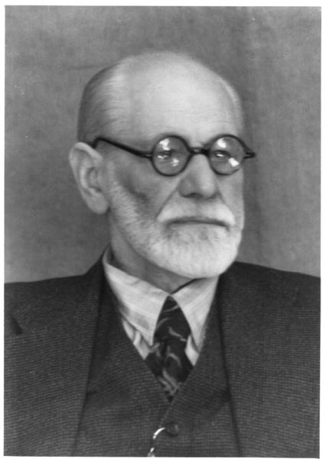
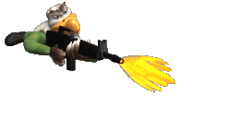
Wave Three: Psychoanalysis
This wave of thinking started with Sigmund Freud (in the early 1900’s).
In a nutshell, during this time period people believed that most of your feelings come from a hidden place in your mind called the unconscious.
We protect ourselves from our real feeling by using defense mechanisms.

Slide 8
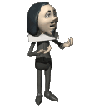
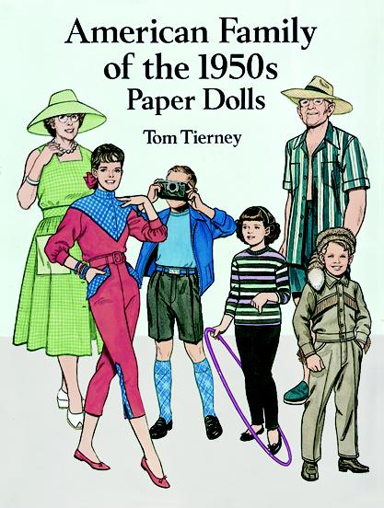
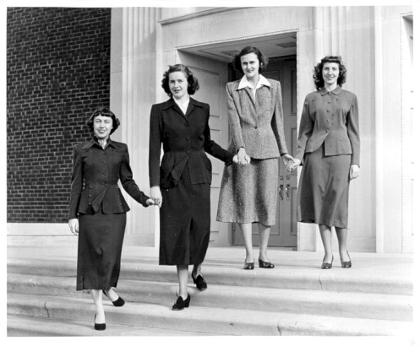
Wave Four: Behaviorism
During this time period (early to mid 1900s), people started to ignore how you feel inside.
JB Watson, Pavlov, and BF Skinner
All that mattered was how you acted.
If you could change your behavior, who cares how you feel.
Very popular during the conservative 1950’s when social appearance mattered more than self expression.

Slide 9
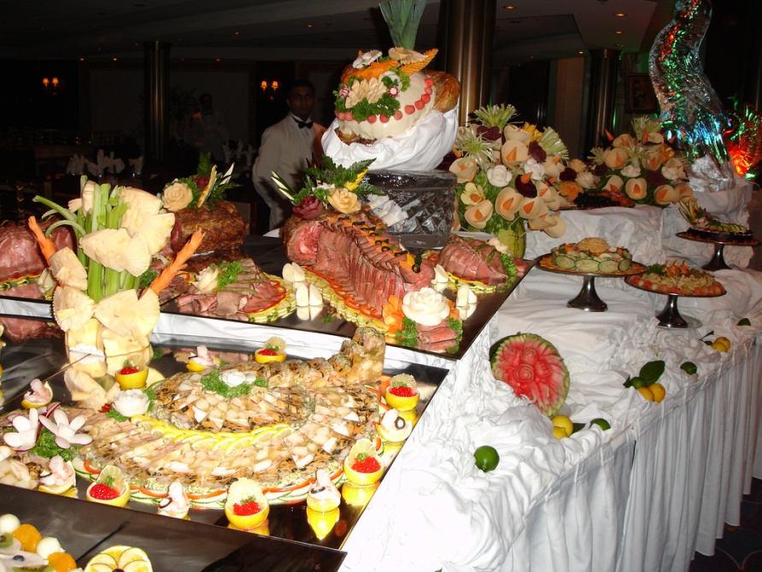
Wave Five: Eclectic
We are now in wave five….which is about variety.
Psychologists pick and choose what theories to use depending on the situation and the client.
Just like Ben 10 choosing the right alien to fight the bad guy depending the situation.

Slide 10
Wave Five is made up of about 7 different perspectives.
In other words, psychologists today, pick and choose from about 7 schools of thought to help you with your problems.
Thus we have:
THE SEVEN SCHOOLS OF PSYCHOLOGY
ALSO CALLED

Slide 11
Unit 1: History, Approaches & Research Methods
Today’s Topic:
the APPROACHES

Slide 12
PSYCHOANALYTIC / PSYCHODYNAMIC
Ideas put forth by Sigmund Freud and other Neo-Freudians.
Focuses on the ideas that:
your early childhood plays a huge role in shaping your personality.
childhood traumas and experiences create unconscious drives and conflicts that impact individual personalities.

Slide 13
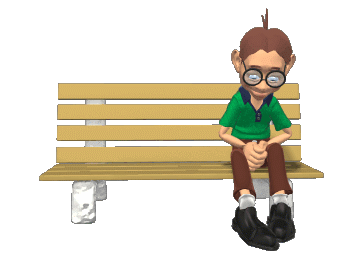
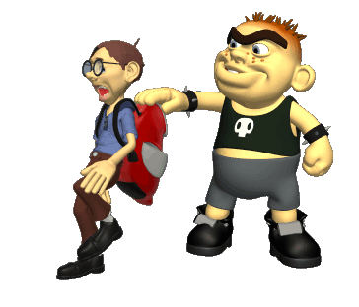
Psychoanalytic Perspective
If a man has intimacy issues and cannot form relationships with others. What do you think someone from this school may think?
In order to get better, we must bring forward the true feelings we have in our unconscious.
Perhaps they may delve into the man’s unconscious and discover that he was bullied when he were younger. The bullying may have caused fear in getting close to others.

Slide 14
PSYCHOANALYTIC / PSYCHODYNAMIC – point behind you -- way back
“My past, my unconscious, determines my behavior”

Slide 15
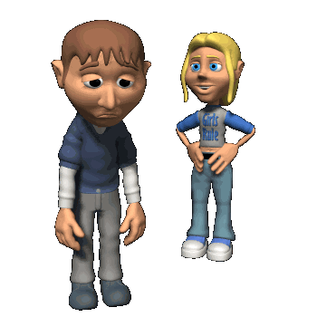
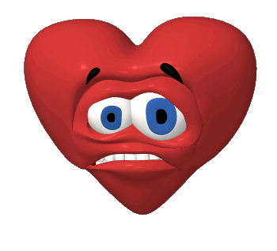
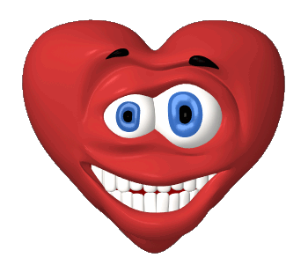
Cognitivist Perspective
Focuses on how we think (or encode information)
How do we see the world?
How did we learn to act to sad or happy events?
Cognitive Therapist attempt to change the way you think.
She rejects you…don’t even get digits.
You meet a girl…
Hopes are high!!!
How do you react to the rejection?
Some learned get back on the horse
And try again.
Some learned to give up and live a lonely life of solitude.

Slide 16
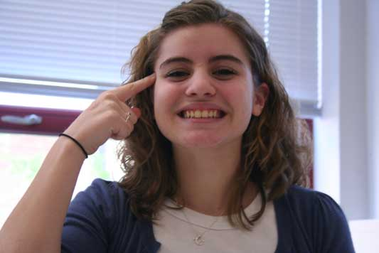
COGNITIVIST – point to forehead
“How I think determines my behavior”

Slide 17
Humanistic Perspective
Peaked in the late 1960’s and 70’s….so it focused on spirituality and free will.
We have to strive to be the best we can be “self-actualization”.
Happiness is defined by the distance between our “self-concept” and “ideal self”.

Slide 18
HUMANISTIC – point to self
“I choose how I behave, and this helps me reach my potential.”

Slide 19
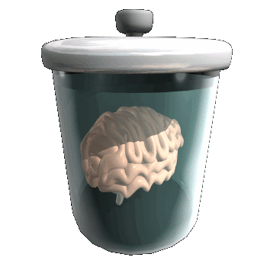
Biological (Neuroscience) Perspective
All of your feelings and behaviors have an organic root.
In other words, they come from your brain, body chemistry, neurotransmitters, etc…
Let us imagine for a second that you are waiting to hear from a college you want to go to. You are not able to sleep, you start to gain weight, your skin blemishes, you start to partake in vices. What is the biological explanation?

Slide 20
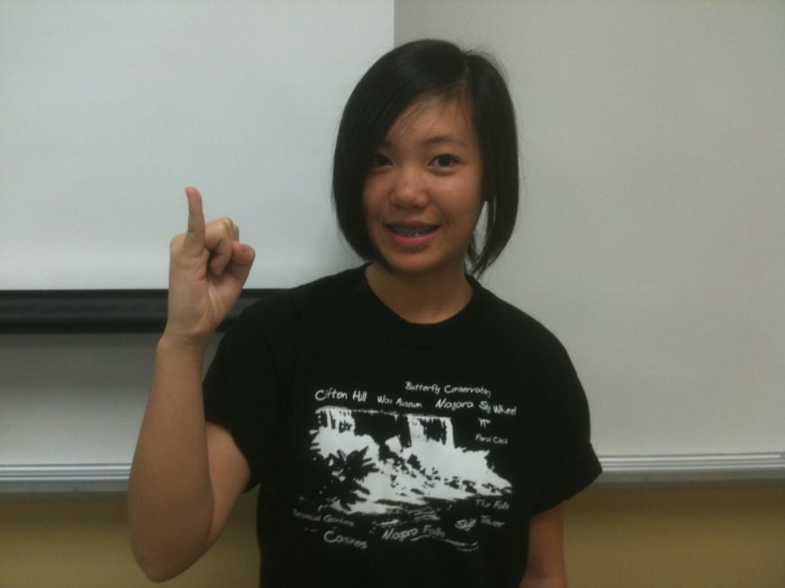
NEUROSCIENCE /BIOLOGICAL -pinky finger
My brain, genes, nervous system and hormones… determine my behavior.

Slide 21
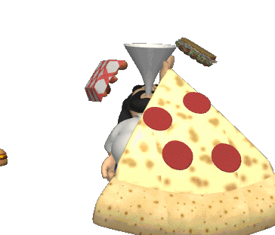
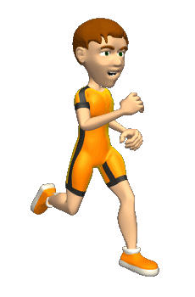
Behavioral Perspective
Pretend that you fail psychology class. You become depressed. In turn, you begin to binge and gain weight.
Focuses on observable behaviors while putting feelings to the side.
We behave in ways because we have been conditioned to do so.
To change behaviors, we have to recondition the client.
What do you think a behaviorist may do?
They would probably ignore the fact that you are depressed and just focus on your overeating.
Maybe make you run a mile every time you eat over 2000 calories.

Slide 22
BEHAVIORAL – middle finger
“My observable behaviors are reinforced or punished, and this is what determines my behavior.”

Slide 23
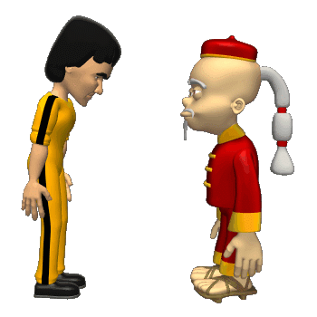
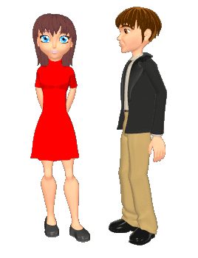
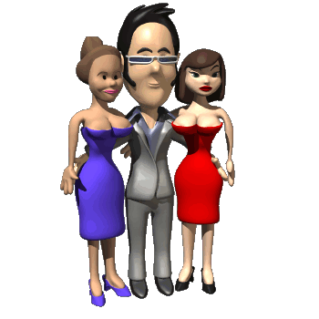
Socio-Cultural Perspective
Says that much of your behavior and your feelings are dictated by the culture you live in.
Some cultures kiss each other when greeting, some just bow.
Does your culture place value on individual or the group?
Is this your culture???
(many girlfriends
and looking smooth).

Slide 24
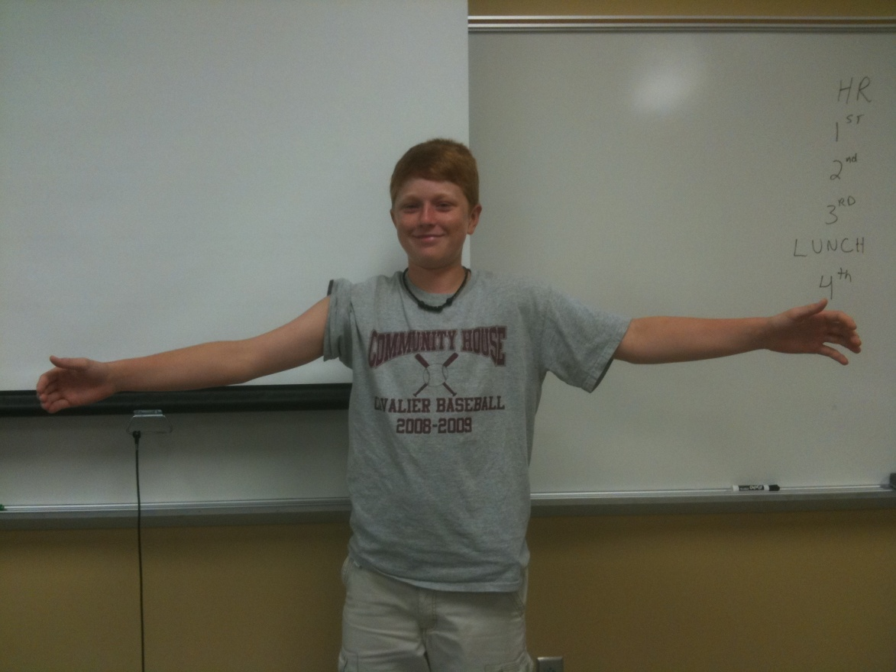
SOCIO-CULTURAL – make “the world” gesture
“My culture and social environment determines my behavior “

Slide 25
Evolutionary Perspective
Focuses on Darwinism.
We behave the way we do because we inherited those behaviors.
Thus, those behaviors must have helped ensure our ancestors survival.
How could this behavior ensured Homer’s ancestors survival?

Slide 26
EVOLUTIONARY – opposable thumbs
Our behaviors are the result of our innate need to survive and reproduce

Slide 27
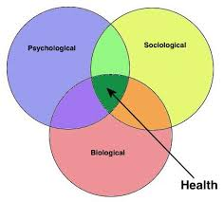
Biopsychosocial
Much current emphasis
Bio= biological
Psycho= psychological
Social= socio-cultural
All three approaches working together to provide explanation for behavior, cognition, and health
Ex/ a bear hibernating
It helped ancestors survive and thus reproduce
Inner physiology drives them to do so
Cold env. Hinder food gathering in the winter

Slide 28
Biological (Neuroscience)
Behavioral
Cognitive
Humanistic
Psychodynamic (Psychoanalytic)
Social-Cultural
Evolutionary/ Sociobiological

Slide 29
Biological (Neuroscience) | Behavior can be understood by describing underlying biochemical and neurological causes.
Behavioral | Interested in directly observable behaviors that are the result of external stimuli.
Cognitive | Cognitive psychologists study thoughts & processes (language, thought & memory).
Humanistic | Views behavior as a product of free will and opposed the determinism of behaviorism & psychoanalysis.
Psychodynamic (Psychoanalytic) | Human behavior is primarily determined by unconscious processes. Stresses the importance of early experiences in determining later behavior patterns.
Social-Cultural | Human behavior is largely the result of our social environments.
Evolutionary/ Sociobiological | Belief that our thoughts and behaviors are the result of evolutionary selection pressures.
brain, neurochemicals, genes
reinforcement or punishment
our thoughts
I choose
events from distant past; unconscious
environment
natural selection

