Slide 1
Warm-up: Write one question you would like to ask before the end of the year…
What’s one place I need to visit before I die?
What was a class that you think I should take in college?
What’s your biggest regret?
What’s the best advice you’ve ever been given?
How do you know if the person you’re with is “the one?”
What do I need to make sure I do while I’m in college?

Slide 3
Chinese Civil War
For 2 decades, the Chinese Communists had struggled against the non-communist government under Chiang Kai-shek
Because Kai-shek was non-communist, we supported him (gave him over $3 billion in aid) even though we disagreed with a lot of the things he did
He was corrupt and took money from his citizens at even the worst of times
Mao Zedong, a communist, gained support by improving the economic and physical situations of the Chinese citizens

Slide 4
Timeline of Chinese Civil War
1931- Japan begins taking over parts of China
1941-1945- America works as an ally of Chiang Kai-shek to help defeat the Japanese
1945- America financially supports Kai-shek, even through his harsh policies
1945-1947- Mao Zedong gains more control over China
May 1949- Chiang Kai-shek fled to Taiwan, still claiming to rule China, while Mao Zedong establishes a new communist government, known as the People’s Republic of China

Slide 5
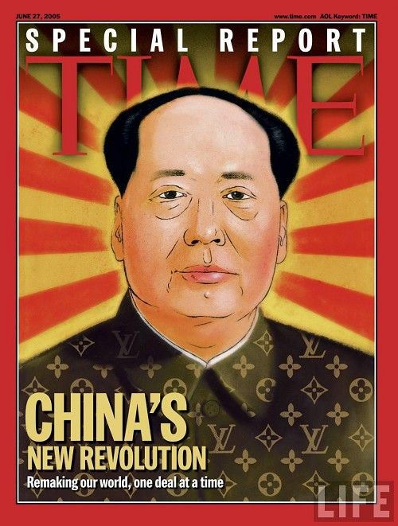
America’s reaction
They are stunned
Many Americans view the loss of China to communism as a threat to their security and want to step up containment policies

Slide 6
Switching gears for a minute: Korea
Korea had been taken over by Japan in 1910 and had owned it through WWII
When Japan surrendered, the troops north of the 38th parallel surrendered to Soviet troops and troops south of the 38th parallel surrendered to American troops
Each agreed to set up governments in their respective zones.

Slide 7
Korea
North of the 38th parallel: North Korea- communist dictatorship
South of the 38th parallel: South Korea- non-communist, democracy
After the U.S. withdrew most of its military, the Soviet Union convinced North Korea to attack South Korea in an attempt to take it over.

Slide 8
What do China and Korea have in common?
Once China becomes communist, America, Britain, and France refuse to recognize Mao’s China on the UN Security council…say only Kai-shek (a non-communist) can send a representative
The U.S.S.R. is against this move- walks out of the United Nations in protest
So…when the U.S. and South Korea ask the United Nations to vote in favor of going to war against North Korea, the vote passes (there is no one there to veto it!)
This becomes the ONE and ONLY UN Police Action

Slide 9
But its really a U.S. war, right?
The United Nations votes Harry Truman commander in chief of UN troops in Korea
Douglas MacArthur is the lead general in Korea
Over 90% of the donated troops for the UN movement are American

Slide 10
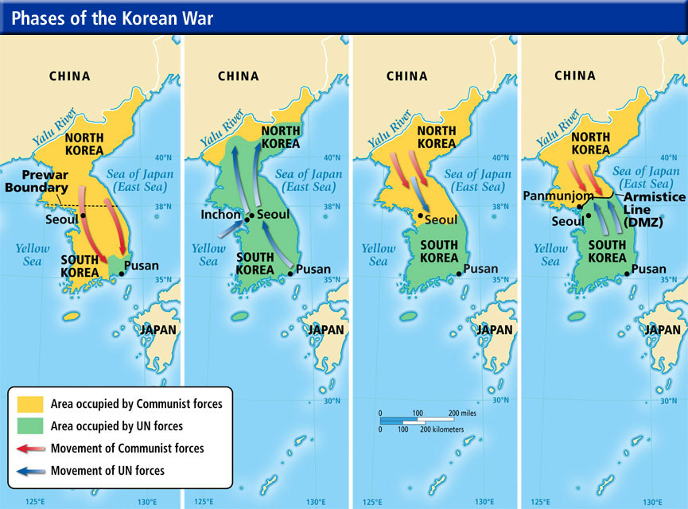
MacArthur wants to open up a 2nd front in China- is that really containment?
Now who feels threatened?
Cease-fire after stalemate
End of the war
The situation when the UN first got involved

Slide 11
A Recap
When the UN troops push the North Koreans back to their northern border, China feels threatened and attacks
MacArthur goes to Truman and says they need to open a second front in China
Truman adamantly disagrees, fearing the Chinese-Soviet alliance- when MacArthur tries to go to Congress behind his back, Truman fires him.
Matthew Ridgway took over for the UN troops, recall Seoul for the South Koreans
Cease-fire negotiations from 1951-1953…finally a resolution in 1953 (coinciding with the death of Stalin)

Slide 12
Korean War Legacy
Years: 1950-1953; many of the same troops from WWII
Nicknamed: “The Forgotten War”- however, 54,000 Americans died and it cost us $67 billion
This was the first time U.S. troops fought in integrated military units
Containment worked- Communism does not spread into South Korea…it remains divided at the 38th parallel
Led to the creation of SEATO- South East Asian Treaty Organization (the NATO of the Pacific)

