Slide 1
Need Number One: Soldiers
Conscription Act:
American Soldiers were known as the:
Nicknamed:
Famous battles with the U.S. involved
Battle of Belleau Wood:
Battle of Chateau Thierry:

Slide 2
Need Number Two: Safe Passage to Europe
Convoy System:

Slide 3
Need Number Three: New Technology
Tanks:
Machine Guns

Slide 4
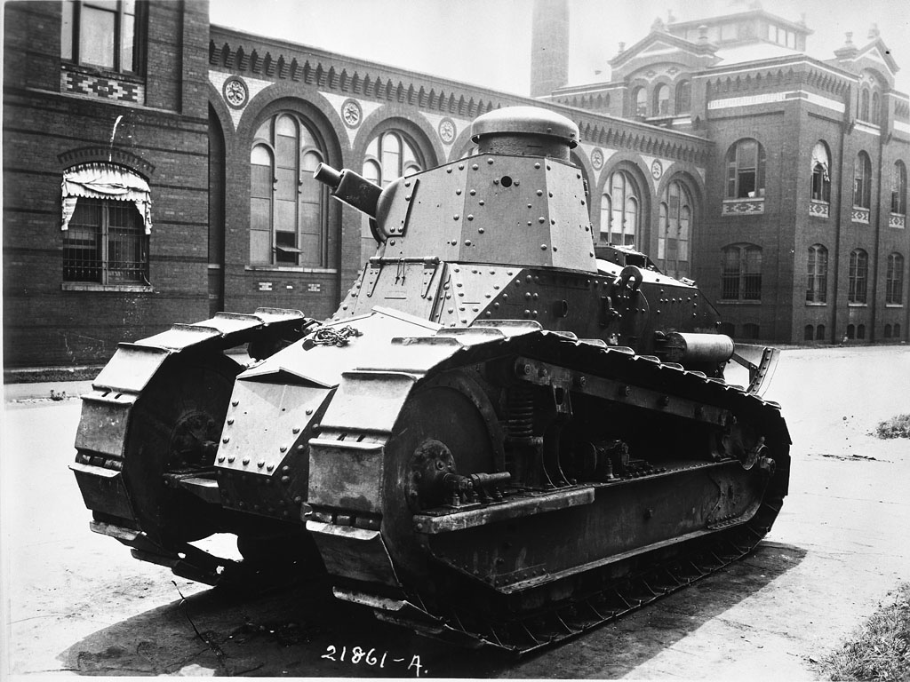

Slide 5
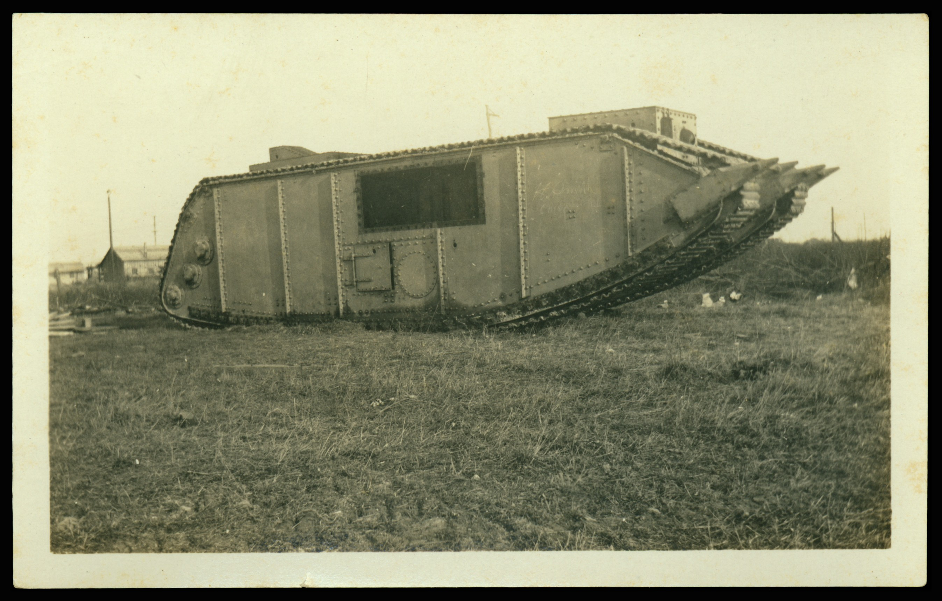

Slide 6
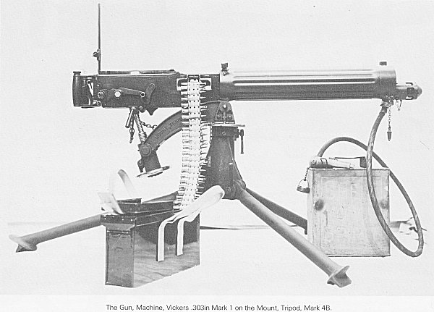
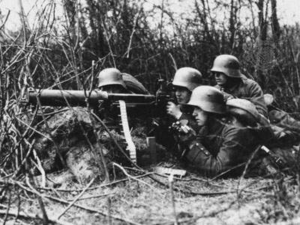
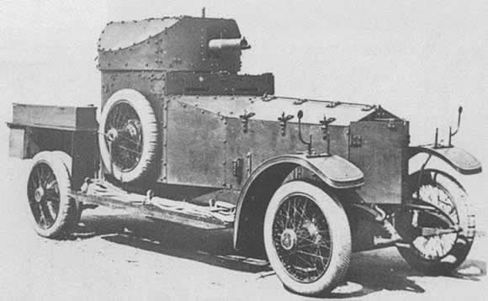

Slide 7
Need Number Three: New Technology
Poison Gas:
Chorine Gas:
Mustard Gas:

Slide 8
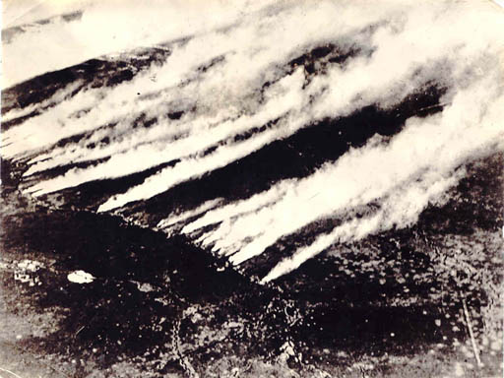

Slide 9
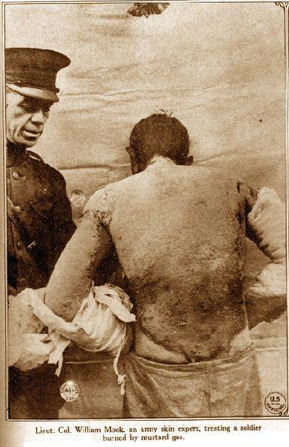

Slide 10
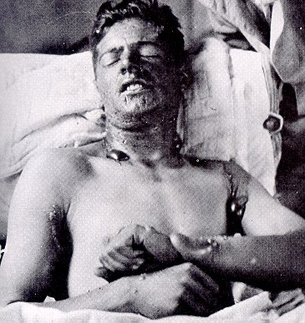

Slide 11
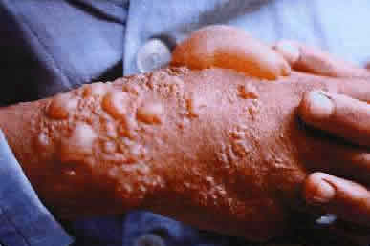

Slide 12
Need Number Three: New Technology
Zeppelins:
Airplanes
Trench Warfare:

Slide 13
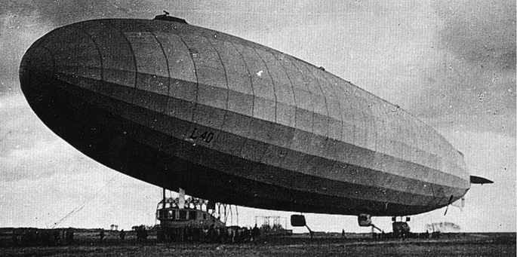

Slide 14
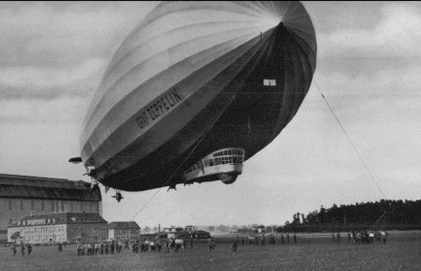

Slide 15
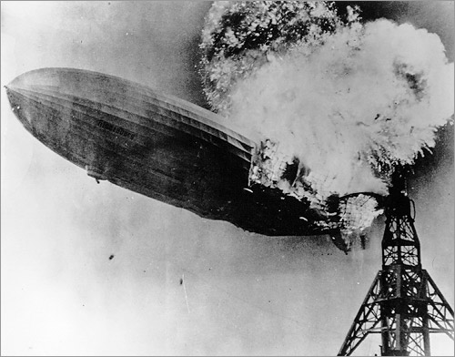

Slide 16
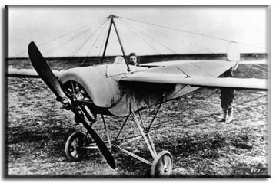

Slide 17
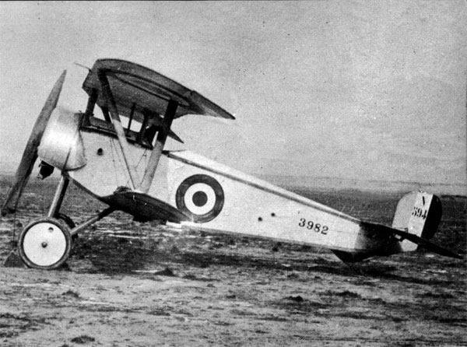

Slide 18
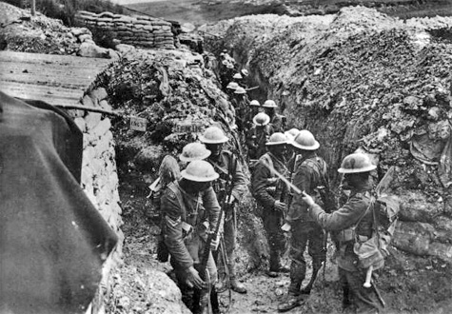

Slide 19
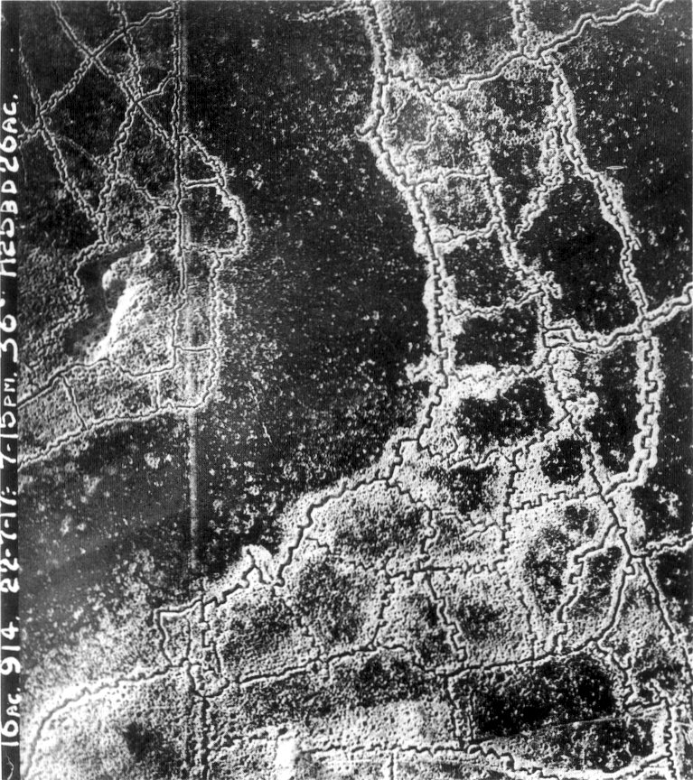

Slide 20
Need Number Four: Protection Against the Enemy
Espionage Act:
Sedition Act:
Committee on Public Information:

Slide 21
Need Number Five: Conservation of Resources
Fuel Administration:
Food Administration:
War Labor Industries Board:

Slide 22
Need Number Six: Paying for the War
Liberty Bonds:

Slide 23
Need Number Seven: Keeping Industry in Line
War Labor Relations Board:

