Slide 1
Early REformers

Slide 2
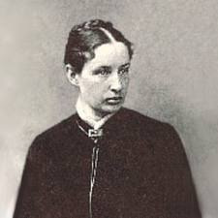
Charity Organization Movement
Key Beliefs:
Wanted charity to be a science
Kept files on those receiving aid
Decided who “deserved” help
Effects:
Unkind treatment of the poor
Disregard of other cultures
Founder: Josephine Lowell

Slide 3
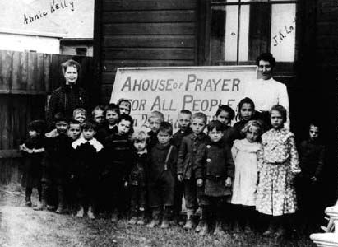
Social Gospel Movement
Key Beliefs:
Wanted to correct problems- not focus on “blaming” individuals
Applied the teachings of Jesus to society
Effects:
Led to the Settlement House Movement

Slide 4
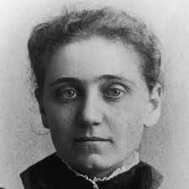
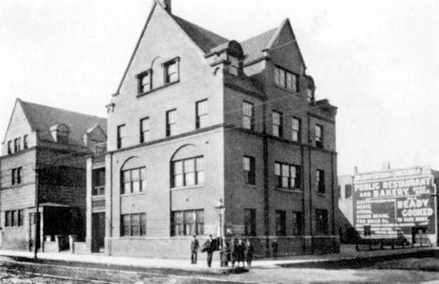
Settlement House Movement
One of the founders: Jane Addams
(other founder- Ellen Gates Starr)
Hull House in Chicago

Slide 5
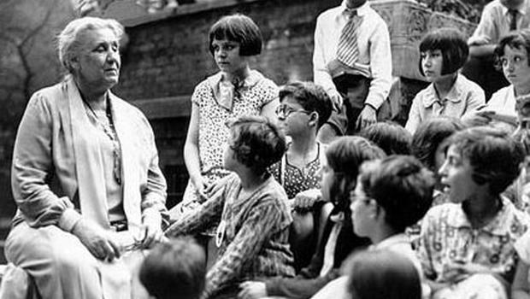
Settlement House Movement
Key Beliefs:
Workers lived in the poor neighborhoods they were trying to help
Became a community center
Cultural events, child care, camps, job training, etc. was provided
Effects:
Hull House was the first in U.S.
By 1910, over 400 in U.S.
Workers helped expose some problems/corruption in the cities

Slide 6
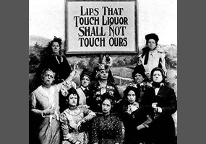
Temperance Movement
Key Beliefs:
Wanted to eliminate alcohol consumption
Believed drinking led to tragedies and undermined morals
Effects:
Formation of the Prohibition Party
By 1890, there were 3 dry states in U.S.
Carry A. Nation became a symbol

Slide 7
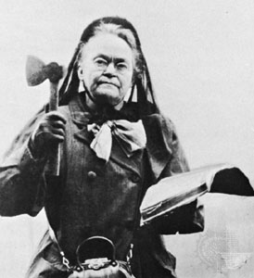
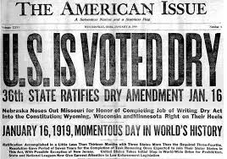
Temperance Movement
Carry A. Nation

Slide 8
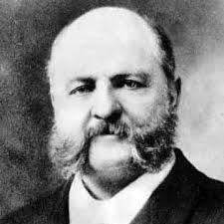
Purity Crusaders
Key Beliefs:
Wanted to rid America of all “vice” (any immoral behavior)
Effects:
Formation of the NY Society for the Suppression of Vice
Laws:
Banned any immoral material to be sent through the U.S. mail
Comstock Law: banned any info about birth control to be distributed through mail
Leader: Anthony Comstock

