Slide 1
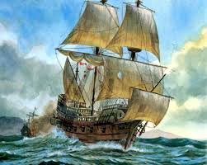
Exploration
Causes:
The Renaissance led to curiosity
Prince Henry the Navigator created a school
Better technology
Stability in Europe

Slide 2
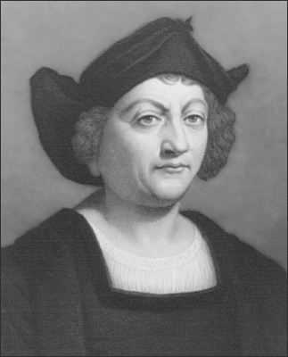
Exploration
Big Names
Marco Polo- first to China
Christopher Columbus- first to New World
Amerigo Vespucci- first to realize New World wasn’t Asia
Ferdinand Magellean- first to circumnavigate
SPAIN AND PORTUGAL!

Slide 3
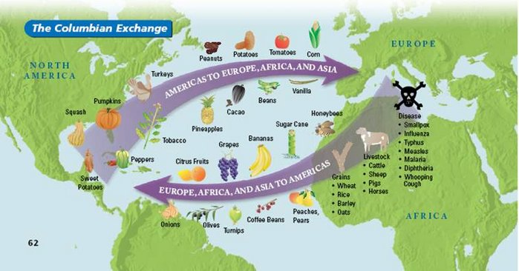
Columbian Exchange

Slide 4
Exploration becomes Colonization!
Reasons
Competition in Europe
Larger Populations
Desire for wealth
Religious conversions (Spain and Portugal)
Treaty of Tordesillas- agreement between Spain and Portugal to split the New World

Slide 5
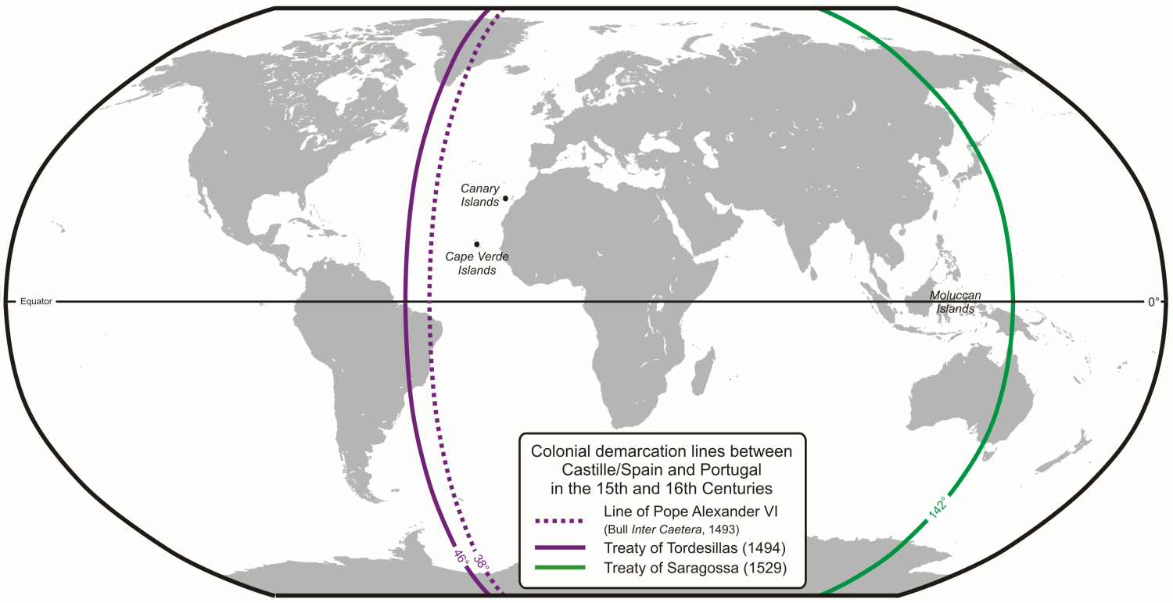
Treaty of Tordesillas

Slide 6
Comparing Colonizing Powers
Spain and Portugal
Began in the late 1400’s, early 1500’s
Used their military to CONQUER the native peoples and used them as slaves
Took wealth OUT!
Tried to force conversion of the native people

Slide 7
Comparing Colonizing Powers
France
Began in the 1500’s
Members of the military set up trading stations
Utilized the native peoples as allies- had the best relationship with them among ANY colonizing power
Great Britain
Began in the late 1500’s
Created “mini-Englands” with their citizens
Used colonies as sources of raw materials

Slide 8
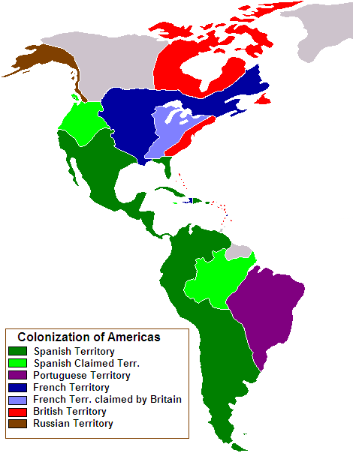
Map of Early Colonization

Slide 9
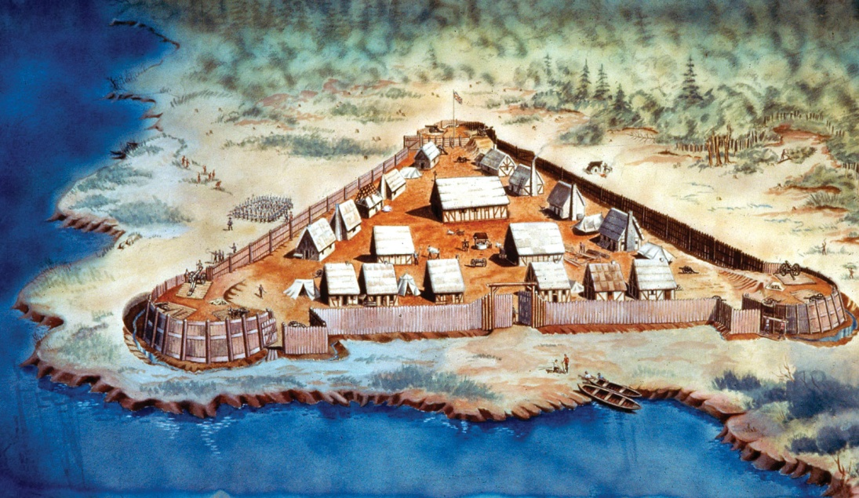
Key Colonies
Jamestown
Location
Key People
Smith
Rolfe
Pocahontas
Known for
Anglo-Powhatan War
Tobacco
House of Burgesses

Slide 10
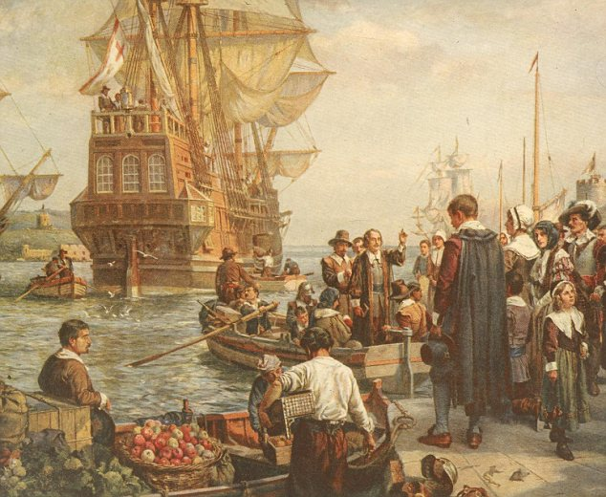
Key Colonies
Plymouth
Location
Key People
William Bradford
Known for
Mayflower Compact
Pilgrims

Slide 11
Key Colonies
Massachusetts Bay
Location
Key People
John Winthrop
Known for
“A City Upon a Hill”
Religious Intolerance
Puritans

Slide 12
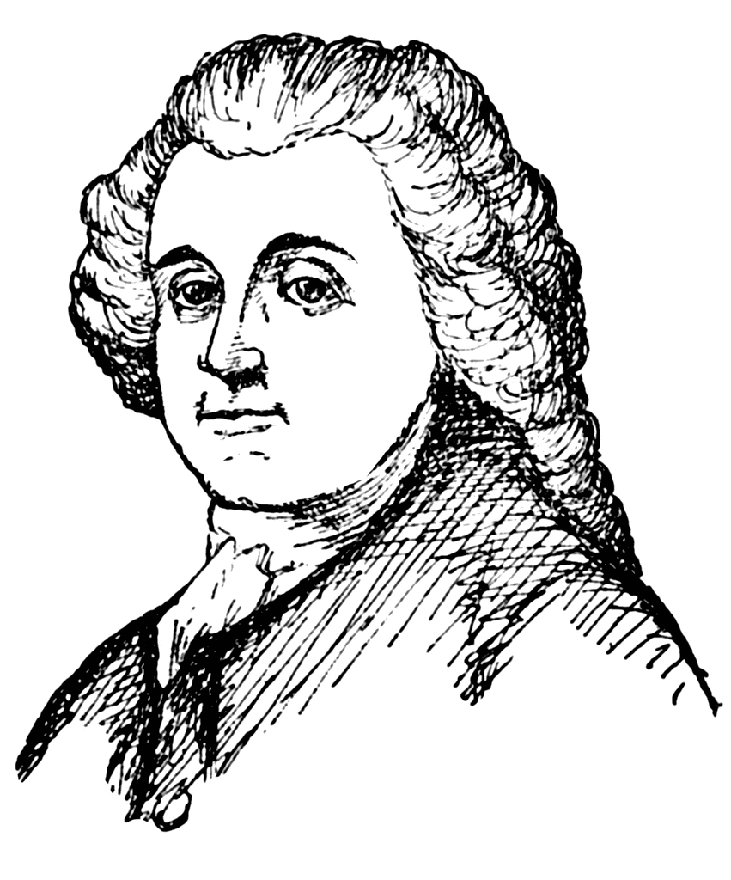
Key Colonies
Rhode Island
Location
Key People
Roger Williams
Anne Hutchinson
Known for
“Sewer of New England”
Religious Tolerance
Most Democratic

Slide 13
Key Colonies
Pennsylvania
Location
Key People
William Penn
Known for
Quakers
Tolerance

Slide 14
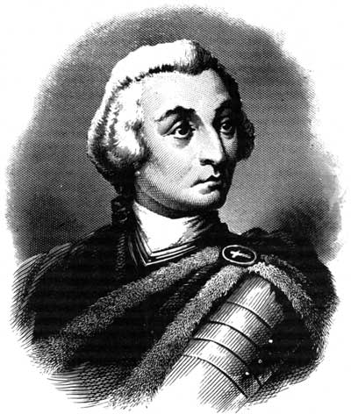
Key Colonies
Georgia
Location
Key People
James Oglethorpe
Known for
Debtor’s Prison
Buffer Zone

Slide 15
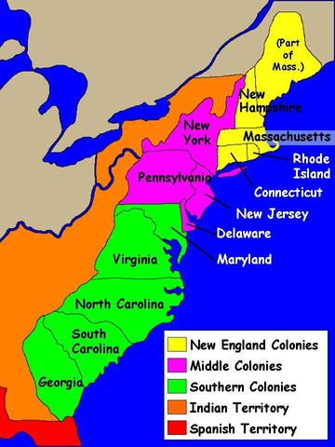
How Geography Played a Role…
The key parts of the:
Southern Colonies
Northern (New England) Colonies
Middle Colonies

Slide 16
Southern Colonies
Included: Virginia, North Carolina, South Carolina, Georgia, Maryland
Jobs: FARMERS
Climate: Virginia and North Carolina receive a lot of rain
Warm and wet climate leads to a lot of disease!
Key Characteristics:
Had the best relationship of all with Britain
People moved to this area to become rich
First slaves
Place in society is based on wealth
Primogeniture system influences settlement
Cash crop = tobacco
Horrible relationship with Native Americans because their jobs required lots of land
Anglo-Powhatan Wars

Slide 17
New England Colonies
Included: Massachusetts Bay, Plymouth, Connecticut, Rhode Island, and New Hampshire
Jobs: Ship-building, traders, lumber, fur traders
Navigation Acts
Passed by English Parliament in 1651 & 1660
Restricted colonial trade to England/English ships
Climate: Cold winters, cooler summers
With cooler climate there is less disease…so the life expectancy is highest in New England
Key Characteristics:
Religion rules EVERYTHING!!!!
Protestant Work Ethic is what saves New England
Family dynamic here
People moved in order to avoid religious persecution- so they have a very bad relationship with England
Dominion of New England, Sir Edmund Andros
Education is important- first schools exist here
Very intolerant of other religions
“Fire and Brimstone” sermons

Slide 18
Middle Colonies
Included: New York, Pennsylvania, New Jersey, Delaware, and Maryland
Jobs: a mix of southern and New England
Climate: a mix of southern and New England
Key Characteristics:
It truly is a mix of both! The further north, the more like NE and the further south the more like Southern
Nicknamed: Bread colonies
Religious colonies:
Maryland: Catholic
Pennsylvania: Quakers (VERY tolerant of other faiths)
Pennsylvania had the best relationship with the Native Americans due to the Quakers and their tolerance of other religions.

Slide 19
Slavery in the Colonies
Located: In the South, first in Virginia
Middle Passage: Nickname for the pathway traveled by slaves from Africa to the Americas
Triangular Trade: system of trade between the Americas, Europe, and Africa. African slaves went to the New World to work farms.
Intentional & deliberate
North America: they worked on tobacco and rice fields mainly
South America: they worked mainly on sugar plantations
Bacon’s Rebellion:
Former indentured servants rebelled against the Virginia government
they claimed it failed to protect them from nearby Native American tribes.
After this rebellion, many areas stopped bringing in indentured servants. This makes slavery increase.

Slide 20
Religion in the Colonies
Pilgrims: Located in Plymouth; intolerant!
Wanted to separate from the Puritans; also known as “separatists”
Puritans: Located in Massachusetts Bay; intolerant!
Wanted to purify the Church of England from within
Quakers: Located in Pennsylvania- known for their tolerance and good relationship with Native Americans
Maryland: Catholics
Rhode Island: formed of all the misfits kicked out of the New England colonies due to religion.

Slide 21
Religion in the Colonies
Salem Witch Trials:
time period where over 30 people were hanged after being accused of being witches.
There was no evidence against those that were killed.
Halfway Covenant:
Used to increase church membership
Citizens would become partial members and receive baptism rights without having to conform to all of the church’s standards
“A City Upon a Hill”:
Famous sermon by John Winthrop.
It states that all work is done in the name of God and therefore requires full effort.
It saves the New England colonies from failure (like tobacco in the South)

