Slide 1
Civil Rights Chart
Rachel Carson
Cesar Chavez
Bob Dylan
Joan Baez
Ralph Nader
Tom Hayden

Slide 2
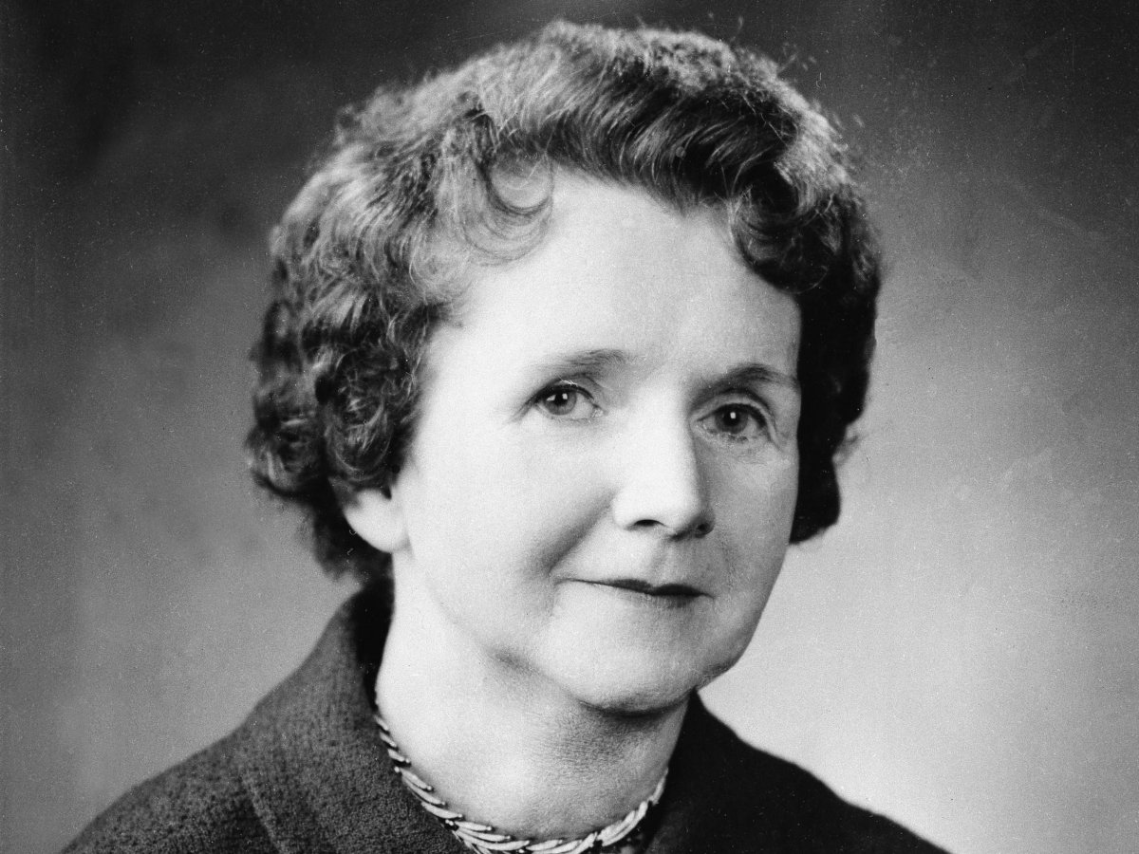
Civil Rights Chart
Rachel Carson:
Supported changes for the environment to prevent pollution
Against the use of DDT
Wrote silent spring
UP Next: Cesar Chavez

Slide 3
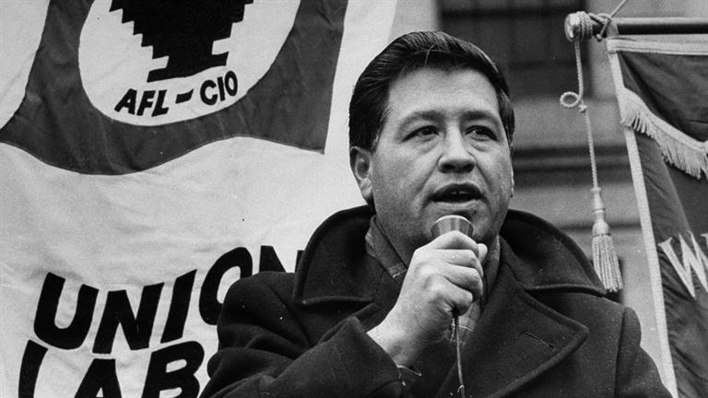
Civil Rights Chart
CeSar Chavez:
Fought for the rights of migrant farm workers
Helped found the national Farm Workers Association
Up Next: Bob Dylan

Slide 4
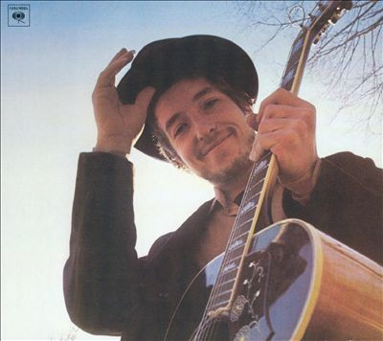
Civil Rights Chart
Bob Dylan:
Wrote protest songs like “Blowing in the Wind” and “A Hard Rain is gonna fall”
Up NEXT: Joan Baez

Slide 5
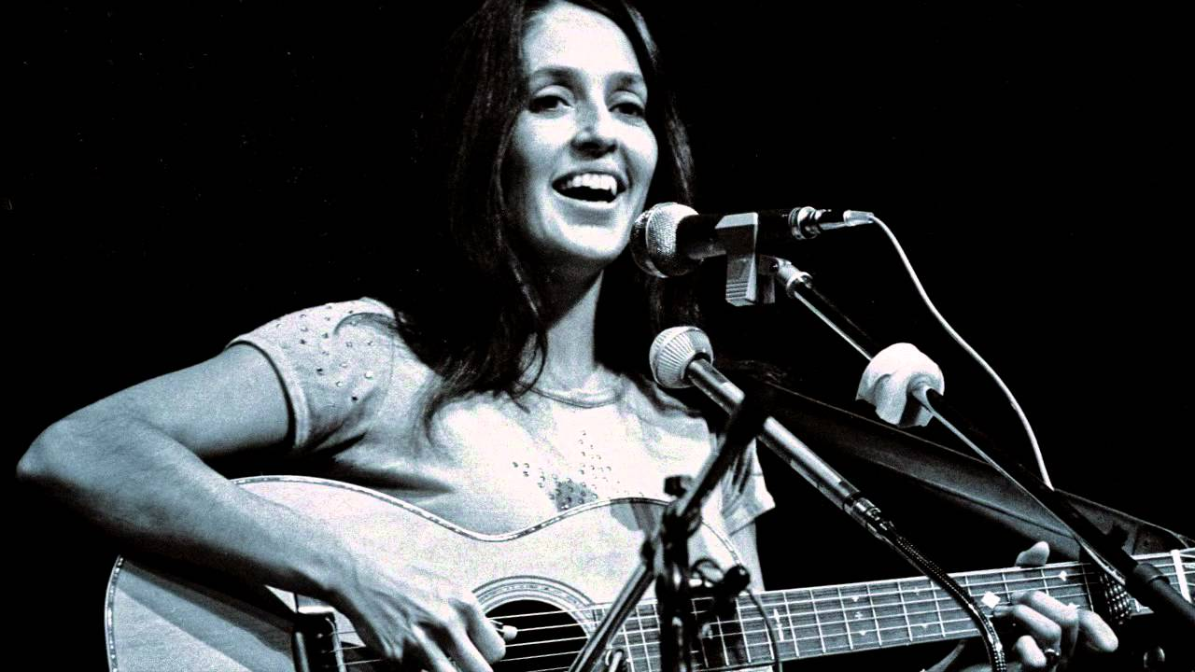
Civil Rights Chart
Joan Baez:
Greatest known female folk artist during the 1960’s
Sang “Oh Freedom” at the March on Washington
UP NEXT: Ralph Nader

Slide 6
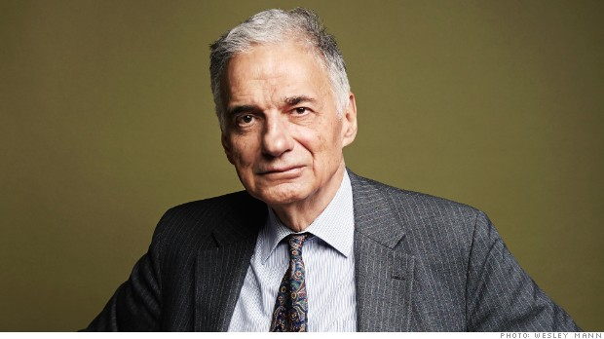
Civil Rights Chart
Ralph Nader:
Wrote “Unsafe at any speed”
Helped establish safety standards for U.S. automobiles and tires
Up Next: Tom Hayden

Slide 7
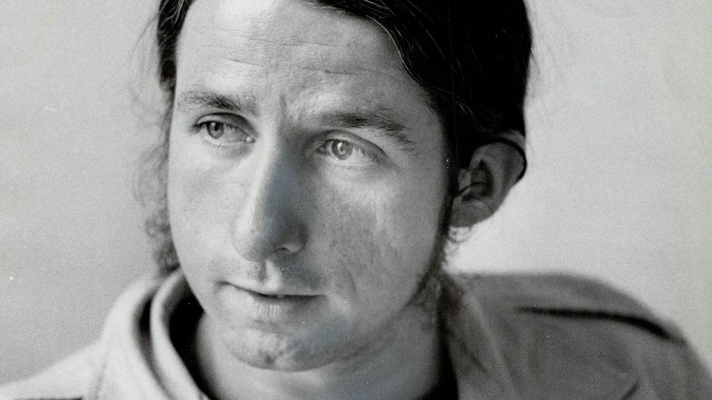
Civil Rights Chart
Tom Hayden:
Leader of the New Left Movement
Founded the Students for a Democratic Society (SDS)

Slide 8
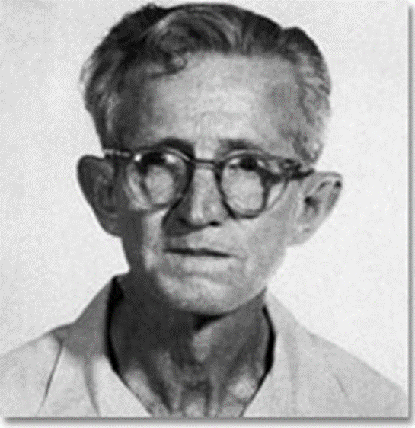
Gideon v. wainwright
Gideon could not afford attorney; state would provide one only in case of capital offense
States must provide attorney to all in felony & capital cases

Slide 9
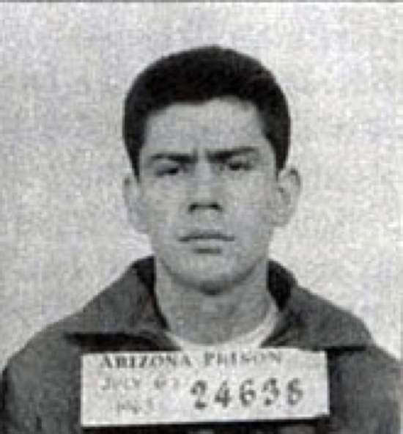
Miranda v. arizona
Miranda was convicted of rape & kidnapping based on statements he made to police
Police must inform suspects of their rights before questioning: the Miranda Warnings

Slide 10
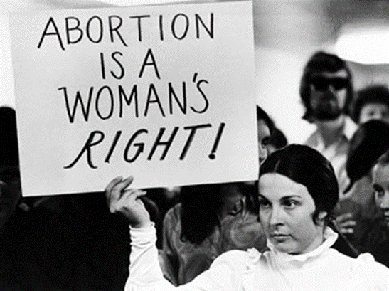
Griswold v. connecticut
Griswold convicted of giving birth control counseling to married couples
Ruling states that states cannot try to prevent a woman’s access to birth control

Slide 11
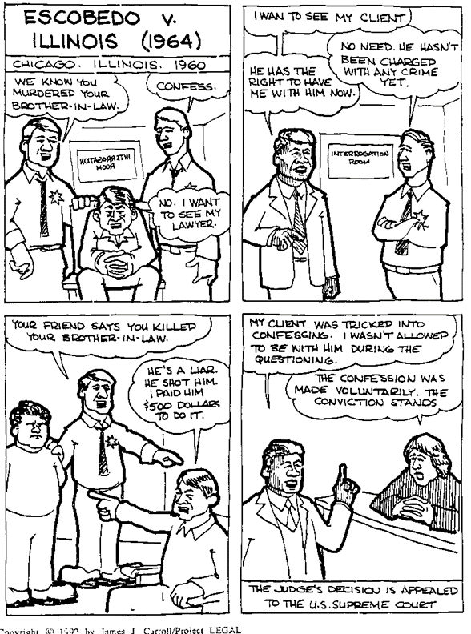
Escobedo v. illinois
Escobedo and lawyer were prevented from seeing each other during his questioning
Ends up confessing to murder
Right to a lawyer during questioning

Slide 12
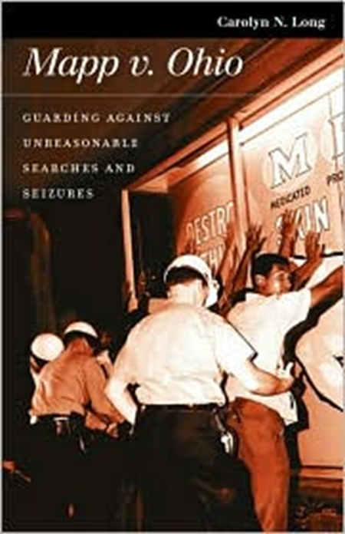
Mapp v. ohio
Search of Mapp’s house for betting slips uncovered obscene materials
People are protected against unwarranted search and seizure – specific search warrant

Slide 13
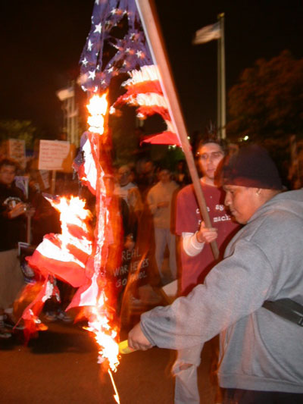
Texas v. johnson
Johnson burned flag in protest of Reagan administration
Arrested for desecration of a flag
Supreme Court classifies this as expressive conduct- freedom of speech

Slide 14
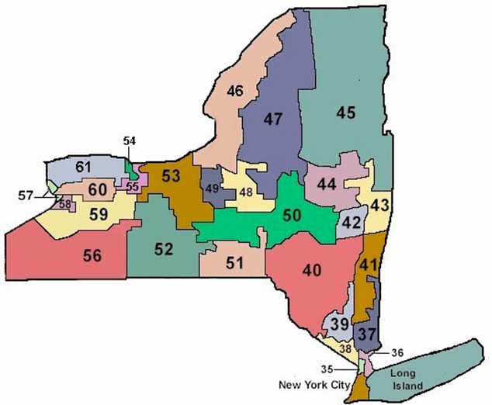
Baker v. carr
Legislative reapportionment (redistricting) had not taken place
Allowed the judicial system to intervene in cases where district lines are disputed- gerrymandering, population miscalculation, etc.

Slide 15
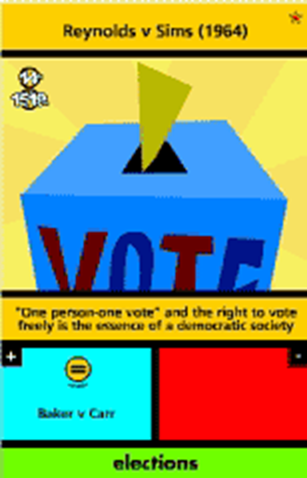
Reynolds v. sims
Voters from Jefferson, Alabama challenged the apportionment of the state legislature
Argued certain districts had smaller populations than others giving some voters more power
“One man, one vote”- voting should be based on population size, not geographic size

Slide 16
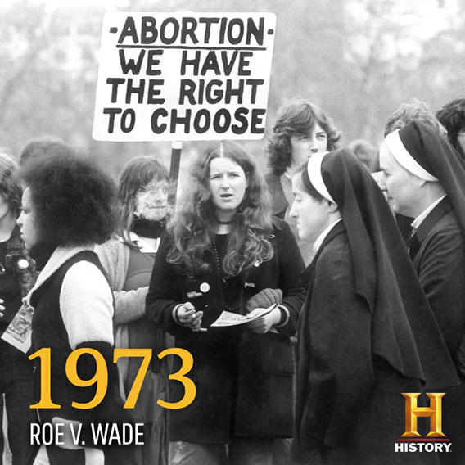
Roe v. wade
Roe lived in Texas and wanted to abort her pregnancy- but only life threatening cases were allowed
Supreme Court decides that women can abort through first trimester (14 weeks) due to privacy rights

Slide 17
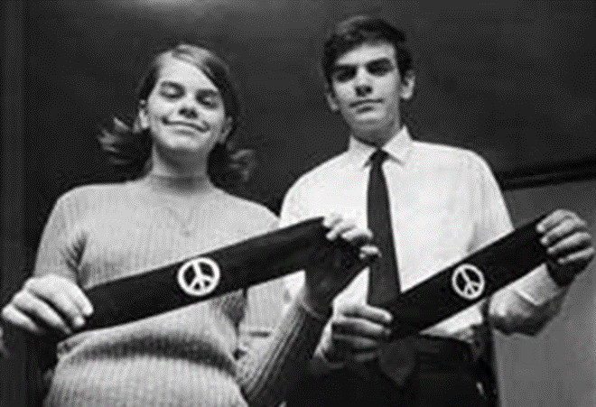
Tinker v. des moines
Marybeth & John Tinker were not allowed to wear black armbands to school to protest the war in Vietnam
Even students have rights – free, silent, symbolic speech … “don’t shed their rights at the schoolhouse gate” – as long as it doesn’t interfere with the educational process

Slide 18
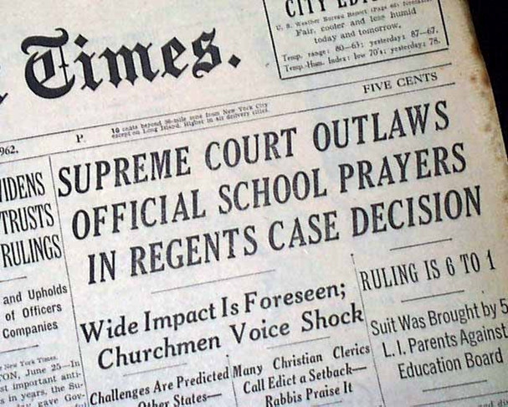
Engle v. vitale
New York tried to establish a voluntary, nondenominational prayer in schools
No prayer in schools allowed- by offering that time you are approving of religion in school

Slide 19
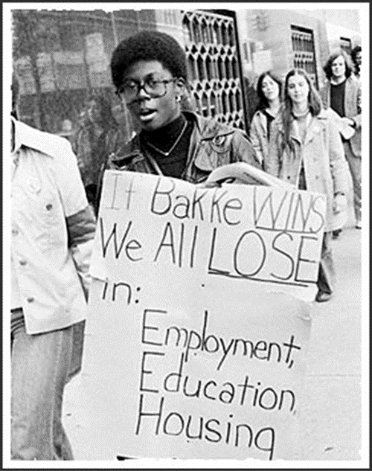
University of CA v. Bakke
Bakke denied admittance twice to medical program. Out of 100 slots, 16 were saved for minority students
Bakke argued affirmative action led to reverse discrimination
Colleges can consider race but not have strict quotas

