Slide 1
Nixon ReCap
Vietnam
Pulls troops out
Roe v. Wade, 25th Amendment (VP Successor) and 26th Amendment (voting), OSHA (Occupational Safety and Hazard Act
Economy
Stagflation (effects Carter and Ford)
Downhill/Very poor
Mass paranoia
Watergate, wiretapping, etc.
Resigns in 1974

Slide 2
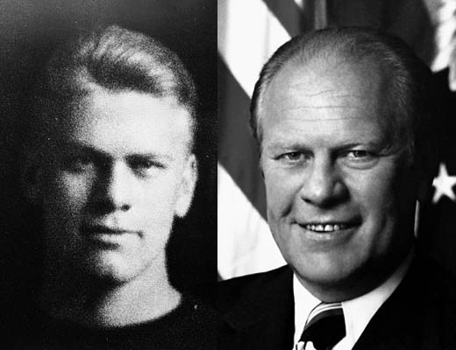
Gerald Ford
Term: 1974-1977
Only President who: is never elected into the Executive Branch
First thing he does is: pardon Nixon

Slide 3
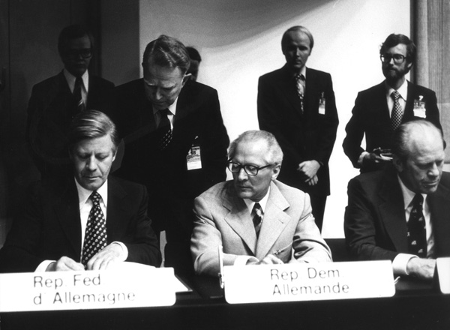
Gerald Ford
Helsinki Accords: agreement signed by 35 nations- meant to improve relations between communist and non communist nations
Part of : Detente
Signed by: U.S., Canada, and all of Europe (except Albania)
July 4th, 1965: nation’s bicentinneal- our 200th birthday…first sign of optimism since JFK

Slide 4
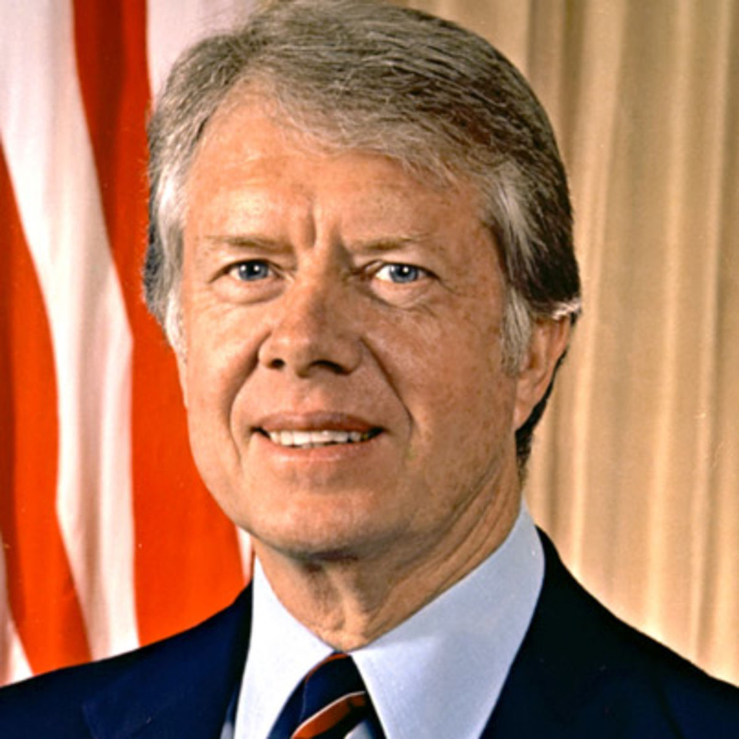
Jimmy Carter
Term: 1977-1981
Known as: the Washington Outsider
Began the: deregulation of business

Slide 5
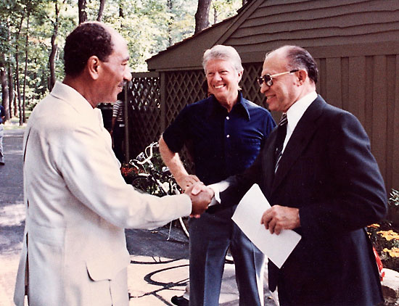
Jimmy Carter
Success in the Middle East
Camp David Accords: The first major longstanding Middle-Eastern peace agreement involving Israel (Officially called: Framework for Peace in the Middle East)
Israel represented by: Menachem Began
Egypt represented by: Anwar Sadat
Agreement: Egypt will recognize Israel as a legitimate country and Israel will remove troops from the Saini Peninsula

Slide 6
Jimmy Carter
Problems in the Middle East
Energy Crisis
Began with OPEC: (Organization of Petroleum-Exporting Countries)- they raise the price of oil going to the United States
Led to the National Energy Act
Gives tax breaks to: people and businesses using solar energy
Increased taxes for: people driving gas guzzling cars
Gave research money to: study alternative fuels

Slide 7
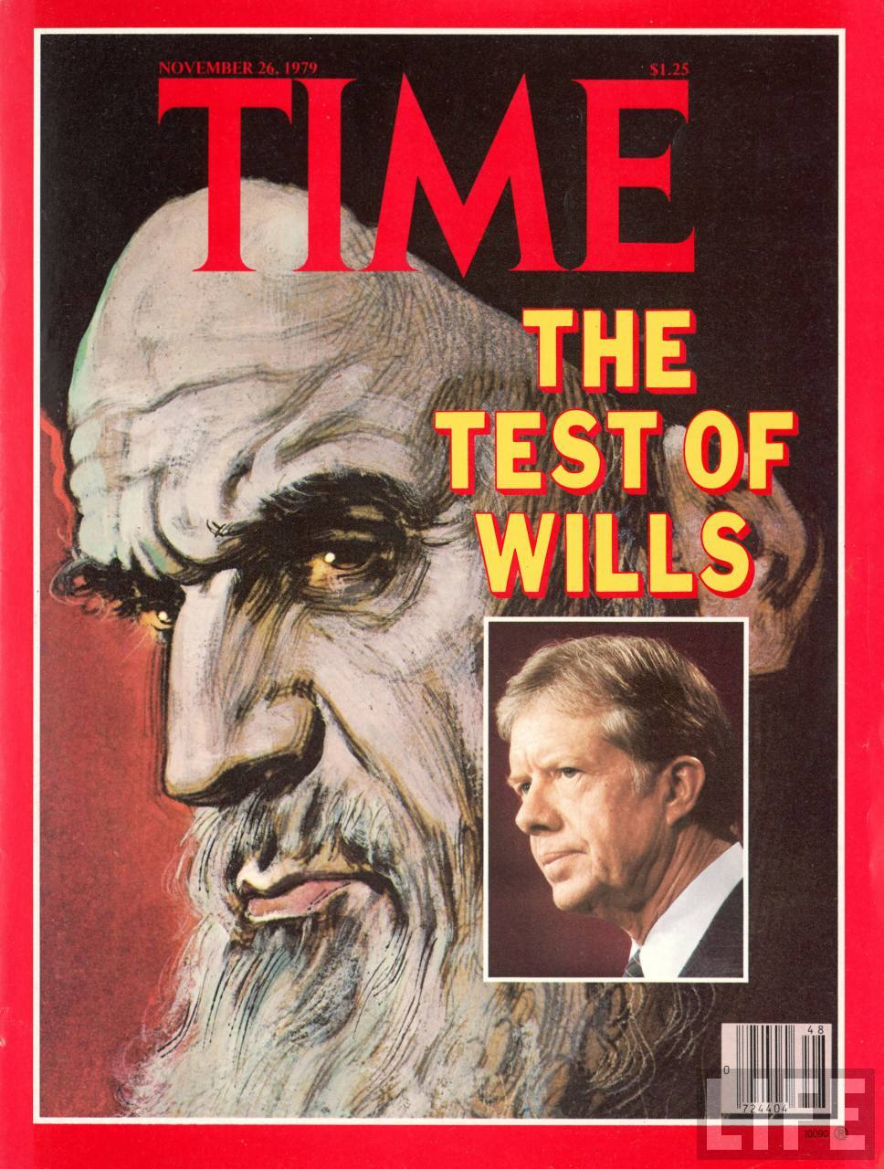
Jimmy Carter
Iranian Hostage Crisis
Iran was in the middle of: a political upheaval
The U.S. supported: the Shah of Iran (he liked the U.S.)
Ayatollah Khomeini: dethrones the Shah and begins speaking out against the U.S.- kidnaps 52 Americans and holds them hostage for 444 days
Ended when: Reagan is inaugurated

Slide 8
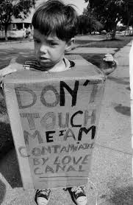
Jimmy Carter
Established: the Department of Education as a separate cabinet department
Three Mile Island: nuclear power plant in Pennsylvania that has a reactor melt down- made Americans fear nuclear energy
Love Canal

Slide 9
Ronald Reagan
Term: 1981-1989
When he was being sworn in: the Iranian hostages are released
Economy
Reaganomics
Also called: Supply-side
Known for: Bringing savings to businesses, which eventually translates into savings for the average consumer

Slide 10
Ronald Reagan
Also gave tax breaks to: the wealthy
“Trickle-down” economics: describes how the savings works
Strategic Defense Initiative
Plan to: build a giant anti-ballistic missile program in space
Had to cut: billions from domestic programs
Also called: Star Wars- IT DOES NOT WORK, BUT it does help to bankrupt the Soviet Union

Slide 11
Ronald Reagan
Continued Carter’s: deregulation of business
Women
Sandra Day O’Conner: first woman appointed to the Supreme Court
Geraldine Ferraro: first woman to run for Vice President- runs against Reagan and Bush…she loses

Slide 12
Ronald Reagan
Scandal
Savings and Loan: Reagan gave tax breaks (money) to mortgage companies to allow them to refinance existing mortgages. Companies instead pocket the money.
Iran-Contra: The U.S. (Oliver North) got caught selling illegal weapons to Iran and using the money to fund pro-western rebels in Nicaragua (The Contras)
Some believe this is tied to: the Iranian Hostage Crisis

Slide 13
Ronald Reagan
The end of the Cold War
Mikhail Gorbachev: leader of the U.S.S.R. when communism disappears
Glasnost: political openness
Perestroika: privatization of businesses
Poland: first Soviet republic to break free

Slide 14
Ronald Reagan
The end of the Cold War
Berlin Wall: it came down in the Spring of 1989; signals an end to the Cold War
15 Territories: run by the Soviet Union all break free- it is now once again Russia
Chechnya: ethnic area in Russia that wanted independence- Russian military used heavy violence to ensure it did not get independence
START: Strategic Arms Reduction Treaty- demilitarization treaty between U.S. and Russia
Tiananmen Square: democratic revolution in China led by college students- ended violently by Chinese government

Slide 15
Ronald Reagan
War on Drugs: declared war on drugs- leading to mandatory minimum sentencing and the “DARE” program with “Just Say No”

Slide 16
George H.W. Bush
Term: 1989-1993
Slogan: “No New Taxes”
Part of the second: Father-Son presidential duos
Continued the: deregulation of business

Slide 17
George H.W. Bush
1st Persian Gulf War
Began when: Iraq invaded Kuwait
Saudi Arabia asked: the U.S. to help get Iraq out
We invaded Kuwait and: Iraq was forced to evacuate
U.S. led by: General Norman Schwartzkopf, aka, Stormin’ Norman- this war also known as Operation Desert Storm
Fostered: an even worse relationship with Iraq

Slide 18
Bill Clinton
Term: 1993-2001
Establishment of the E.U.
Stands for: European Union
Purpose: free trade for all member nations (Europe)- makes trade easier and more profitable
In response the U.S. set up: NAFTA (North American Free Trade Agreement)- members are U.S., Canada, and Mexico.

Slide 19
Bill Clinton
Economy
For the first time in decades, the U.S.: has a surplus
This means we: spent less money than we made BUT we still are carrying a hefty national debt

Slide 20
Bill Clinton
Tries to reform: healthcare
Scandals
Whitewater
From when Clinton: was governor of Arkansas
Accused of: using his position of power to get others to invest in the Whitewater property group
No charges: were ever filed

Slide 21
Bill Clinton
Scandals
Monica Lewinski
He had an: affair with Lewinski while she served as a White House intern
He lied about it: under oath
Only the second president to: be impeached
Kenneth Starr: served as the prosecuting attorney during the removal trial

Slide 22
Bill Clinton
Bosnia
The UN sends troops to Bosnia in response to: genocide led by the Serbs against the Croats
Clinton agrees to: send U.S. troops to be a part of the UN standing military in Bosnia

Slide 23
George W. Bush
Term: 2001-2009
Contested election of 2000
Between: Al Gore and Bush
Came down to: Florida
Many residents said: they misunderstood the ballot and they call for a revote

Slide 24
George W. Bush
The Governor, Jeb Bush, decided: that there would be no revote and the state’s electoral votes would go to George Bush
He is the: brother of George Bush
However the Supreme Court: also ruled in favor of Jeb Bush’s decision
The election goes to: Bush

Slide 25
George W. Bush
September 11th, 2001
First terrorist attack: against civilians in America
Killed: over 3,000 Americans
Hit: the World Trade Towers and the Pentagon
Led by: Al-Qaeda

Slide 26
George W. Bush
September 11th, 2001
Led to the: War on Terror, Creation of the Department of Homeland Security
Bush gives the: “Axis of Evil” speech
Said we would go after: evil everywhere
Named: Iraq, Iran, and North Korea as “evil empires”

Slide 27
George W. Bush
War in Iraq
Began over the idea of: Iraq’s possession of weapons of mass destruction
We invaded Iraq, captured: Saddam Hussein and turned him over to the Iraqi people
Hussein is: convicted of human rights violations and executed
We are: still there today
Economy begins sliding into: a recession- A BIG ONE!

Slide 28
Barack Obama
Term: 2009-2017
First African-American president
“Yes We Can”
Response to growing recession
Bailout packages to struggling companies, especially brokerage companies
“Cash for Clunkers”- opportunity to turn in old cars for guaranteed money if they bought something more energy efficient
Rise of the Tea Party

Slide 29
Barack Obama
Affordable Health Care Act
First health care plan to pass
Still contested today
Plan was to help combat escalating health care costs and corruption
Benghazi Attack
Took place in Libya on the 11 year anniversary of the September 11th attacks
First U.S. diplomat killed in action since 1979
Brought about many questions regarding transparency, honesty, and foreign policy

