Slide 2
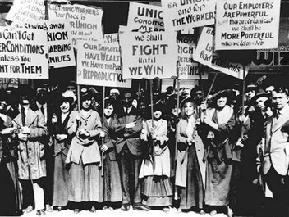
What is it??
Progressive Era
Time period from 1900-1915
Focus: cleaning up all the problems that developed from urbanization
Came out of: the earlier Populist Movement
Key Presidents Involved:
Teddy Roosevelt
William Taft
Woodrow Wilson
WHAT were the problems that existed???

Slide 3
What were some of the problems??
Overcrowding in cities
Poor sanitation
Lots of disease
Discrimination
Low pay for workers
Companies not providing safe working conditions
Companies not being careful with the products they are making: some food products will not be safe to eat
Long hours for work
Railroad companies taking advantage of famers
Corruption in city government through voting

Slide 4
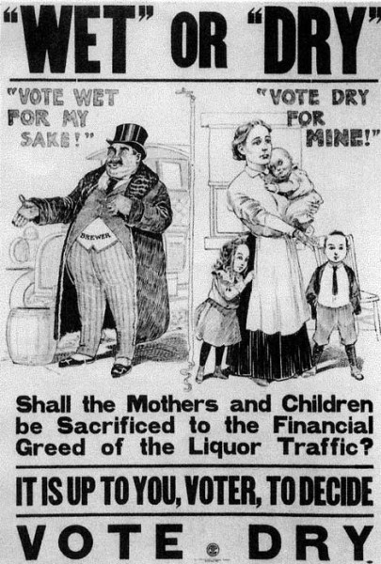
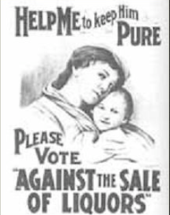
Social Reform
Social Reform is the cleaning up of problems within society
Key Reforms:
Child Labor
Women’s Suffrage
Temperance

Slide 5
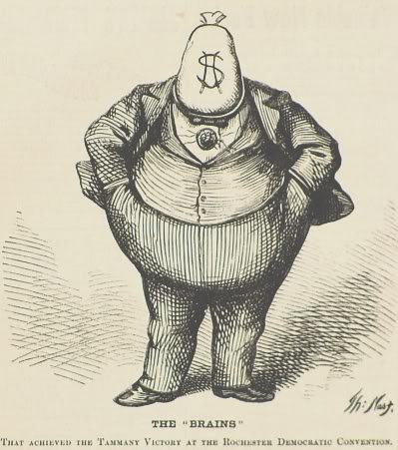
Municipal (Government) Reform
More power given to voters
Initiative (when voters can create their laws for government to vote on)
Referendum (citizens vote on laws directly)
Recall (citizens can vote to remove elected officials)
Amendments Passed
16: government can pass an income tax
17: people can vote for senators
Voting Process
Direct Primaries: citizens pick who runs for office in America
Secret Ballot: starts around 1900, makes it so no one knows who you vote for (before this, there was a lot of corruption trying to influence votes)

Slide 6
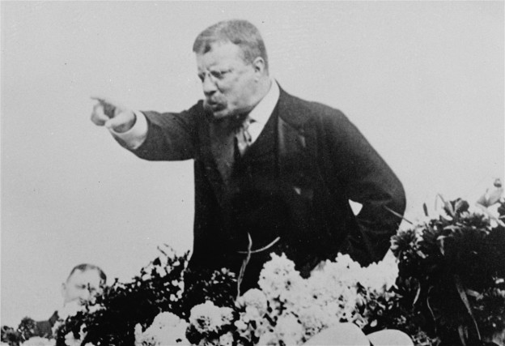
The Progressive Presidents- Roosevelt
Entered after the assassination of McKinley
Considered the presidency a “Bully Pulpit” (it was his job to use the power he had to create a better society)- he will not be a president who is afraid of power
He focuses on:
Reforming big business practices
Guarding public health
Conserving the nation’s resources

Slide 7
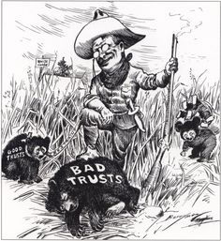
The Progressive Presidents- Roosevelt
Big Business Reform
Trust-Bustin’ Teddy
Goes after the ones that harm the public health!
Regulation rather than busting
Sherman Anti-trust Act really not that effective- needed a strong president
Interstate Commerce Commission is strengthened
Mann Act: ends sex trafficking
Elkins Act: ends rebate policy
Hepburn Act: got rid of free passes
“Square Deal”
Anthracite Coal Strike
Northern Securities v. U.S.- this court case starts to break up monopolies
Came after U.S. v. E.C. Knight

Slide 8
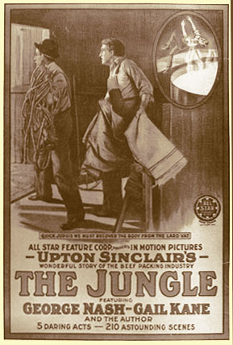
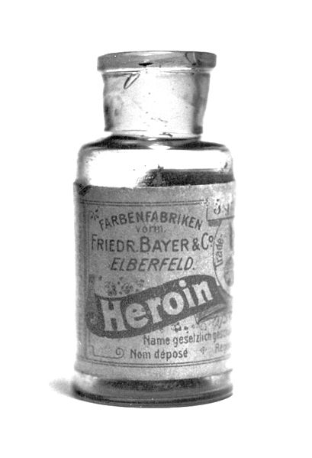
The Progressive Presidents- Roosevelt
Guarding the public health
Upton Sinclair and The Jungle
Started the term: “muckraker”
Led to the Meat Inspection Act
Pure Food and Drug Act

Slide 9
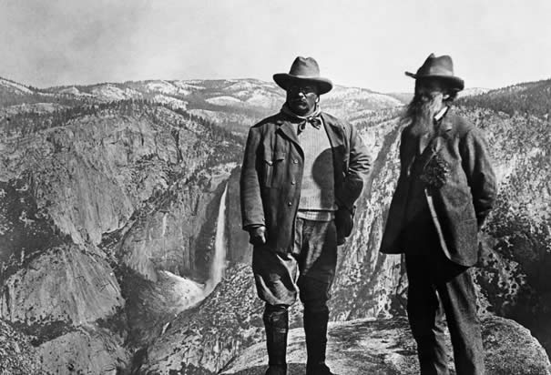
The Progressive Presidents- Roosevelt
Conservation
Roosevelt believed the west had ‘healing powers’
Wanted to make sure generations to come to see the beauty
He and his Secretary of the Interior, Ethan A. Hitchcock, developed a conservation plan
Roosevelt added an additional 200 million acres for national forests, mineral reserves, and water projects
Established the Bureau of Forestry and named Gifford Pinchot to head it

