Slide 1
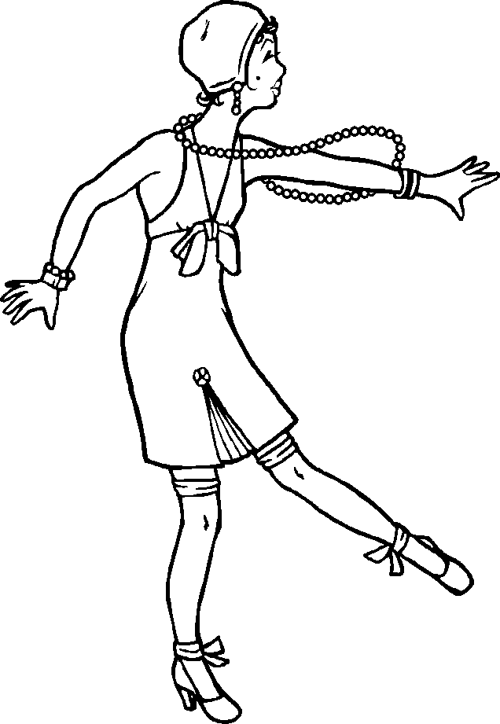
The Roaring twenties!!

Slide 2
Changes during the twenties
Changes for African Americans
Economics
Arts and Leisure
Sports and Entertainment
Red Scare
Government
Foreign Policy
Changes for Women

Slide 3
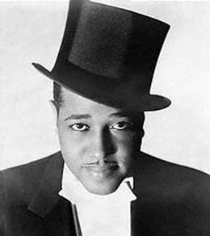
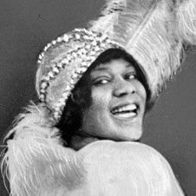
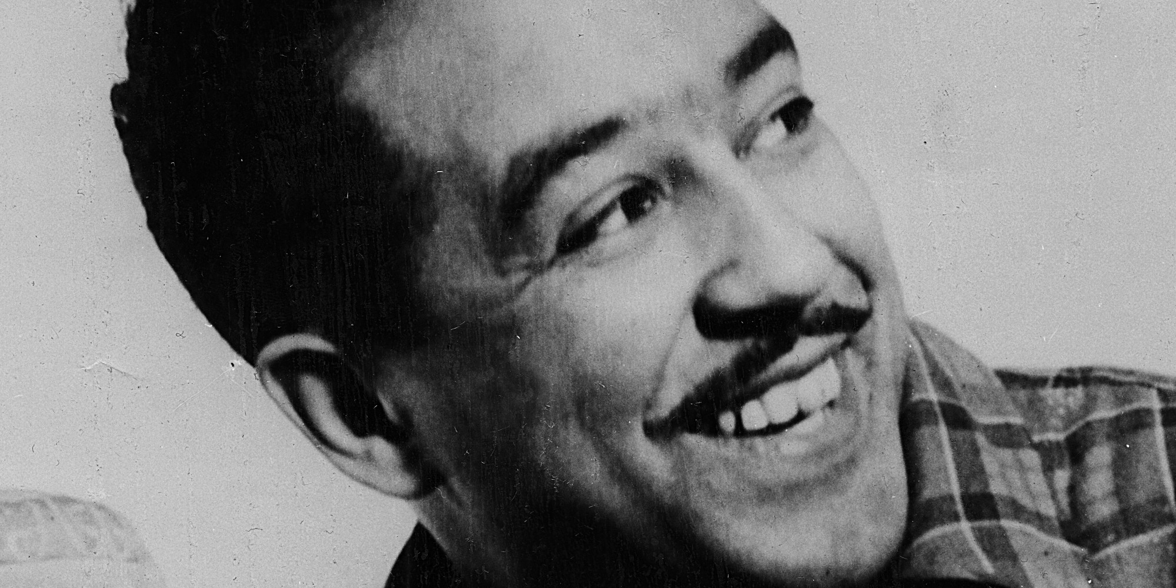
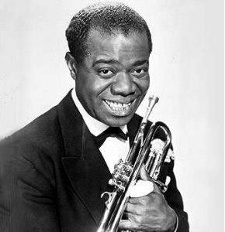
African americans
Growth of Jazz
Duke Ellington
Bessie Smith
Louis Armstrong
Harlem Renaissance
Movement throughout black culture that influenced the arts and social thought
Langston Hughes
James Weldon Johnson
Zora Neale Hurston
Apollo Theater

Slide 4
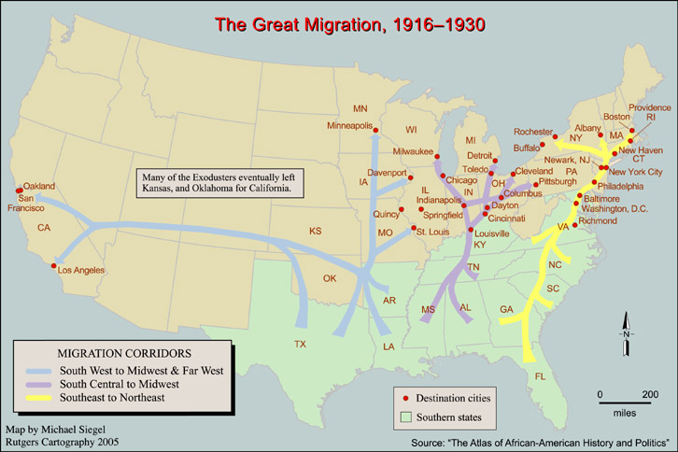
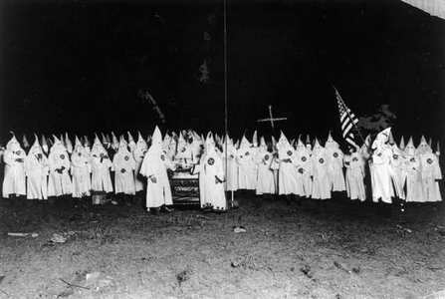
African americans
The Great Migration
Racism in the south and economic opportunities in the north
KKK
Growth due to Red Scare
Violence increased

Slide 5
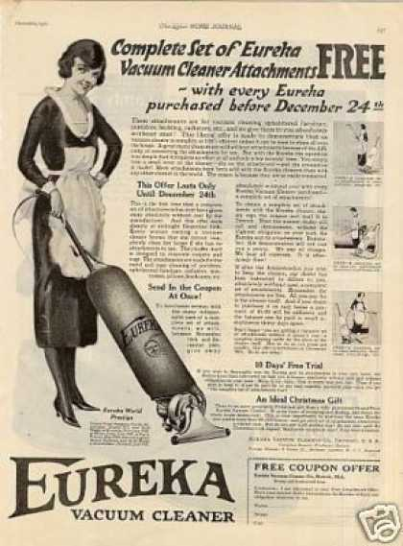
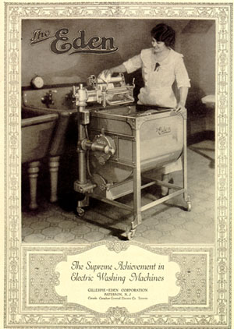
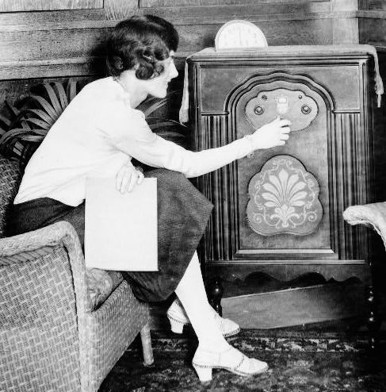
Economics
Easy Credit
“Buy now, pay later”
Installment Plans
“Must haves”

Slide 6
Economics
Unregulated lending of money in banks
Bank runs
Bank Run
Buying Stock on Margin
Pay for a percentage of stock, and borrow the rest
Lose your money and owe what was borrowed

Slide 7
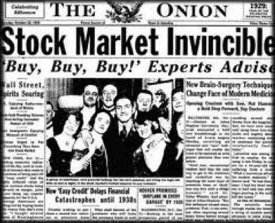
Economics
High Speculation of Stock
Invest big, to get big
Believed market would always go up
GNP
Gross National Product
1920-1920 went up 6% annually
Constantly going up

Slide 8
Arts and literature
Jazz
Art Deco architecture and design
Literature
F. Scott Fitzgerald
Ernest Hemingway
Zora Neal Hurston
Edna St Vincent Millay
Sinclair Lewis
Lost Generation: group of writers who moved to Europe after WWI over their disillusionment with America

