Slide 1
The Great Depression
Leading to the New Deal

Slide 2
The Roaring 20’s
Time of unprecedented prosperity in America
Problem was: the prosperity was VERY uneven and VERY unregulated
While many Americans experienced increases in their incomes, some experienced HUGE gains- creating a massive unequal distribution of wealth
Businesses and banks were not being watched by the national government leading to problems
Businesses were reporting exaggerated gains
Banks were lending too much money
Calvin Coolidge took away many of the safeguards that existed to protect the American economy

Slide 3
Long Term Causes of the Great Depression
Problems with the Stock Market
Businesses reporting exaggerated gains
Meant to increase the value of their stocks
Led to fast crash of stock prices
High speculation of stock
Idea of “Go hard or go home”
Belief that you couldn’t make a lot of money if you didn’t risk a lot
Buying on margin
The idea of borrowing money to buy stock
Not a problem as long as the price of stock continues to go up

Slide 4
Long Term Causes of the Great Depression
Problems with the Banks
They were lending out too much money
Sometimes over half of the money banks had in reserves was lent out- that means that as soon as a crisis hits, banks would be subject to closures due to people unable to repay their loans
They were loaning out too much money to speculators

Slide 5
Long Term Causes of the Great Depression
Americans were living in debt
Americans living in denial believing that the economy would never slow down and they were not saving
New must-haves: radio, automobiles, vacuums
Credit: the idea of “buy now, pay later”
Installment plans

Slide 6
Long Term Causes of the Great Depression
Over Production
Factories
American industry had continued to grow since the 1880s
While workers had seen some wage increases, many workers couldn’t afford to buy the products
After WWI, there were tariffs and poverty in Europe preventing Europeans from buying American products
All of this lead to a massive surplus, leading to lower prices
Farmers
They experienced their depression BEFORE the stock market crash
American farmers were still producing at the WWI levels when they were growing for Allied powers

Slide 7
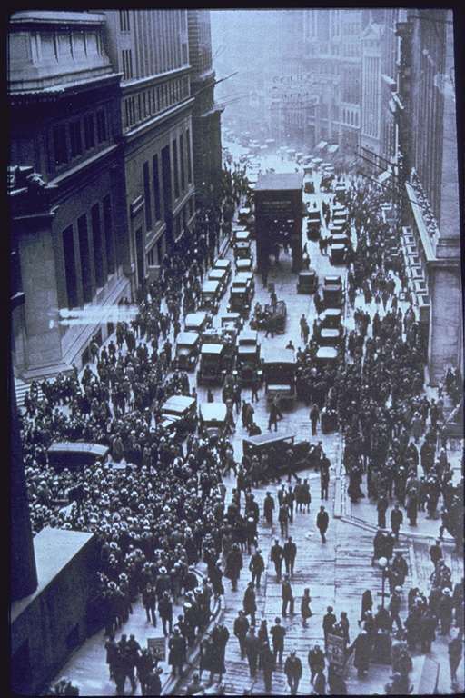
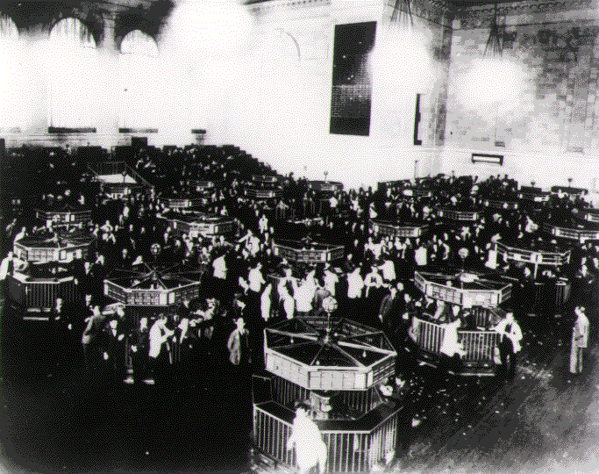
STOCK MARKET CRASH AND FINANCIAL PANIC
WALL STREET ON THE DAY OF THE CRASH, OCTOBER 1929
Notes:
The trading floor of the New York Stock Exchange just after the crash of 1929. On Black Tuesday, October twenty-ninth, the market collapsed. In a single day, sixteen million shares were traded--a record--and thirty billion dollars vanished into thin air. Westinghouse lost two thirds of its September value. DuPont dropped seventy points. The "Era of Get Rich Quick" was over. Jack Dempsey, America's first millionaire athlete, lost $3 million. Cynical New York hotel clerks asked incoming guests, "You want a room for sleeping or jumping?"

Slide 8
“Black Tuesday”
October 29, 1929
$30 Billon Disappears
REASONS FOR THE STOCK MARKET CRASH
STOCKS WERE OVERPRICED DUE TO SPECULATION (ARTIFICIAL INFLATION)
MASSIVE FRAUD AND ILLEGAL ACTIVITY
BUYING ON MARGIN

Slide 9
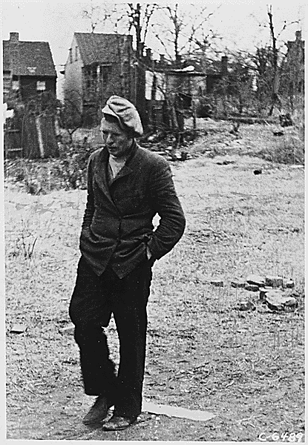
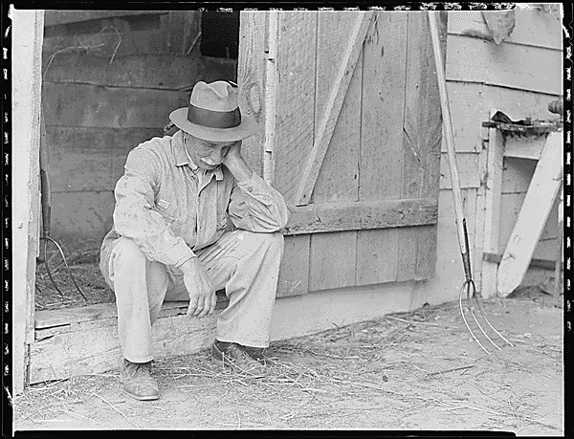
THE GREAT DEPRESSION
BEGINS

Slide 10
EFFECT OF DEPRESSION ON CONSUMER SPENDING FROM 1929 T0 1933 IN BILLIONS OF DOLLARS

Slide 11
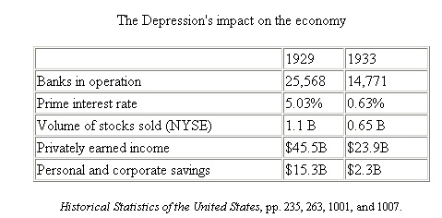

Slide 12
THE DEPRESSION CAUSED A DRAMATIC DROP IN INCOME AND SAVINGS (IN BILLIONS OF DOLLARS)
personal and corporate savings

Slide 13
Banks Failed
After the crash, many begin withdrawing money from banks
Bank Runs
Banks had invested other people’s moneys
Millions of people lost their life savings
Banks closed because withdrawals outnumbered deposits

Slide 14
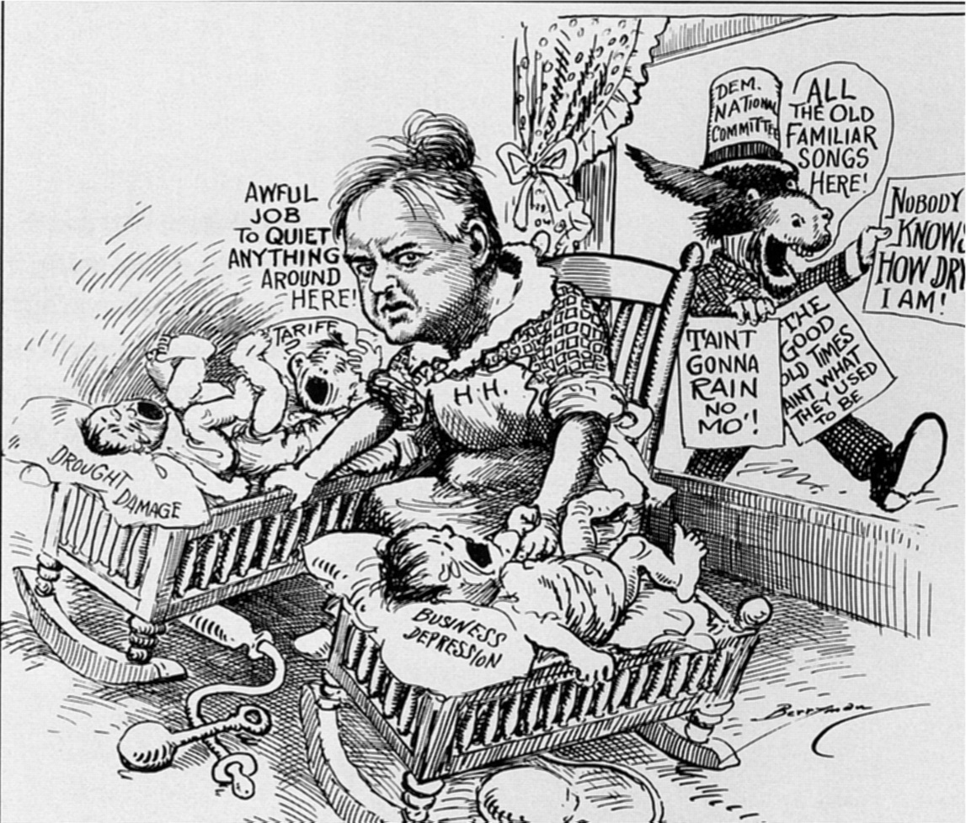
WITHIN EIGHT MONTHS OF TAKING OFFICE, HOOVER HAD TO DEAL WITH THE GREATEST ECONOMIC DECLINE IN U.S. HISTORY.
HE WAS NOT PREPARED.
HOOVER MADE ONLY MINIMAL ATTEMPTS TO END THE ECONOMIC CRISIS.
“ECONOMIC DEPRESSION CANNOT BE CURED BY LEGISLATIVE ACTION OR EXECUTIVE PRONOUNCEMENT. ECONOMIC WOUNDS MUST BE HEALED BY THE ACTION OF THE CELLS OF THE ECONOMIC BODY - THE PRODUCERS AND CONSUMERS THEMSELVES”
HERBERT HOOVER

Slide 15
HOOVER'S RESPONSE TO THE GREAT DEPRESSION
RUGGED INDIVIDUALISM
EMPHASIS ON PRIVATE REMEDIES
HAWLEY-SMOOT TARIFF
RECONSTRUCTION FINANCE CORPORATION (RFC)
INCREASED PUBLIC WORKS SPENDING
THE BONUS MARCH

Slide 16
Rugged Individualism
Hoover’s belief that Americans needed to help themselves
He argued it wasn’t the role of government to interfere in private business and that what made America great and our businesses so successful was the American drive to take care of ourselves
This falls in line with the American belief in laissez faire- or “hands off” of business and the economy

Slide 17
Hawley Smoot Tariff
Started out as a fairly reasonable protective tariff- especially designed to help farmers (who at this time in 1930 were the most affected)
Lobbyists pressuring Congress got over 1,000 amendments added which made it the highest protective tariff in America’s peacetime history
Raised the average tariff rate to 60%
Tariffs cause:
Average citizens to spend more money
Fewer sales overseas
Not what America needed while the economy continued to slump!

Slide 18
Reconstruction Finance Corporation
As the economic condition in America continued to worsen, Hoover finally took actually establishing the RFC
Began in 1932
Extended credit to banks, insurance corporations, and large American businesses
Part of “Trickle Down Economics”
Once businesses improved, hopefully jobs would become available
Many Americans resented this- viewed it as “aid to the rich”
HOWEVER- this really was the beginning of the first ever government aid…prepared Americans for FDR’s approach

Slide 19
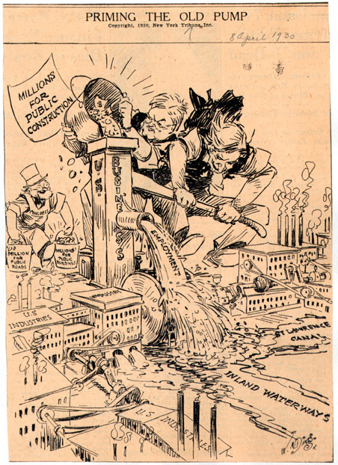
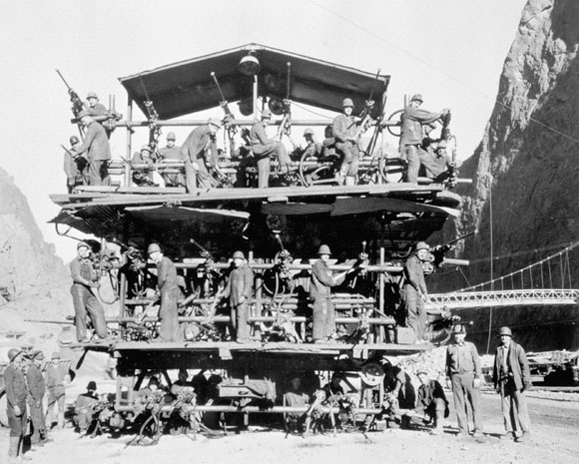
HOOVER RELIEF AND GOVERNMENT “MAKE WORK” CONSTRUCTION PROJECTS
CONSTRUCTION OF THE HOOVER DAM IN NEVADA EMPLOYED THOUSANDS WHO NEEDED JOBS

Slide 20
UNEMPLOYMENT IN MILLIONS OF WORKERS
UNEMPLOYMENT WORSENS THROUGHOUT HOOVER’S PRESIDENCY: 1929-1933
HOOVER’S SOLUTIONS TO THE GREAT DEPRESSION:
CREATED THE PRESIDENT’S COMMITTEE ON UNEMPLOYMENT RELIEF
CREATION OF THE RFC
ENCOURAGED ACTIVITIES OF COMMUNITY CHEST PRIVATE RELIEF ORGANIZATIONS
ADVOCATED CONCEPT THAT THIS DEPRESSION WOULD CURE ITSELF AS THEY ALWAYS HAD IN THE PAST

Slide 21
THE CHART SHOWS THE DROP IN NATIONAL INCOME (IN BILLIONS OF DOLLARS) AS A RESULT OF THE STOCK MARKET CRASH AND THE GREAT DEPRESSION

Slide 22
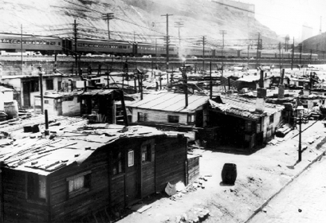
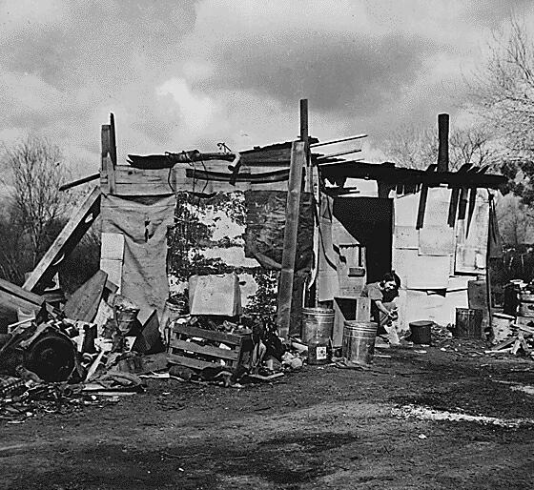
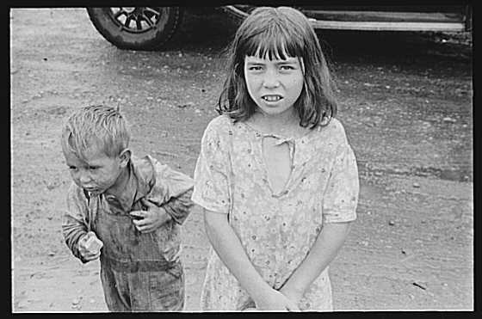
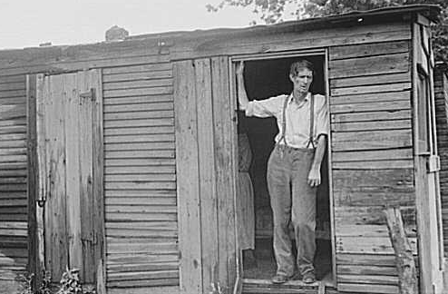
“Hoovervilles”, homeless camps

Slide 23
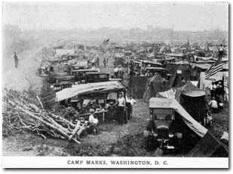
THE BONUS MARCH
MAY –JULY 1932
A GROUP OF WWI VETERANS WHO HAD BEEN DENIED EARLY BONUS PAYMENTS THEY ORGANIZED A PROTEST MARCH ON WASHINGTON IN 1932.
TWENTY THOUSAND MEN SET UP A TENT CITY, VOWING TO STAY UNTIL THEY GOT THEIR MONEY.
HOOVER SENT IN THE ARMY (LED BY FUTURE GENERALS OF THE ARMY DOUGLAS MACARTHUR AND DWIGHT D. EISENHOWER) TO BREAK UP THE PEACEFUL DEMONSTRATION.
BONUS MARCHERS SET UP CAMP IN WASHINGTON D.C.

Slide 24
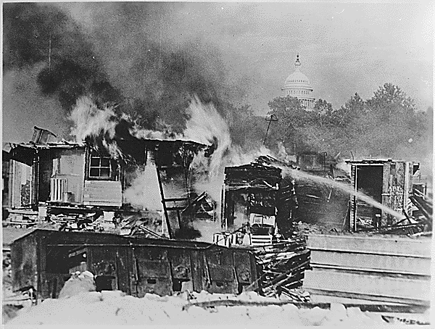
ONE VETERAN WAS KILLED, 50 PROTESTORS AND SOME POLICE OFFICERS WERE INJURED. THE MARCHERS DISPERSED. THERE WAS ANOTHER SMALLER MARCH IN THE NEXT YEAR. PRESIDENT HOOVER WAS WIDELY CRITICIZED FOR HIS HANDLING OF THE SITUATION.
SHACKS OF THE BONUS ARMY AFTER THEY WERE FORCED OUT

Slide 25
Election of 1932
Franklin Roosevelt (D) won
Promised Americans a New Deal
Very vague, but he won
Was inaugurated on March 4, 1933
Too much of a delay
Congress passed the 20th amendment
Changed inauguration to January
Begins period known as “Hundred Days”
Roosevelt starts trying to “fix” American economy

Slide 26
THE ELECTION OF 1932
POPULAR VOTE
ALMOST 57% OF THE ELECTORATE VOTED
ELECTORAL VOTES FOR EACH CANDIDATE

Slide 27
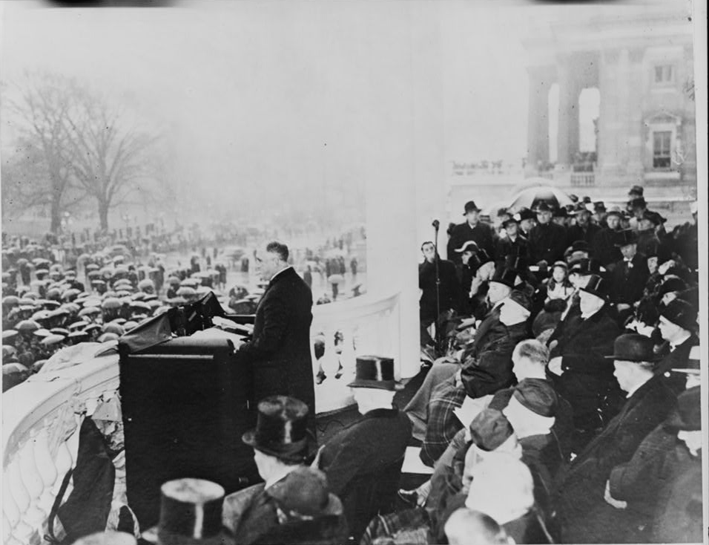
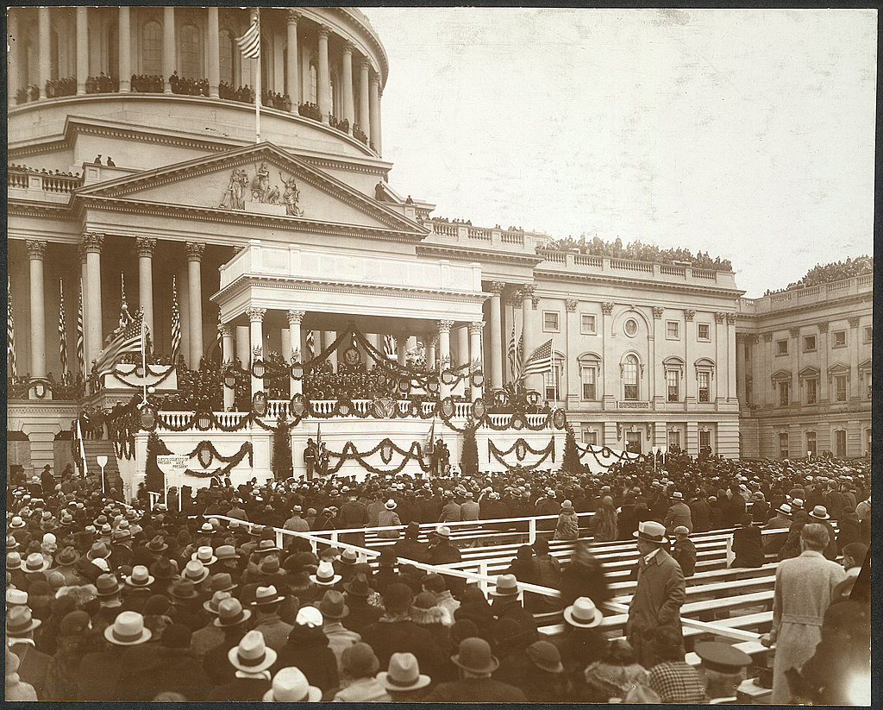
THE FDR INAUGURATION, MARCH 4, 1933
SEVERAL WEEKS BEFORE HE HAD NARROWLY ESCAPED AN ASSASSINATION ATTEMPT WHERE THE MAYOR OF CHICAGO WAS KILLED

Slide 28
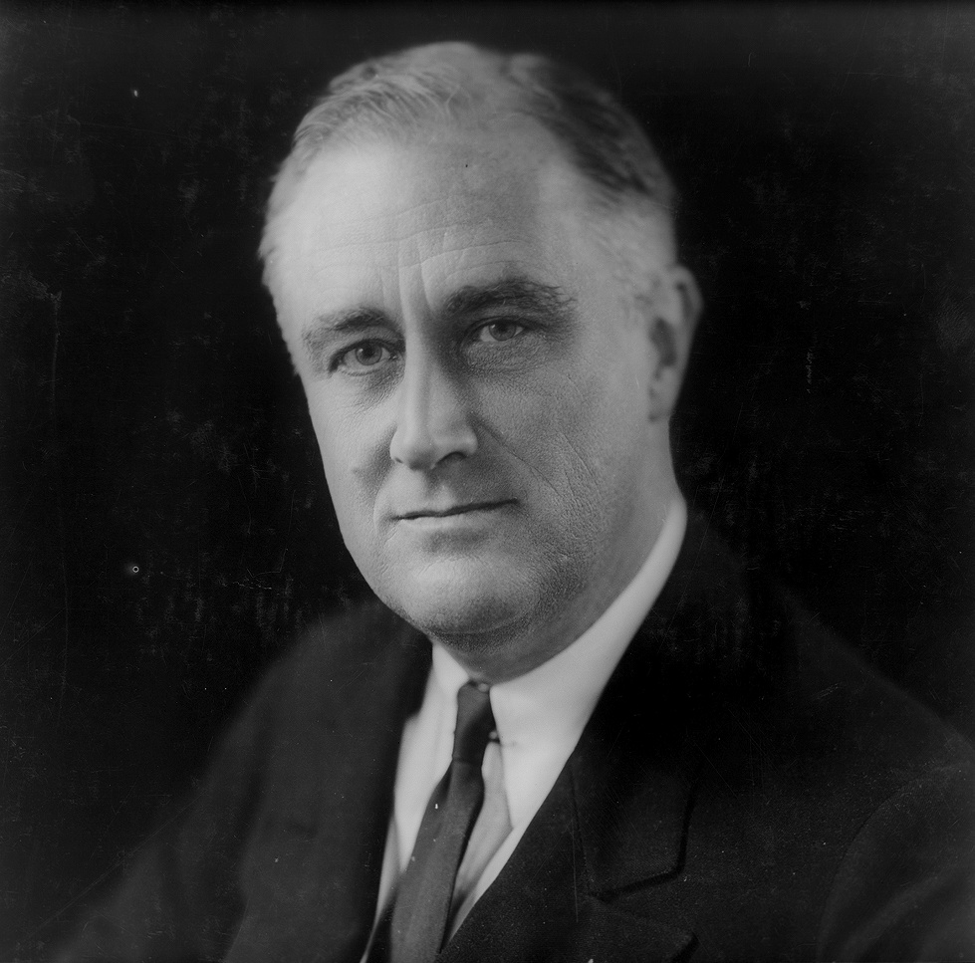
FRANKLIN DELANO ROOSEVELT BECAME THE 32ND PRESIDENT OF THE UNITED STATES
“HAPPY DAYS ARE HERE AGAIN”
FDR’S CAMPAIGN SONG: LYRICS ON NEXT PAGE

Slide 29
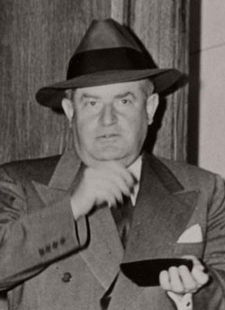
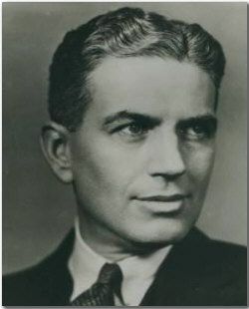
FDR’S BRAIN TRUST
HE SURROUNDED HIMSELF WITH BRILLIANT SOCIAL, ECONOMIC AND POLITICAL THINKERS AS ADVISORS TO HELP DEVELOP STRATEGIES TO PULL THE NATION OUT OF THE DEPRESSION.
BRAIN TRUST MEMBERS
-Harry Hopkins –
-Henry Morgenthau
-Louis Lowe
-Cordell Hull
-Frances Perkins –
-Sam Rosenman
-Raymond Moley
-Rexford Tugwell
TUGWELL ROSENMAN

Slide 30
FDR’S PHILOSOPHY
KEYNESIAN OR "PUMP PRIMING" ECONOMICS
JOHN MAYNARD KEYNES- DEFICIT SPENDING: THE IDEA THAT YOU HAVE TO SPEND MORE IN ORDER TO MAKE MONEY.
MONEY SHOULD BE INVESTED IN THE WORKING CLASS. S
AS SPENDING INCREASED IT WAS EXPECTED BUSINESS WOULD EXPAND TO MEET THE NEW DEMAND AND HIRE NEW WORKERS.
THIS WOULD BRING MORE GROWTH.
OPPOSITE OF THE REPUBLICAN PLAN: SUPPLY SIDE OR "TRICKLE DOWN" ECONOMICS.

Slide 31
100 DAYS MARCH 9-JUNE 13TH
FIRST HUNDRED DAYS OF HIS ADMINISTRATION ROOSEVELT AND HIS BRAIN TRUST WERE A WHIRLWIND OF ACTIVITY
LEGISLATION WAS INTRODUCED AND PASSED AT A FURIOUS PACE
HE ASKED FOR EXECUTIVE POWER TO WAGE WAR AGAINST POVERTY AND PESSIMISM.
HE WANTED A POWER "AS GREAT AS THE POWER THAT WOULD BE GIVEN ME IF WE WERE IN FACT INVADED BY A FOREIGN FOE."

Slide 32
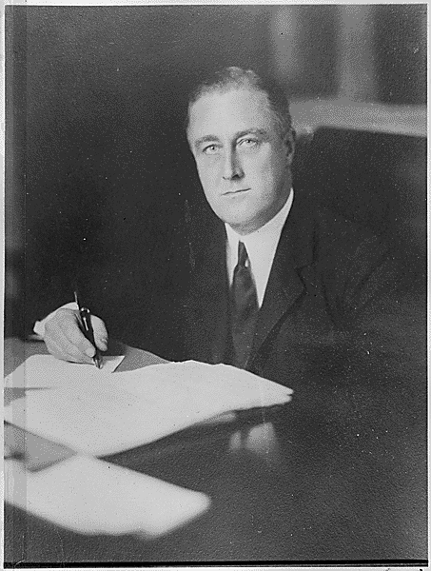
FDR’S NEW DEAL
RELIEF
REFORM
RECOVERY
MANY OF HIS PROGRAMS COMBINED ELEMENTS OF ALL THREE

Slide 33
WHAT FDR DID IN THE 100 DAYS IN 1933
MARCH 6TH “BANK HOLIDAY” FOR FOUR DAYS
MARCH 9TH EMERGENCY BANKING RELIEF ACT INTRODUCED, PASSED, SIGNED IN THE SAME DAY
FIRST “FIRESIDE CHAT”, FDR’S INFORMAL METHOD OF COMMUNICATING WITH THE AMERICAN PEOPLE USING RADIO
AAA
NRA
PWA
CCC
FERA
TVA

Slide 34
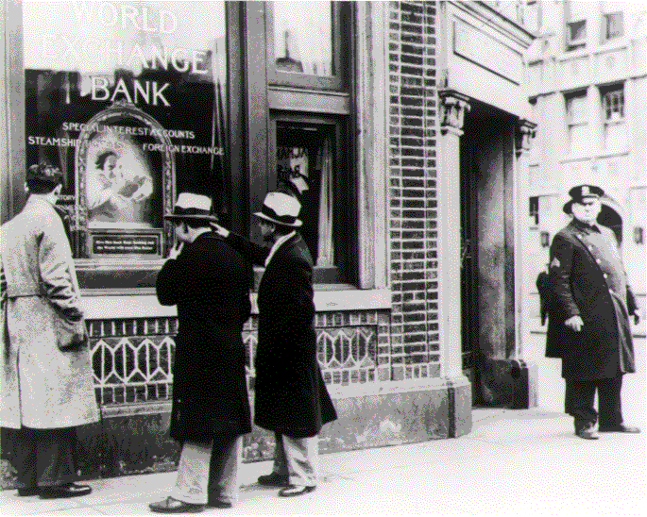
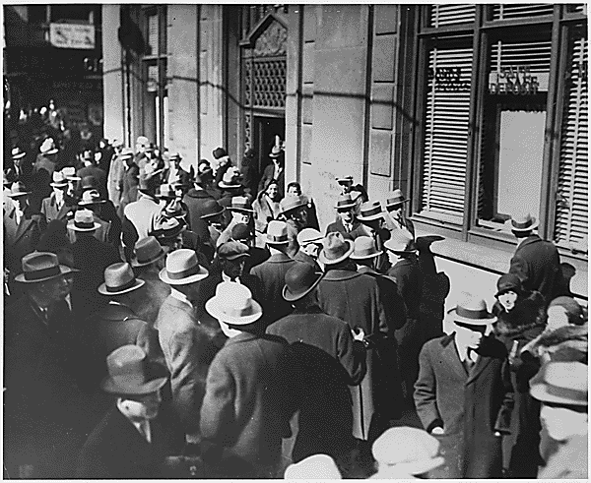
FDR CLOSED THE BANKS FOR SEVERAL DAYS, A “BANK HOLIDAY” TO AVOID PANIC. THEY OPENED A FEW DAYS LATER WHEN THE SITUATION HAD CALMED.
A BANK PANIC WAS WHEN PEOPLE CANNOT GET THEIR MONEY BECAUSE THE BANK WAS CLOSED

Slide 35
AGRICULTURAL ADJUSTMENT ACT,(AAA)
FARM CREDIT ADMINISTRATION LOANED $100 MILLION TO FARMERS IN ITS FIRST SEVEN MONTHS.
AAA PAID $100 MILLION TO PLOW UP 10 OF THE 40 MILLION ACRES PLANTED FOR THE 1933 SEASON.
WHEAT AND CORN FARMERS WERE PAID NOT TO PLANT
HOGS WERE KILLED TO RAISE PORK PRICES FOR FARMERS. THE AAA PAID FARMERS TO KILL 5 MILLION BABY PIGS AND 200,000 SOWS.
THE RESULTS OF AAA INTERVENTIONS WERE THAT BY 1936 FARM INCOME WAS UP 50%, SURPLUSES REDUCED AND PRICES ROSE.

Slide 36
NATIONAL INDUSTRIAL RECOVERY ACT (NIRA) ORGANIZED THE NATIONAL RECOVERY ADMINISTRATION (NRA)
ANTI-TRUST LAWS WERE SUSPENDED, BUSINESSES WERE ASKED TO VOLUNTARILY FOLLOW CODES TO REGULATE WAGES, HOURS, PRICES
40-HOUR WORK WEEK, 40-CENT MINIMUM WAGE
BLUE EAGLE SYMBOL OF VOLUNTARY COMPLIANCE
PROTECTED THE RIGHT OF WORKERS TO ORGANIZE AND COLLECTIVE BARGAINING
DECLARED UNCONSTITUTIONAL BY THE SUPREME COURT TWO YEARS LATER IN 1935
NRA blues

Slide 37
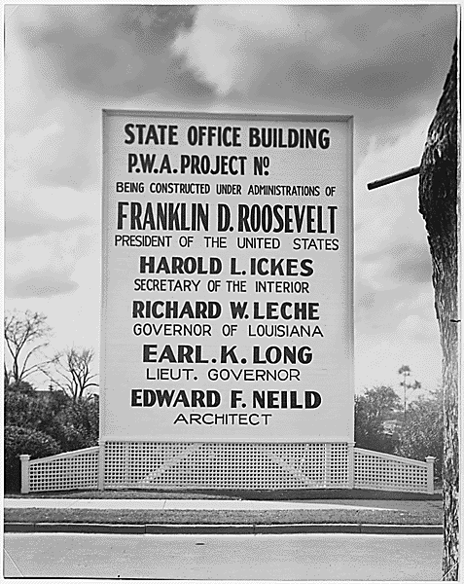
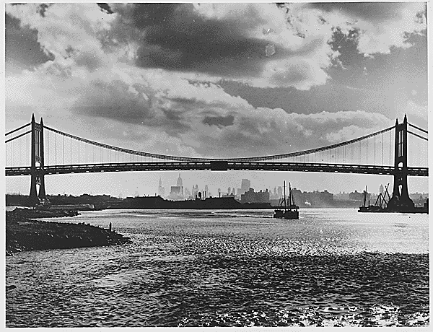
PUBLIC WORKS ADMINISTRATION (PWA)
SPENT $3.3 BILLION ON PUBLIC WORKS PROJECTS AS "PUMP-PRIMING” TO GET THE ECONOMY MOVING

Slide 38
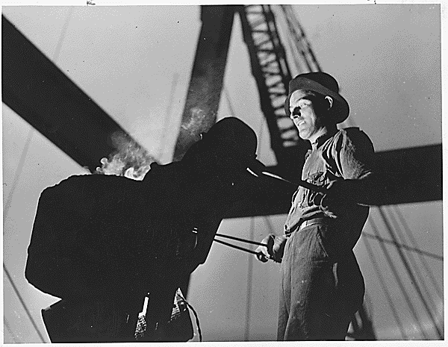
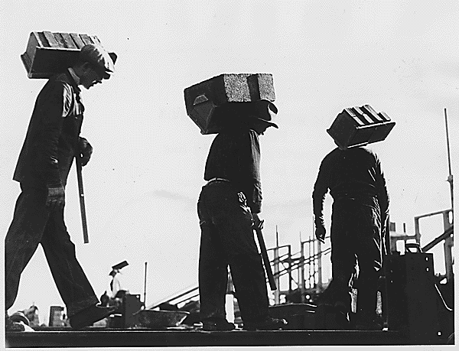
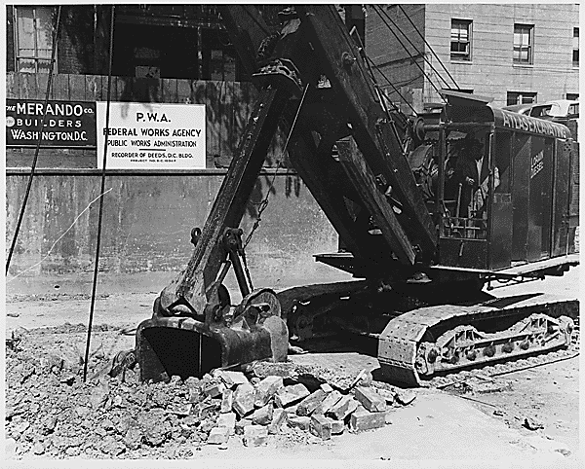
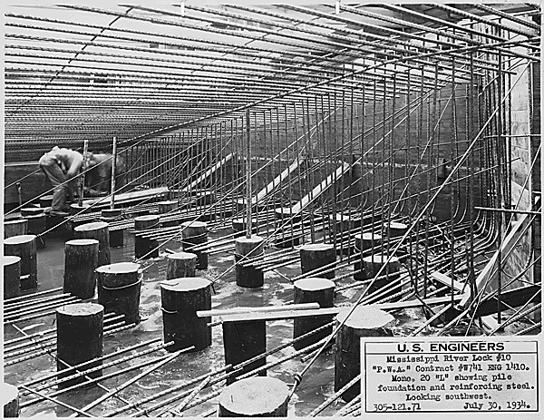
PWA GAVE CONSTRUCTION JOBS TO THE UNEMPLOYED

Slide 39
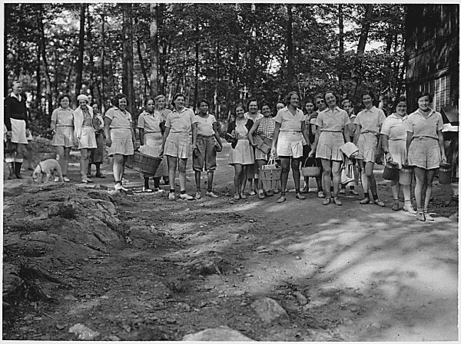
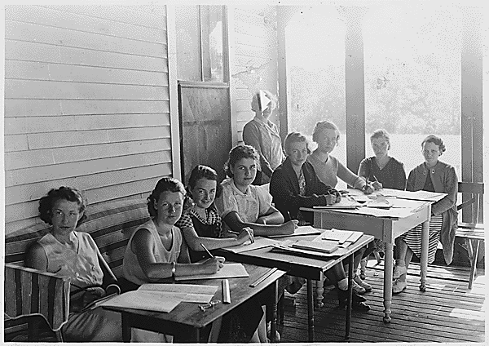
FEDERAL EMERGENCY RELIEF ADMINISTRATION (FERA)
THIS GAVE EMERGENCY CHECKS DIRECTLY TO UNEMPLOYED PERSONS TO SURVIVE THE WINTER. IT GAVE MATCHING GRANTS TO STATES TO BOLSTER LOCAL RELIEF EFFORTS AND IT SET UP CAMPS FOR UNEMPLOYED WOMEN.
UNEMPLOYED WOMEN'S CAMP
CAMPS FOR UNEMPLOYED WOMEN IN MAINE

Slide 40
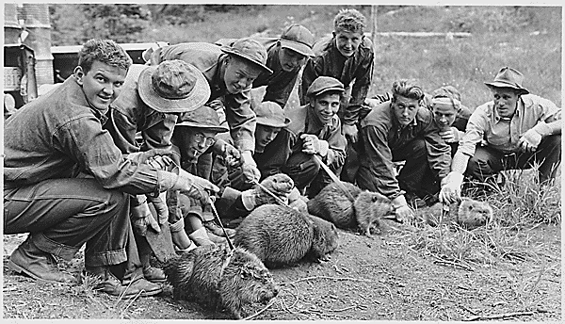
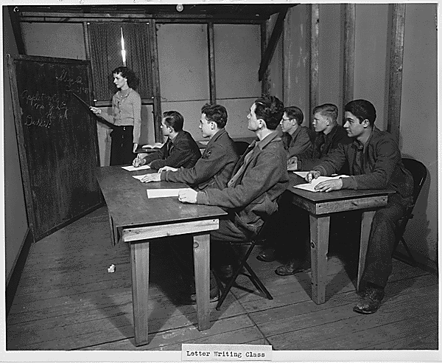
CIVILIAN CONSERVATION CORPS (CCC)
CREATED JOBS IN A SEMI-MILITARY MANNER FOR YOUTH 18-25 FROM FAMILIES RECEIVING RELIEF. OVER 2 MILLION YOUNG PEOPLE WERE ENROLLED BY 1941. THEY WERE PAID $30 A MONTH WITH A PORTION BEING SENT TO THEIR FAMILIES.

Slide 41
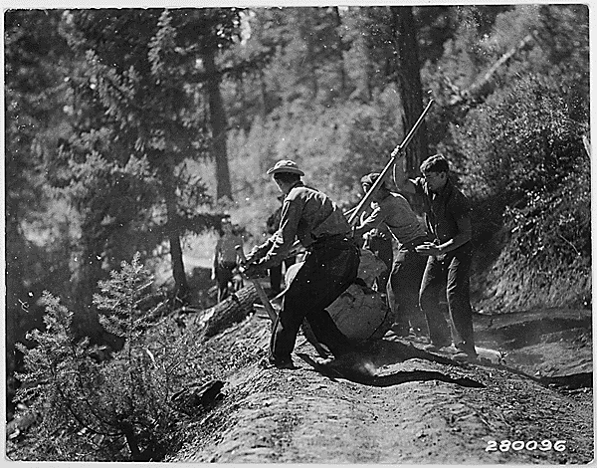
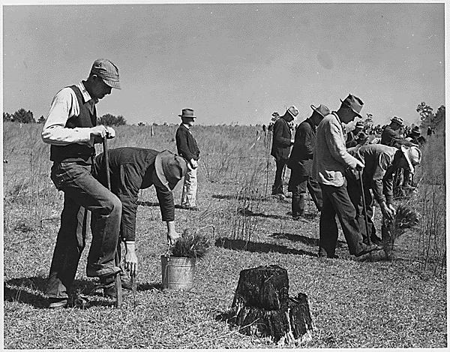
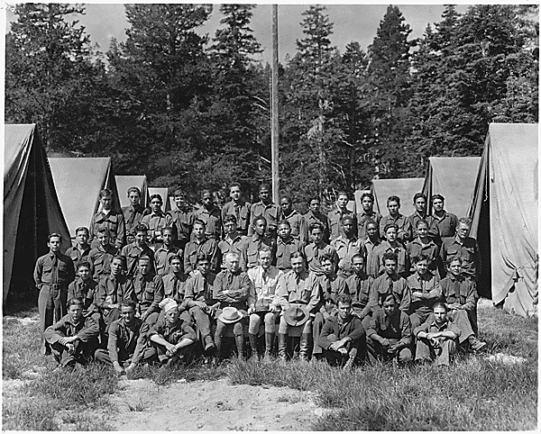
THE CCC HELPED MILLIONS OF YOUNG MEN THROUGHOUT THE DEPRESSION AS WELL AS HELPING THE ENVIRONMENT

Slide 42
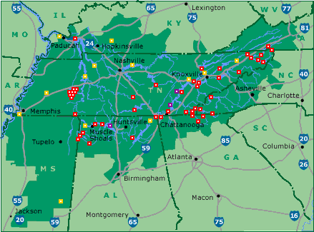
TENNESSEE VALLEY AUTHORITY (TVA)
TVA TODAY

Slide 43
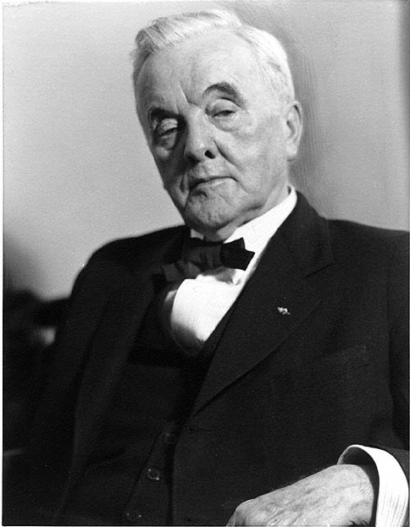
THE TVA WAS A GREAT SUCCESS
BRINGING CHEAP ELECTRIC POWER
CONTROLLING FLOODS
REPLANTING FORESTS
THE TVA IS STILL THE NUMBER ONE PRODUCER OF ELECTRICITY IN THE U.S.

Slide 44
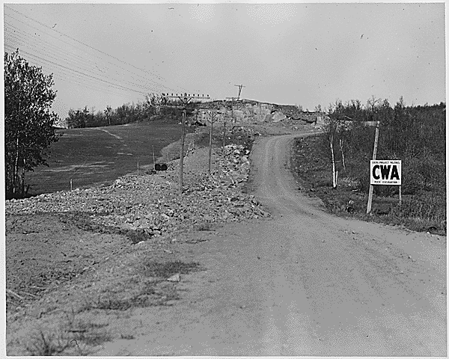
CIVIL WORKS ADMINISTRATION (CWA)
THE CWA WAS SET UP TO PUT 4,000,000 MEN AND WOMEN TO WORK AS SOON AS POSSIBLE. FOUR HUNDRED MILLION DOLLARS OF PUBLIC WORKS FUNDS WERE PROVIDED. HALF OF THE PEOPLE EMPLOYED BY THE CWA CAME FROM THE RELIEF ROLLS AND THE OTHER HALF WERE UNEMPLOYED PERSONS. A CWA PROJECT HAD TO DIRECTLY OR INDIRECTLY CONTRIBUTE TO THE CONSTRUCTION OF SOMETHING. THE CWA WAS CRITICIZED FOR “BOONDOGGLES” (WASTEFUL OR IMPRACTICAL PROJECT OR ACTIVITY OFTEN INVOLVING GRAFT). IT WAS ABANDONED IN 1934.

Slide 45
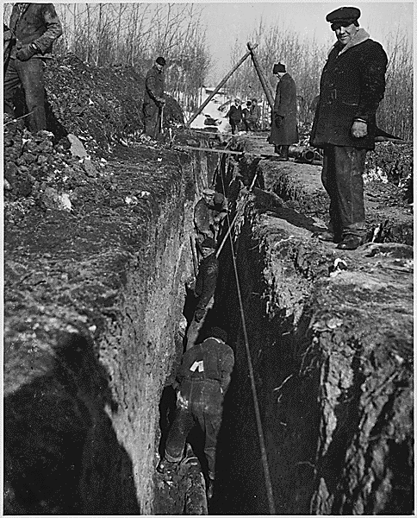
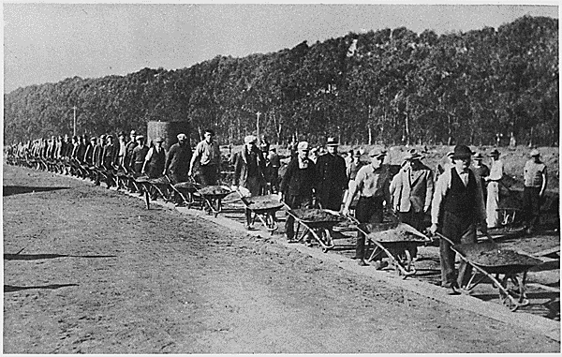
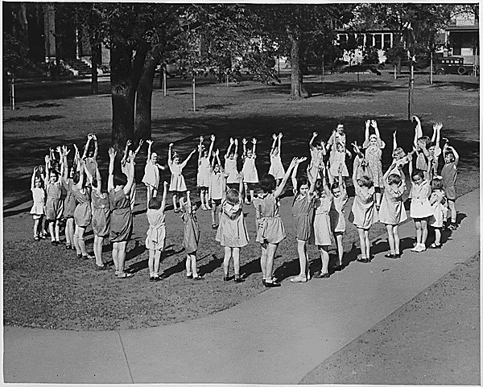
CWA JOBS VARIED, FROM DIGGING NEW SEWER SYSTEMS TO LEADING EXERCISE SESSIONS FOR SCHOOL CHILDREN

Slide 46
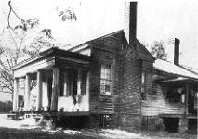
HOME OWNERS LOAN CORPORATION (HOLC) 1933-1936
BY THE EARLY 1930’S, HOMEOWNERS WERE LOSING THEIR HOMES DUE TO FORECLOSURES AT THE RATE OF 1,000 A DAY.
CONGRESS ESTABLISHED THE HOLC IN JUNE OF 1933, WITH THE INTENT OF HELPING HOMEOWNERS IN DANGER OF LOSING THEIR HOMES
HOLC BOUGHT UP MORTGAGES FROM BANKS AND REFINANCED THEM AT RATES THAT ALLOWED HOMEOWNERS TO MAKE LOWER PAYMENTS AND KEEP THEIR HOMES.
HOLC SAVED 20% OF HOMEOWNERS FROM LOSING THEIR HOMES DURING THE DEPRESSION

Slide 47
BANKING AND STOCK MARKET REGULATIONS
GLASS-STEAGALL BANKING ACT: JUNE 1933, MADE IT ILLEGAL FOR BANKS TO SPECULATE IN THE STOCK MARKET WITH DEPOSITORS FUNDS. IT SET UP THE FDIC.
FDIC: FEDERAL DEPOSIT INSURANCE CORPORATION GUARANTEED INDIVIDUAL DEPOSITS. THIS STABILIZED THE BANKING SYSTEM AND PEOPLE BEGAN PUTTING THEIR MONEY IN BANKS AGAIN.
THE SECURITIES ACT: PASSED IN 1933, AND THE SECURITIES AND EXCHANGE COMMISSION (SEC) PASSED IN 1934 IMPLEMENTED CHANGES THAT CURBED ABUSES IN THE STOCK MARKET.
FDR BROKE THE BOND BETWEEN PAPER MONEY AND GOLD. THE GOVERNMENT WAS NOW FREE TO PRINT ADDITIONAL DOLLARS AND ENCOURAGE INFLATION SO MANUFACTURES COULD GET MORE DOLLARS FOR THEIR PRODUCTS.

Slide 48
THE NEW DEAL COMES UNDER ATTACK FROM BOTH THE LEFT AND RIGHT
“IT SEEMS CLEAR THE HONEYMOON IS OVER” (HARLAN STONE, SUPREME COURT JUSTICE COMMENTING ON THE GROWING OPPOSITION TO THE NEW DEAL)
LEFT RIGHT
LIBERAL CONSERVATIVE
THOSE WHO WANTED THE GOVERNMENT TO DO MORE TO END THE DEPRESSION BY INTERVENING IN THE ECONOMY
THOSE WHO WANTED THE GOVERNMENT TO STAY OUT OF THE ECONOMY AND LET THE DEPRESSION CURE ITSELF
POLITICAL SPECTRUM

Slide 49
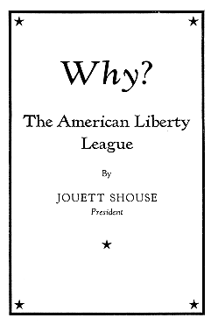
CRITICS FROM THE RIGHT
THESE GROUPS FEARED FDR WAS TAKING THE U.S. DOWN THE ROAD TO SOCIALISM
AMERICAN LIBERTY LEAGUE
IN AUGUST OF 1934, OPPONENTS OF FDR'S NEW DEAL ORGANIZED THE "AMERICAN LIBERTY LEAGUE." THE LEAGUE STATED THAT IT WOULD WORK TO "DEFEND AND UPHOLD THE CONSTITUTION" AND TO "FOSTER THE RIGHT TO WORK, EARN, SAVE AND ACQUIRE PROPERTY."

Slide 50
THE LEFT WING CRITICS
THEY WERE A MORE DIVERSE AND COLORFUL GROUP WITH NON-TRADITIONAL PLANS FOR ENDING THE DEPRESSION
HUEY LONG
FATHER CHARLES COUGHLIN
FRANCIS E. TOWNSEND
UPTON SINCLAIR

Slide 51
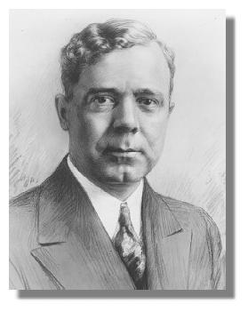
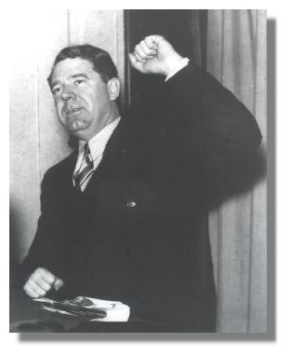
HUEY LONG
“EVERY MAN A KING”
HUEY WAS GOVERNOR AND LATER A SENATOR FROM LOUISIANA. AS GOVERNOR HE INTRODUCED MANY REFORMS BUT WAS ACCUSED OF ACTING LIKE A DICTATOR.

Slide 52
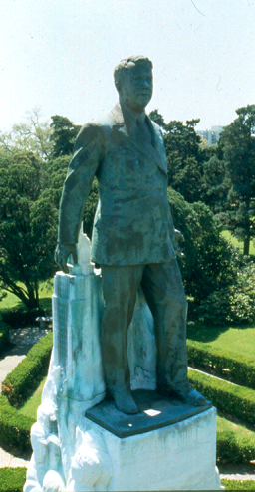
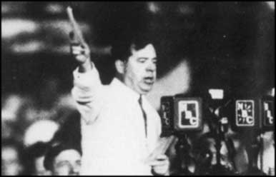
HUEY LONG’S SHARE OUR WEALTH PROGRAM
HE WANTED THE FEDERAL GOVERNMENT TO CONFISCATE ALL INCOMES OVER ONE MILLION DOLLARS ($13 MILLION IN 2002 DOLLARS) AND USE THE MONEY TO GIVE EACH FAMILY A HOME AND AN INCOME OF $2000 ($26,000 IN 2002 DOLLARS) A YEAR.
HIS PROGRAM WAS EXTREMELY POPULAR AND HE DECLARED HIMSELF A CANDIDATE FOR PRESIDENT FOR THE 1936 ELECTION. HE WAS MURDERED IN SEPTEMBER OF 1935 AND HIS MOVEMENT COLLAPSED.
Huey’s barbeque speech

Slide 53
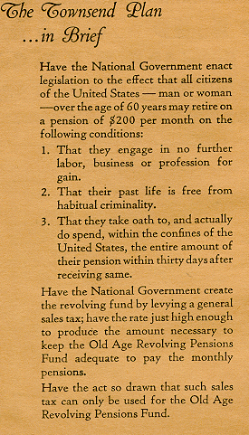
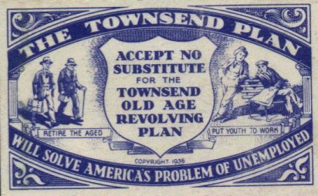
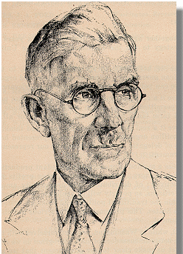
FRANCIS E. TOWNSEND, A DOCTOR IN HIS 60’S CAME UP WITH THE TOWNSEND PLAN WHICH WOULD GIVE EVERYONE OVER 60 $200 ($2523 IN 2002 DOLLARS) A MONTH TO SPEND IN 30 DAYS.

Slide 54
FATHER CHARLES COUGHLIN
“THE RADIO PRIEST”
"The great betrayer and liar, Franklin D. Roosevelt, who promised to drive the money changers from the temple, had succeeded [only] in driving the farmers from their homesteads and the citizens from their homes in the cities. . . I ask you to purge the man who claims to be a Democrat, from the Democratic Party, and I mean Franklin Double-Crossing Roosevelt."
POPULAR CATHOLIC PRIEST WHO HAD A LARGE RADIO AUDIENCE. HE WAS AN EARLY SUPPORTER OF FDR BUT CHANGED AND BECAME A BITTER CRITIC. HE WAS BOTH AN ANTI- SEMITE AND ANTI-CAPITALIST
Notes:
ANTI CAPITALIST MEANT HE WAS AGAINST THE FUNDAMENTAL U.S. ECONOMIC SYSTEM OF PRIVATE OWNERSHIP OF THE MEANS OF PRODUCTION

Slide 55
UPTON SINCLAIR AND THE EPIC MOVEMENT IN CALIFORNIA
SOCIALIST UPTON SINCLAIR, AUTHOR OF THE JUNGLE, RAN FOR GOVERNOR OF CALIFORNIA IN 1934 AS A DEMOCRAT. HIS EPIC (END POVERTY IN CALIFORNIA) ENVISIONED THE STATE BUYING UP CLOSED FACTORIES AND UNUSED LAND AND PUTTING UNEMPLOYED CALIFORNIANS TO WORK MAKING GOODS AND GROWING FOOD. HE WAS SOUNDLY DEFEATED IN THE ELECTION AND HIS EPIC PROGRAM DIED SOON AFTER.
ANTI- SINCLAIR AD FROM THE 1934 ELECTION

Slide 56
SECOND NEW DEAL PROGRAMS, 1934-1936
IN THE 1934 CONGRESSIONAL ELECTIONS, DEMOCRATS INCREASED THEIR MAJORITIES IN BOTH THE HOUSE AND SENATE (THEY GAINED 9 SEATS IN BOTH). FDR AND THE NATION SAW THIS AS PROOF THE AMERICAN PEOPLE BACKED NEW DEAL REFORMS. THIS ENCOURAGED FDR AND HIS “NEW DEALERS” TO PROPOSE EVEN MORE LEGISLATION TO END THE DEPRESSION AND RETURN THE U.S. TO PROSPERITY. TAXES ON THE WEALTHY WERE ALSO INCREASED.
FHA: FEDERAL HOUSING AUTHORITY
WPA: WORKS PROGRESS ADMINISTRATION
NATIONAL YOUTH ADMINISTRATION
SOCIAL SECURITY
FARM PROGRAMS: RESETTLEMENT ADMINISTRATION, FARM SECURITY ADMINISTRATION
RURAL ELECTRIFICATION ADMINISTRATION
WAGNER ACT: LABOR UNIONS
THE REVENUE ACT OF 1935
Notes:
THE DEMOCRATS HAD GAINED 90 SEATS IN THE HOUSE AND 13 IN THE SENATE IN THE 1932 ELECTION

Slide 57
FEDERAL HOUSING ADMINISTRATION (FHA), 1934
THE GOAL OF THE FHA WAS TO IMPROVE HOUSING AND PUT AS MANY AMERICANS INTO THEIR OWN HOMES AS POSSIBLE. IT DID THIS BY ENCOURAGING BANKS TO MAKE LOANS AND FAMILIES TO APPLY FOR THEM. IT ALSO CREATED FHA GUARANTEED MORTGAGE LOANS SO IF THE HOMEOWNER DEFAULTED ON THE LOAN FHA WOULD PAY THE BANK THE BALANCE. THIS ENCOURAGED BANKS TO MAKE MORE LOANS.
Notes:
TODAY THE FHA IS PART OF HUD

Slide 58
WORKS PROGRESS ADMINISTRATION (WPA), 1935
THE CWA WAS ENDED IN MARCH OF 1934, WHEN FDR WORRIED IT WAS COSTING TOO MUCH MONEY AND MIGHT CREATE A PERMANENT DEPENDENT CLASS. WHEN THE DEPRESSION CONTINUED TO WORSEN AND WITH INCREASED CONGRESSIONAL SUPPORT HE CREATED THE WPA. IT EMPLOYED 3.5 MILLION WORKERS AT WAGES BELOW PREVAILING UNION SCALES. FDR’S LONGTIME FRIEND HARRY HOPKINS WAS PUT IN CHARGE AND UNDER HIS LEADERSHIP OVER $11 BILLION WAS INJECTED INTO THE U.S. ECONOMY BY 1943.
HARRY HOPKINS
Notes:
HARRY HOPKINS ALSO HAD BEEN IN CHARGE OF THE CWA

Slide 59
SOCIAL SECURITY ACT 1935
A SYSTEM OF OLD AGE PENSIONS HAD BEEN ONE OF THE GOALS OF THE PROGRESSIVE MOVEMENT. FDR MADE THIS GOAL A REALITY WITH THE PASSAGE OF THE SOCIAL SECURITY ACT IN 1935. THE ACT CONTAINED SEVERAL PROVISIONS:
UNEMPLOYMENT COMPENSATION FOR LAID OFF WORKERS
COMPENSATION TO DISABLED WORKERS
PAYMENTS TO THE WIVES AND CHILDREN OF DECEASED WORKERS
OLD AGE INSURANCE, OFTEN CONSIDERED THE MOST IMPORTANT FEATURE OF THE ACT

Slide 60
FRANCIS PERKINS WAS IMPORTANT IN THE CREATION OF THE SOCIAL SECURITY ACT
IN 1933, FDR APPOINTED MS. PERKINS AS HIS SECRETARY OF LABOR, A POSITION SHE HELD FOR 12 YEARS, LONGER THAN ANY OTHER SECRETARY OF LABOR, MAKING HER THE FIRST WOMAN TO HOLD A CABINET POSITION IN THE UNITED STATES.

Slide 61
FDR AND UNIONS
FDR WAS A STRONG SUPPORTER OF UNIONS AND THE RIGHT OF WORKING PEOPLE TO ORGANIZE
THE NATIONAL INDUSTRIAL RECOVERY ACT CONTAINED A PROVISION WHICH GUARANTEED WORKERS THE RIGHT TO ORGANIZE UNIONS AND BARGAIN COLLECTIVELY.
UNION MEMBERSHIP JUMPED FROM 2.8 MILLION IN 1933 TO 3.7 MILLION 1934.
DESPITE THE LAW MANY EMPLOYERS IGNORED IT AND REFUSED TO BARGAIN WITH UNIONS.
IN 1935, CONGRESS PASSED THE NATIONAL LABOR RELATIONS ACT ALSO KNOWN AS THE WAGNER ACT WHICH GAVE ENFORCEMENT POWERS TO THE NLRB.
WITH GOVERNMENT ACTING AS A MEDIATOR UNION MEMBERSHIP JUMPED TO 11 MILLION BY 1941.

Slide 62
GROWTH IN UNION MEMBERSHIP UNDER FDR

Slide 63
ELECTION OF 1936

Slide 64
FDR AND THE SUPREME COURT: 1937
“COURT PACKING SCHEME”
THE SUPREME COURT HAD DECLARED FIVE NEW DEAL PROGRAMS UNCONSTITUTIONAL IN 1935.
IN 1936,THE COURT STRUCK DOWN FOUR OTHER NEW DEAL INITIATIVES.
FDR BEGAN TO SEE THE SUPREME COURT AS AN ENEMY OF THE NEW DEAL AND HIS ATTEMPTS TO END THE DEPRESSION.
TO COUNTER THE SUPREME COURT'S NEGATIVE RULINGS HE PROPOSED WHAT BECAME KNOWN AS THE “COURT PACKING SCHEME” WHICH WAS A PLAN TO INCREASE THE NUMBER OF FRIENDLY JUSTICES ON THE SUPREME COURT.
THE POLITICAL CARTOONS ON THE FOLLOWING SLIDES TRACE THE EVOLUTION OF FDR’S STRUGGLE TO BRING THE COURT UNDER WHAT SOME CALLED HIS CONTROL.

Slide 65
RECESSION IN THE FALL OF 1937
FDR WAS WEAKENED POLITICALLY BY THE FIGHT OVER THE SUPREME COURT AND FOUND IT HARDER TO DEAL WITH CONGRESS
THERE WAS STILL HIGH UNEMPLOYMENT AND MILLIONS WERE STILL SURVIVING ON GOVERNMENT RELIEF PAYMENTS
HUGE BUDGET DEFICITS WERE PILING UP
IN JUNE OF 1937, CONCERNED OVER THE DEFICITS, FDR HAD CONGRESS CUT SPENDING FOR GOVERNMENT ANTI- DEPRESSION MEASURES INCLUDING PUBLIC EMPLOYMENT TO SUCCESSFULLY BALANCE THE BUDGET
THE RESULT WAS A SEVERE RECESSION WITH THE STOCK MARKET CRASHING AND 10 MILLION WORKERS LOSING THEIR JOBS
FDR WAS FORCED TO QUICKLY POUR MONEY INTO PROGRAMS SUCH AS CCC AND WPA TO ALLEVIATE THE RECESSION

Slide 66
DROUGHT STRIKES

Slide 67
Year | Jan | Feb | Mar | Apr | May | Jun | Jul | Aug | Sep | Oct | Nov | Dec | Ann
1930 | 5.51 | 3.81 | 1.48 | 1.12 | 3.49 | 1.38 | 2.65 | 2.09 | 1.41 | 1.87 | 2.99 | 2.70 | 30.50
1931 | 2.11 | 3.82 | 4.30 | 3.85 | 1.14 | 3.68 | 1.59 | 6.23 | 2.35 | 2.03 | 4.30 | 7.94 | 43.34
Avg. 1900- 1929 | 4.78 | 3.50 | 5.00 | 4.32 | 4.34 | 4.10 | 4.01 | 3.64 | 3.52 | 3.28 | 3.75 | 4.94 | 48.42
Year | Jan | Feb | Mar | Apr | May | Jun | Jul | Aug | Sep | Oct | Nov | Dec | Ann
1930 | 5.51 | 3.81 | 1.48 | 1.12 | 3.49 | 1.38 | 2.65 | 2.09 | 1.41 | 1.87 | 2.99 | 2.70 | 30.50
1931 | 2.11 | 3.82 | 4.30 | 3.85 | 1.14 | 3.68 | 1.59 | 6.23 | 2.35 | 2.03 | 4.30 | 7.94 | 43.34
Avg. 1900- 1929 | 4.78 | 3.50 | 5.00 | 4.32 | 4.34 | 4.10 | 4.01 | 3.64 | 3.52 | 3.28 | 3.75 | 4.94 | 48.42

Slide 68
DUST BOWL
THE DUST BOWL REFERS TO THE AREA WHICH WAS DEVASTATED FIRST BY DROUGHT THEN BY WIND
CAUSED BY:
POOR FARMING PRACTICES
OVERGRAZING THAT DESTROYED DEEP ROOTED NATURAL GRASSES.
STRONG WINDS BLEW CROPS AWAY IN CLOUDS OF “DUST”.

Slide 69
WHERE DID THE DUSTBOWL TAKE PLACE ?

Slide 72
HOW DID IT AFFECT THE FARMERS IN THE REGION?
MANY FARMERS DECIDED TO PACK UP AND LEAVE TO CALIFORNIA HOPING FOR A NEW START.
SO MANY OF THE MIGRANTS WERE FROM OKLAHOMA THEY SOON BECAME KNOWN AS “OKIES”.
MANY OF THE MIGRANTS ENDED UP LIVING IN MIGRANT/REFUGEE CAMPS.

Slide 76
LYNCHING, WHICH HAD BEEN ON THE DECLINE, BEGAN TO INCREASE ALONG WITH ALL OTHER FORMS OF RACISM
“COLORED ADMISSION 10¢
LETTER BY ELEANOR ROOSEVELT ON LYNCHING

Slide 77
WOMEN IN THE GREAT DEPRESSION
THE MOST INFLUENTIAL WOMAN DURING THE GREAT DEPRESSION WAS ELEANOR ROOSEVELT, THE PRESIDENT’S WIFE. SHE WAS A TIRELESS WORKER FOR LIBERAL CAUSES CHAMPIONING THE RIGHTS OF POOR AND MINORITIES.

Slide 78
THE END OF THE NEW DEAL
THE LAST MAJOR PIECE OF NEW DEAL LEGISLATION FDR WAS ABLE TO GET PASSED WAS THE FAIR LABOR STANDARDS ACT IN JUNE OF 1938. IT SET UP STANDARDS AND GUIDELINES FOR MINIMUM WAGES AND MAXIMUM WORKING HOURS. THE WORKING WEEK WAS SET AT 40 HOURS, A MINIMUM HOURLY WAGE WAS IMPOSED (40 CENTS AN HOUR) AND CHILD LABOR WAS BANNED IN INTERSTATE COMMERCE.
FOREIGN AFFAIRS AND THE THREAT OF WAR OVERSHADOWED DOMESTIC ECONOMIC PROBLEMS. THE NEED TO PREPARE FOR WAR AND SUPPORT OUR ALLIES BROUGHT FULL EMPLOYMENT AS FACTORIES RUSHED TO MEET THE NEEDS OF THE MILITARY.

Slide 79
LEGACY OF THE NEW DEAL: HOW DID IT CHANGE AMERICA?
INCREASE IN THE POWER OF THE FEDERAL GOVERNMENT
INCREASE OF THE ROLE THE FEDERAL GOVERNMENT PLAYS IN THE LIFE OF THE PEOPLE
GROWTH OF EXECUTIVE POWER
THE USE OF DEFICIT SPENDING AS A TECHNIQUE FOR MAINTAINING THE ECONOMIC HEALTH OF THE NATION
CREATION OF A WELFARE STATE AND THE ACCEPTANCE THAT THE FEDERAL GOVERNMENT SHOULD TAKE RESPONSIBILITY FOR THE WELFARE OF THE PEOPLE
THE RIGHT OF WORKING PEOPLE TO ORGANIZE UNIONS TO ADVANCE THEIR ECONOMIC INTERESTS
RENEWED INTEREST IN PRESERVING AND PROTECTING THE ENVIRONMENT
MAJOR CONSTRUCTION AND INSTITUTIONS ARE STILL WITH US TODAY
SHOWED DEMOCRACY IS CAPABLE OF RESPONDING TO MAJOR DISRUPTIONS AND HAS THE TOOLS TO REFORM ITSELF

