Slide 1
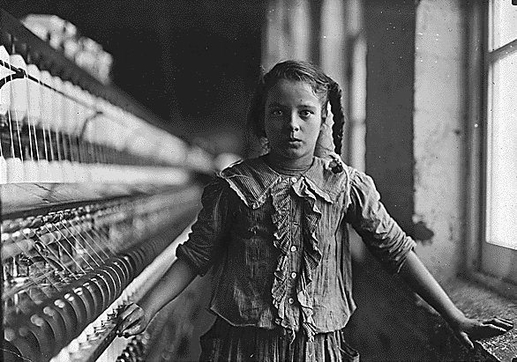
Goal Five: Industrial Revolution

Slide 2
4 big industrialists
The 4 wealthiest people in America at this time are:
John D. Rockefeller: Oil Industry
Andrew Carnegie: Steel Industry
Cornelius Vanderbilt: Railroad Industry
JP Morgan: Financial Industry

Slide 3
Ways People Got Rich
Gained monopolies
Natural
Horizontal Consolidation: when you buy up companies that are like yours (Rockefeller)
Vertical Consolidation: when you buy up companies that go into the production of your product (Carnegie)
Trust (Informal monopoly)- when someone controls a business but doesn’t own them (Rockefeller)
Incorporated new technology
INDUSTRIAL REVOLUTION!!!

Slide 4
Growth in Technology
1790-1860: U.S. Patent Office issued: 36,000 patents (a patent is a temporary monopoly on a new technology- measuring the amount of patents issued allows us to measure a growth in new technology)
That equals: 514 patents a year
1860-1890: U.S. Patent Office issued: 500,000 patents
That equals: 16,667 patents a year
45.6 patents a day

Slide 5
Technology Landmarks
OIL
1858: Edwin Drake is sent by: Pennsylvania Rock Oil Company to attempt to drill and pump oil out of the ground.
Before- they had to dig a hole and wait or use whale oil
Successful in 1859: which makes oil the new energy source

Slide 6
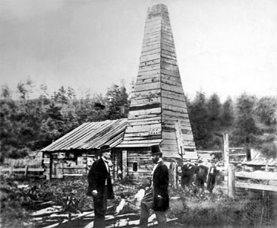

Slide 7
Technology Landmarks
ELECTRICITY
1878: Thomas Edison- aka: the “Wizard of Menlo Park”
Establishes his: invention factory in Menlo Park, NJ
Main goal: is to create affordable, in home lighting
Found a: long burning filament which made a light bulb possible
His electricity is: based on direct current (must be directly connected to an energy source
1883: New York City becomes the first city to have lights at night in the WORLD!!!!
1890: power stations are set up all across the U.S. to facilitate lighting

Slide 8
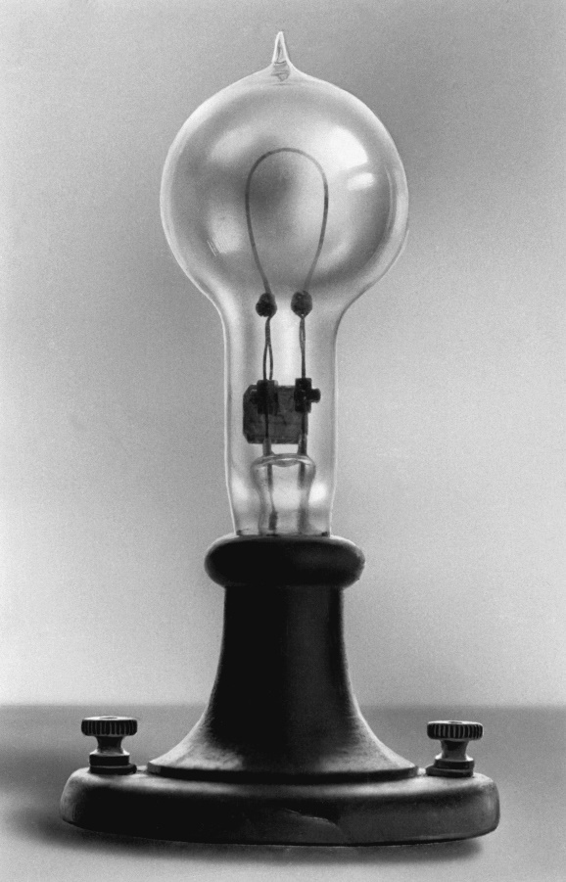
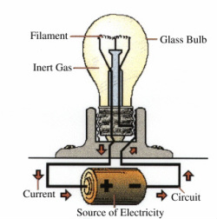
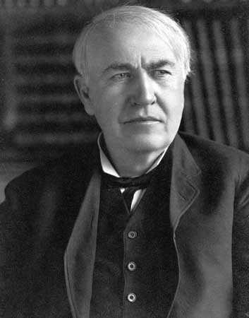

Slide 9
Technology Landmarks
Lewis Latimer: creates an even longer-lasting filament, which means a longer lasting bulb
George Westinghouse: bases his lighting on alternating current instead of direct current
It’s cheaper
It allows electricity to travel further distances
COMMUNICATION
Samuel Morse: patents the first telegraph and develops Morse code to use with it

Slide 10
Technology Landmarks
Alexander Graham Bell: invents the telephone
1878: Finances: a test run of 21 phones in Connecticut
1879: 1st telephone: installed in the White House
1900: 1.5 million: phones in the U.S. are in use- also 69 million telegraph messages are sent that year
Shows: technology overlaps
Just because a new technology is created, doesn’t mean everyone gets rid of the old (think DVDs and Blu-rays)

Slide 12
Technology Landmarks
STEEL
Bessemer Process
Henry Bessemer: develops a faster and cheaper way to make steel
First to use this process is Andrew Carnegie
Makes: the mass production of steel possible
Led to: a new age of building that is now possible with steel- including things like the Brooklyn Bridge

Slide 13
Technology Landmarks
Invention | Inventor | What was it used for?
Light Bulb | Thomas Edison | Factories and homes to have light at night
Telegraph | Samuel Morse | Communication
Telephone | Alexander Graham Bell | Communication
Bessemer Process | Henry Bessemer | Made steel fast and cheaply
Mechanical Reaper | Cyrus McCormick | Gather crops quickly
Steel Plow | John Deere | Dig troughs for planting seeds

Slide 14
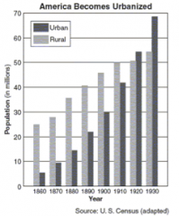

Slide 15
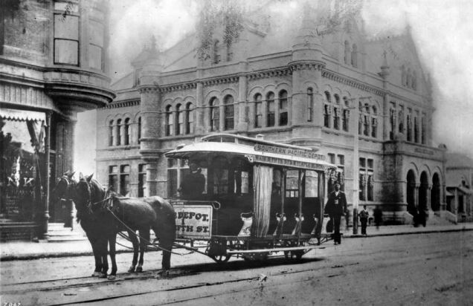
Changes in the Cities
Transportation
Problems???

Slide 16
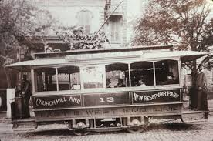
Trolley

Slide 17
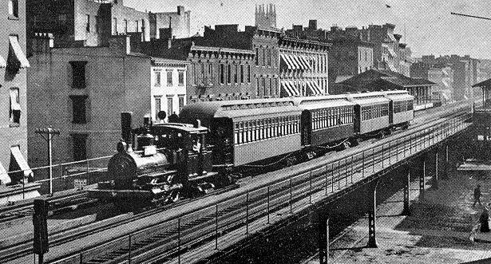
Elevated Trains

Slide 18
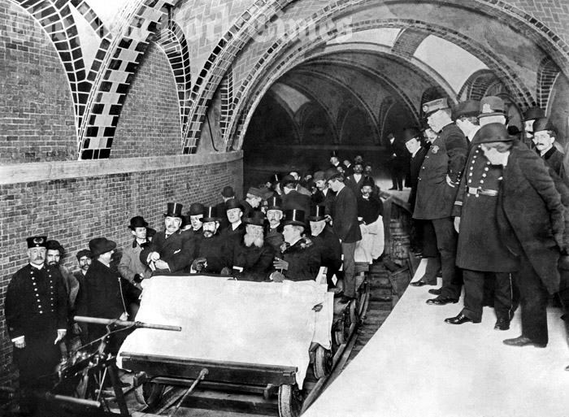
Subway

Slide 19
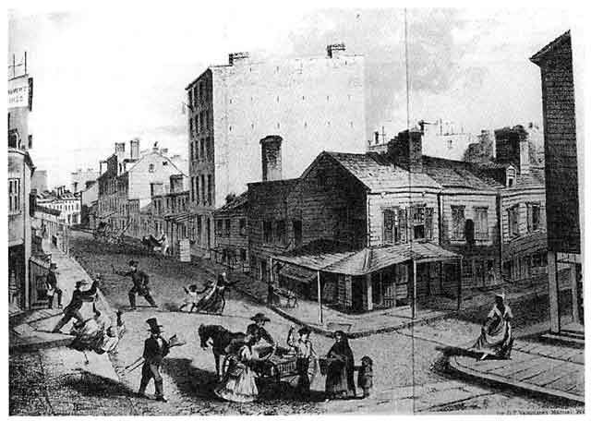
Changes in the Cities
Industry
NYC: 1860

Slide 20
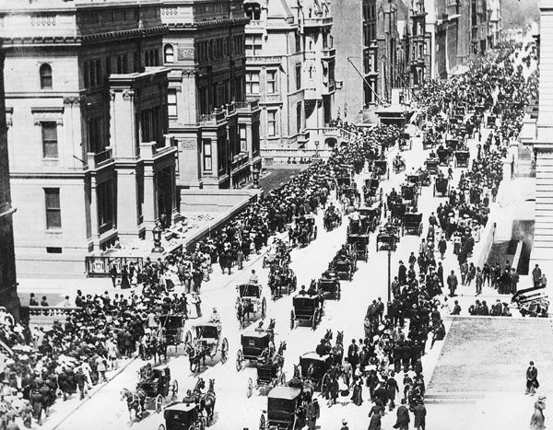

Slide 21
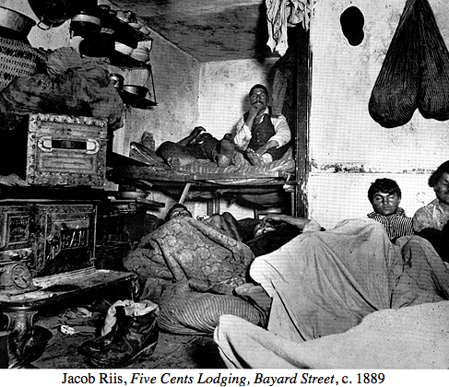
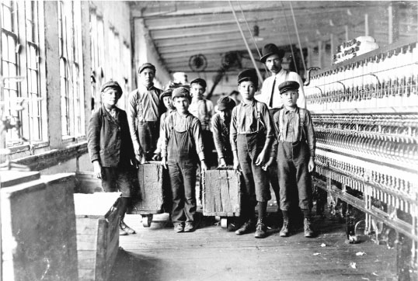

Slide 22
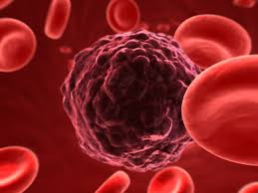
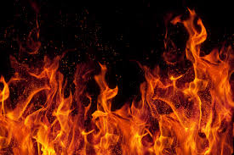
Changes in the Cities
Problems

Slide 23
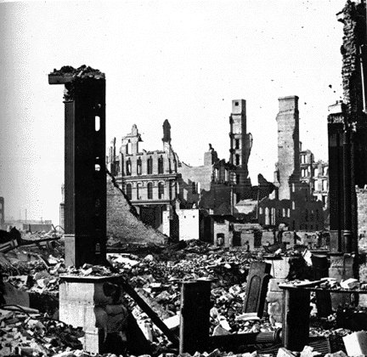

Slide 24
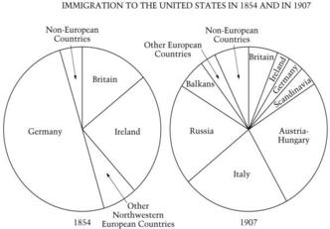
Changes in the Cities
Immigration

Slide 25
Area of Change | Before 1880 | After 1880 | Generalization
Transportation | Walking, Animals | Trolley, Elevated trains, and subways | Transportation becomes easier, people can live further away from their jobs- growth of suburbs
Industry | Businesses are smaller, many white males | Businesses are larger, buildings are taller, mainly women, children and immigrants that are working | Businesses are growing very quickly leading to more people moving to the cities and big industrialists getting more and more wealthy
Problems | Disease, death, and fire | Disease, death, and fire | More people in the cities made problems that already existed worse
Immigration | “Old” immigrants- mainly going to be from N and W Europe- fit in to American society | “New” immigrants- mainly from S, C, and E Europe- stand out for being very different | Lead to “nativism”- discrimination on immigrants and the belief that people born in America should have American resources first

Slide 26
Jacob Riis
Famous for: writing “How the Other Half Lives” which exposed the problems in the cities like:
Poverty
Unsanitary conditions
Child Labor

Slide 27
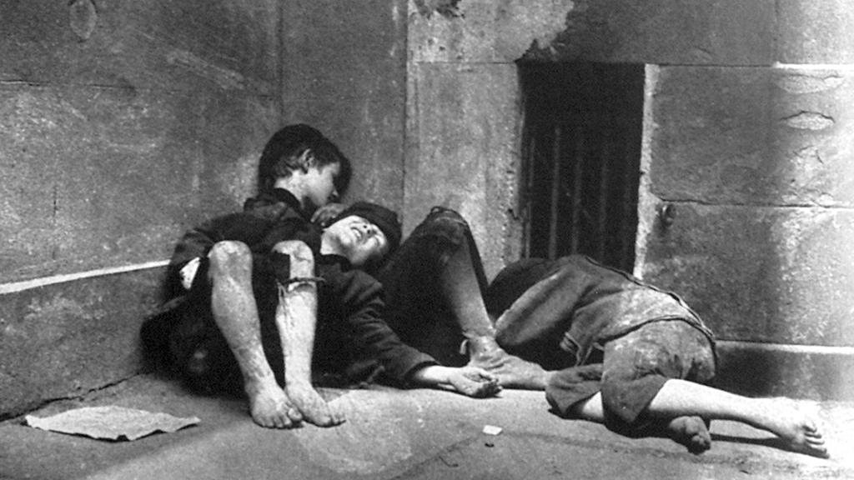

Slide 28
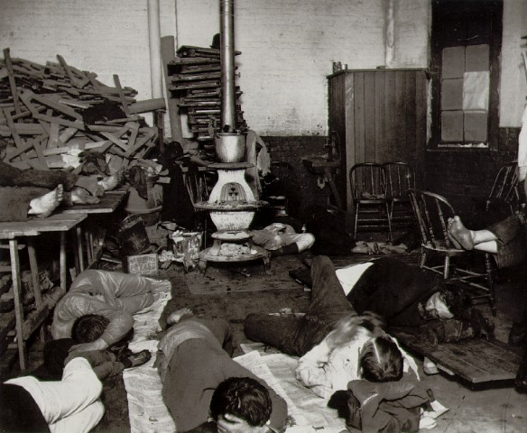

Slide 29
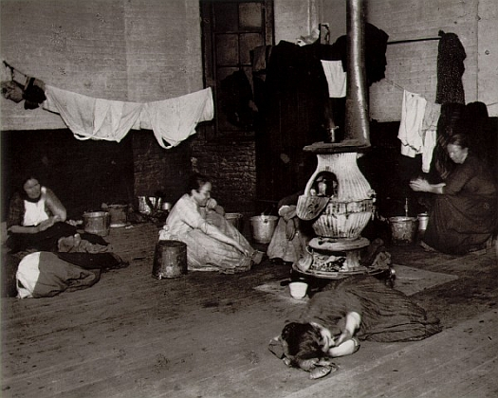

Slide 30
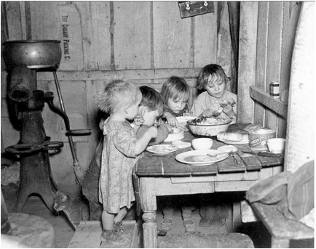

Slide 31
Effects of the growth of cities
The gap between the: rich and the poor widened
The business owners were making a lot of money off their rising companies, especially with better technology increasing productivity and a cheap labor force. Immigrants were keeping the pay scale down since they were willing to work cheaply.
Cities became: hard to govern
With so many people living in a small area, cities were hard to control. Also business leaders are gaining more control of the government given the fact that they are making so much money.
More money and responsibility is being given to: city leaders and officials
Many of these officials are appointed or picked by top business leaders.
All of this led to more corruption in the cities!!!!!!

Slide 32
Corruption: Spoils System
Background:
Started by Andrew Jackson
It is characterized by giving away government jobs to loyal, UNQUALIFIED, political friends
Breaking Point: President Garfield was assassinated when he didn’t give a job to a loyal follower
Solved with: Pendleton Civil Service Act which requires all government employees to pass a competency exam

Slide 33
Corruption: Railroads
Background: companies were accepting bribes and charging more for shorter trips than longer trips
Important court cases
Munn v. Illinois (1877): ruled that states could regulate railroads
Wabash v. Illinois (1886): overturned Munn; instead ruled that since railroads were part of interstate trade, only the national government could make laws about them (Gibbons v. Ogden)
***Problem is: national government ISN’T doing anything yet
Solved with: the Interstate Commerce Commission which is the government group eventually set up to regulate railroads

Slide 34
Corruption NOW: The Rise of Political Machines
Political Machine: an unofficial city organization meant to keep one political party in office. Usually headed by a “Boss”
Works off of: the exchange of favors (giving away jobs and/or money in exchange for votes)
Immigrants were easy prey for machines because they liked getting the jobs and money- they benefited!
There is no secret ballot at this time and so the voting was watched- you had to follow through!

Slide 35
Political Machines
One of the most notorious of all time: was Tammany Hall in New York City
Headed by William Marcy Tweed or “Boss” Tweed
Controlled: the New York Treasury which allowed him to report false expenses to the federal government (just like Credit Mobilier)- would say that government projects cost more to build than they truly did…and he would pocket the rest.
Gained between $50-300 MILLION!!!!
Thomas Nast: political cartoonist who exposed Boss Tweed leading to Tweed’s eventual arrest.

Slide 36
The Progressives!!!
Progressivism: movement to improve the way of life in America
Goal: end corruption and lessen problems in the cities
Came out of the earlier: the Populist movement
Notes:
Dangerous working conditions
• Child labor
• Long hours, low wages, no job
security, no benefits
• Company towns
• Employment of women
- tenements and slums

Slide 37
Areas of Social Reform
Child Labor: children as young as 5 working in factories- lead to lack of education and working accidents- work to end it
Women’s Suffrage: movement to get women the right to vote
Temperance: movement to get rid of alcohol in America- believe it root of all evil

Slide 38
Areas of Municipal Reform
Initiative: when citizens can create their own bills to be voted on to become laws
Referendum: a law that citizens vote on instead of legislature
Recall: when citizens can vote to remove corrupt elected official from office

